Slide 1
Book A
Fiona Forman
M. Sc. Applied Positive Psychology
Slide 1

Slide 2
Welcome to the Tools to Thrive programme.
Lesson 1: How to Thrive
Aim of the programme:
To provide you with healthy coping skills and strategies (tools) to help you to feel strong, confident and resilient in facing the challenges of life, so that you reach your potential and thrive.
With any new skill, it takes time and effort to see results and improvements.
Try each tool and see how it works for you. If you see benefits, keep doing it.
Slide 2

Slide 3
Lesson 1: How to Thrive
Format of the Programme:
8 Lessons
Reflective Journal - use it during/between lessons
Offers skills and strategies to help you to thrive - brain-based ‘Tools to Thrive’
An accompanying Pupil Digital Page with videos, online articles and other resources for each lesson is available at:
www.otb.ie/t2t-a-p
Slide 3

Slide 4
Lesson 1: How to Thrive
Lesson 1 Learning Outcomes
That you will:
Understand the meaning, concept and importance of thriving
Become aware of the ‘little things’ you can do to help yourself to thrive
Become familiar with 4 ‘Happy Hormones’ which help you to thrive
Become aware of factors that influence thriving which are either outside or within your control
Slide 5
Slide 4

Slide 5
Lesson 1: How to Thrive
It’s now more important than ever to learn how to thrive.
So many pressures and challenges (big and small) of modern life can have a negative impact on mental health and well-being.
Reflect on some of the pressures and challenges you feel and consider how they compare to the following list…
Slide 3
Slide 5

Slide 6
Lesson 1: How to Thrive
Inequality
Climate crisis
World conflict
Negative impacts of social media
Injustice
Intense pace of life
Relationship difficulties
Body image pressures
Pressure to fit in
Toxic online culture
Pressure to succeed
Lack of support
Slide 3
Slide 6

Slide 7
Lesson 1: How to Thrive
It’s no wonder that young people may often feel…
Worried
Stressed
Overwhelmed
Afraid
Angry
Hopeless
Anxious
Not good enough
Uncertain
If you feel overwhelmed by emotions like this, remember to reach out for support from trusted people around you. We always need support to help us to thrive. You can also check out the Pupil Digital Page (www.otb.ie/t2t-a-p) online for a list of organisations that offer additional support.
Slide 7

Slide 8
Lesson 1: How to Thrive
Without a set of healthy coping strategies/skills to use to deal with challenges, the use of unhealthy coping strategies might develop instead.
Reflect on some unhealthy coping strategies a young person might use to cope with these stressors and challenges and consider how they compare to the following list…
Slide 8

Slide 9
Lesson 1: How to Thrive
UNHELPFUL COPING STRATEGIES | CHARACTERISTICS
Avoiding challenges and problems instead of facing them
Slide 9

Slide 10
Lesson 1: How to Thrive
It’s vital to develop a set of helpful coping strategies and skills that you can use to help you thrive, despite challenges and stressors.
Slide 10

Slide 11
Lesson 1: How to Thrive
Reflect for a moment about
what it means to thrive…
In pairs/alone, take a moment to brainstorm any words or phrases related to the words ‘thrive’ or ‘thriving’.
We’ll then compare them with the words on the word art image on the next slide…
Slide 5
Slide 11

Slide 12
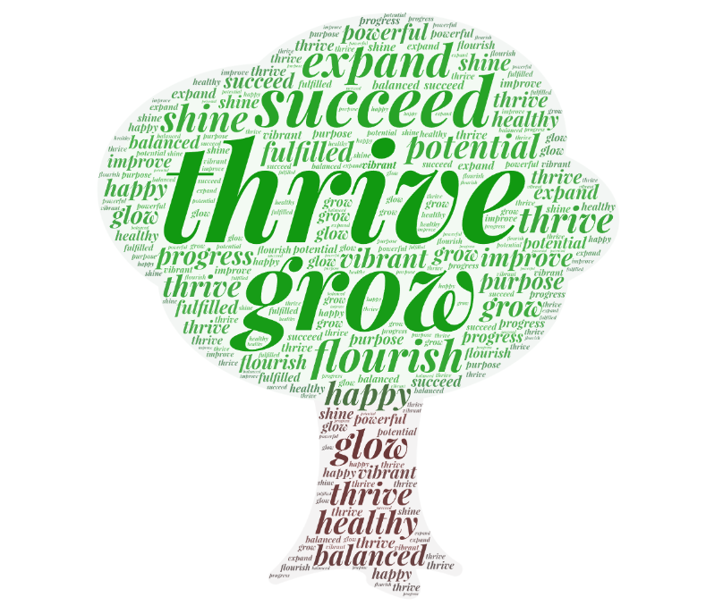
Slide 12

Slide 13
Lesson 1: How to Thrive
Reflect on this definition of what it means to thrive:
To thrive is to have good levels of well-being and to mostly feel confident, happy and good about yourself and your life.
When you are thriving, you are growing into the best version of yourself and reaching towards your potential.
You feel connected to others and you understand that you can have a positive impact on the people around you and the wider world too.
Continued next slide
Slide 13

Slide 14
Lesson 1: How to Thrive
You feel resilient and trust yourself to be able to cope with the challenges and difficulties of life.
You believe in yourself and know that you are good enough, just as you are.
Thriving doesn’t mean feeling happy and positive all the time. It means you understand that all emotions are important and you can deal with difficult emotions in helpful ways.
Slide 14

Slide 15
Lesson 1: How to Thrive
In order to thrive, you must first make sure that you know how to guide your brain and nervous system into thriving mode, which means feeling safe, calm and connected.
This is known as regulating the nervous system. From this calm state, you can then guide yourself to become energised and empowered whenever you need to.
Slide 15

Slide 16
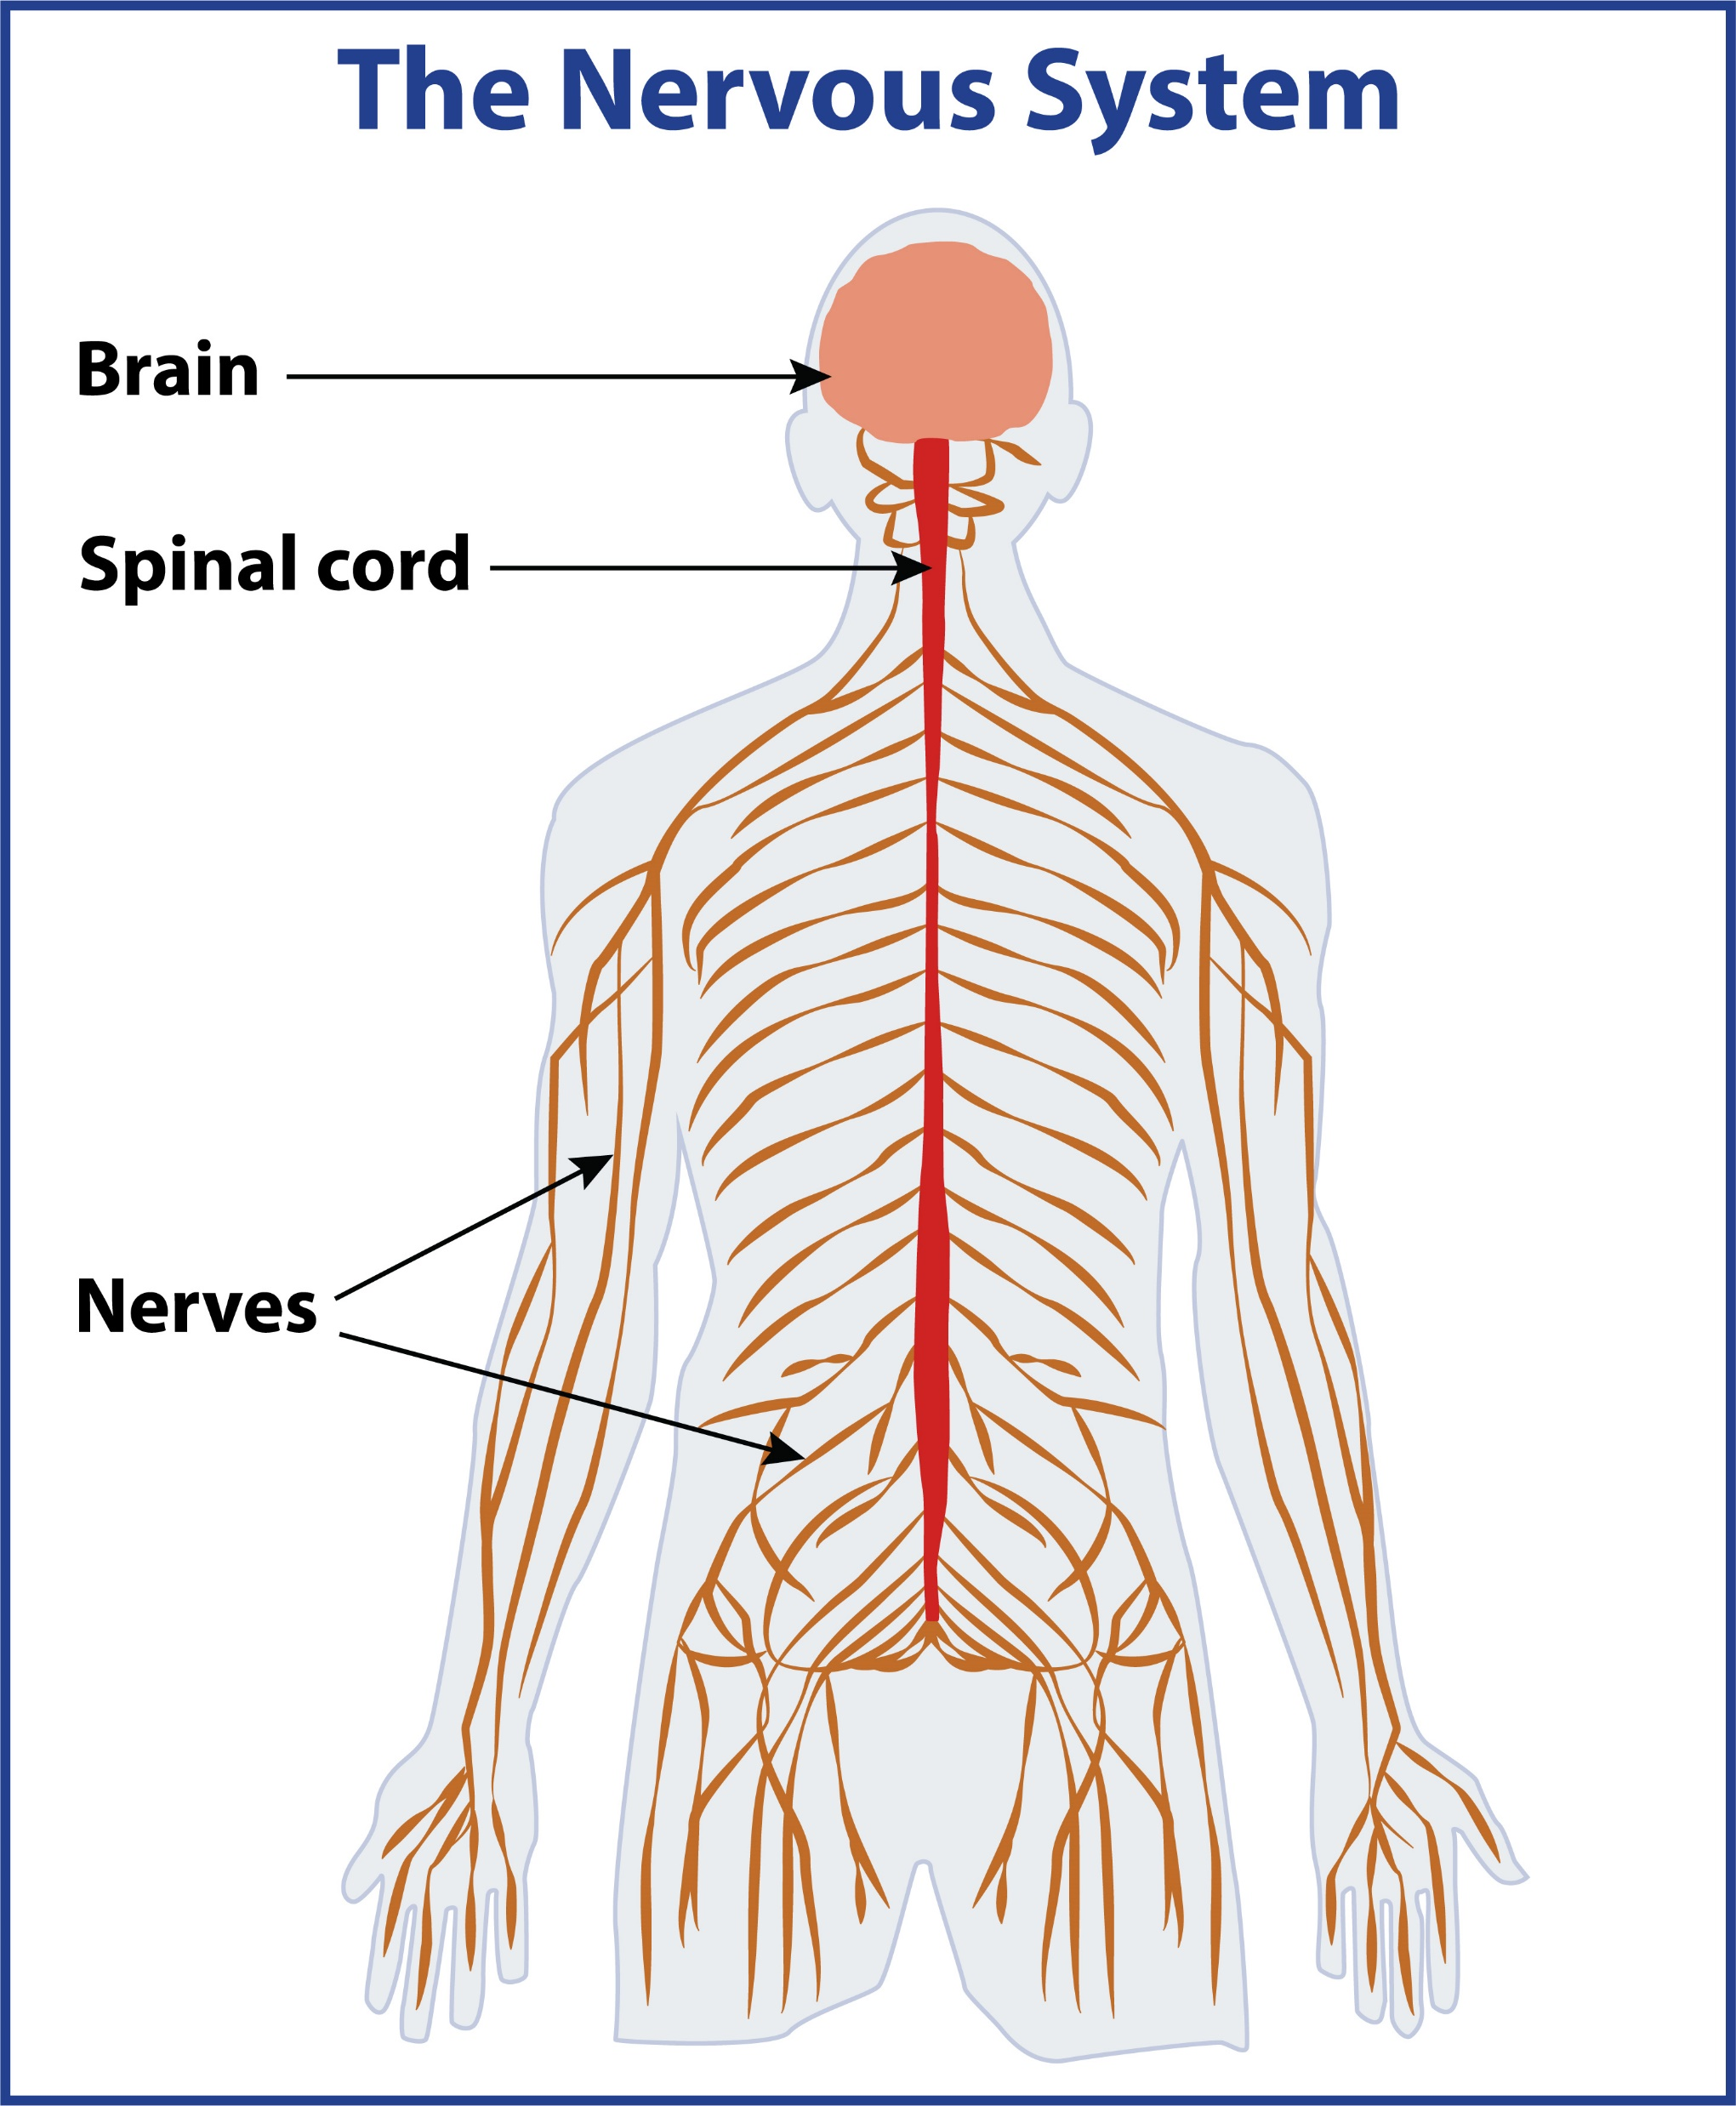
The Nervous System –
Lesson 1: How to Thrive
includes the brain, spinal cord and a network of nerves…
detects and responds to perceived threats in our environment to help us to survive…
For more information on The Nervous System, see p. 2 of your Reflective Journal
Slide 16

Slide 17
Lesson 1: How to Thrive
To thrive, we need to look after all dimensions (parts) of our well-being every day.
Can you name the 5 dimensions?
PHYSICAL
WELL-BEING
SPIRITUAL
WELL-BEING
MENTAL
WELL-BEING
SOCIAL
WELL-BEING
EMOTIONAL
WELL-BEING
They are all interconnected…
Slide 17

Slide 18
Lesson 1: How to Thrive
Keeping your body strong and healthy through physical activity, rest, sleep and healthy eating
Keeping your mind healthy, through becoming aware of your thoughts and learning how they affect your feelings and behaviour
Understanding and dealing with your emotions in helpful, rather than unhelpful ways
Slide 5
Slide 18

Slide 19
Lesson 1: How to Thrive
Creating positive relationships with other people through giving and receiving support, friendship, love and care
Having meaning in your life and a connection to a greater purpose than yourself (not necessarily religious)
Slide 5
Slide 19

Slide 20
Lesson 1: How to Thrive
Watch…
There are lots of ‘little things’ that we can do every day to recharge our batteries and help ourselves to thrive.
Watch this video by author and podcaster Jay Shetty for some ideas – even though it is not specifically aimed at students, it still contains some useful tips.
Slide 20
Notes:
www.otb.ie/t2t-tiredness

Slide 21
Lesson 1: How to Thrive
Video Follow-Up Discussion:
Option for group-work/pair work:
Create a list of 3 celebrities/historical figures that you admire for how they look/looked after their well-being and mental health.
Discuss the reasons why you chose them.
Slide 21

Slide 22
Lesson 1: How to Thrive
Reflection 1:
My Little Things…
Reflect on all the little things you do that give your well-being a boost and help you to thrive.
Make a list of some of them now in your Reflective Journal.
Try to include all the dimensions of well-being. There are some ideas on the next slide.
Remember to do some of them every day to boost your mood and help you to feel good about yourself and your life.
Slide 22

Slide 23
Lesson 1: How to Thrive
Talking to family/friends
Reflection 1
Little Things...
Spending time in nature
Chilling/relaxing
Getting enough sleep
Meditating
Spending time on hobbies/interests
Spending time with friends
Exercising
Listening
to music
Being creative
Helping and supporting others
Working towards a goal
Reaching out for support when I need it
Slide 23

Slide 24
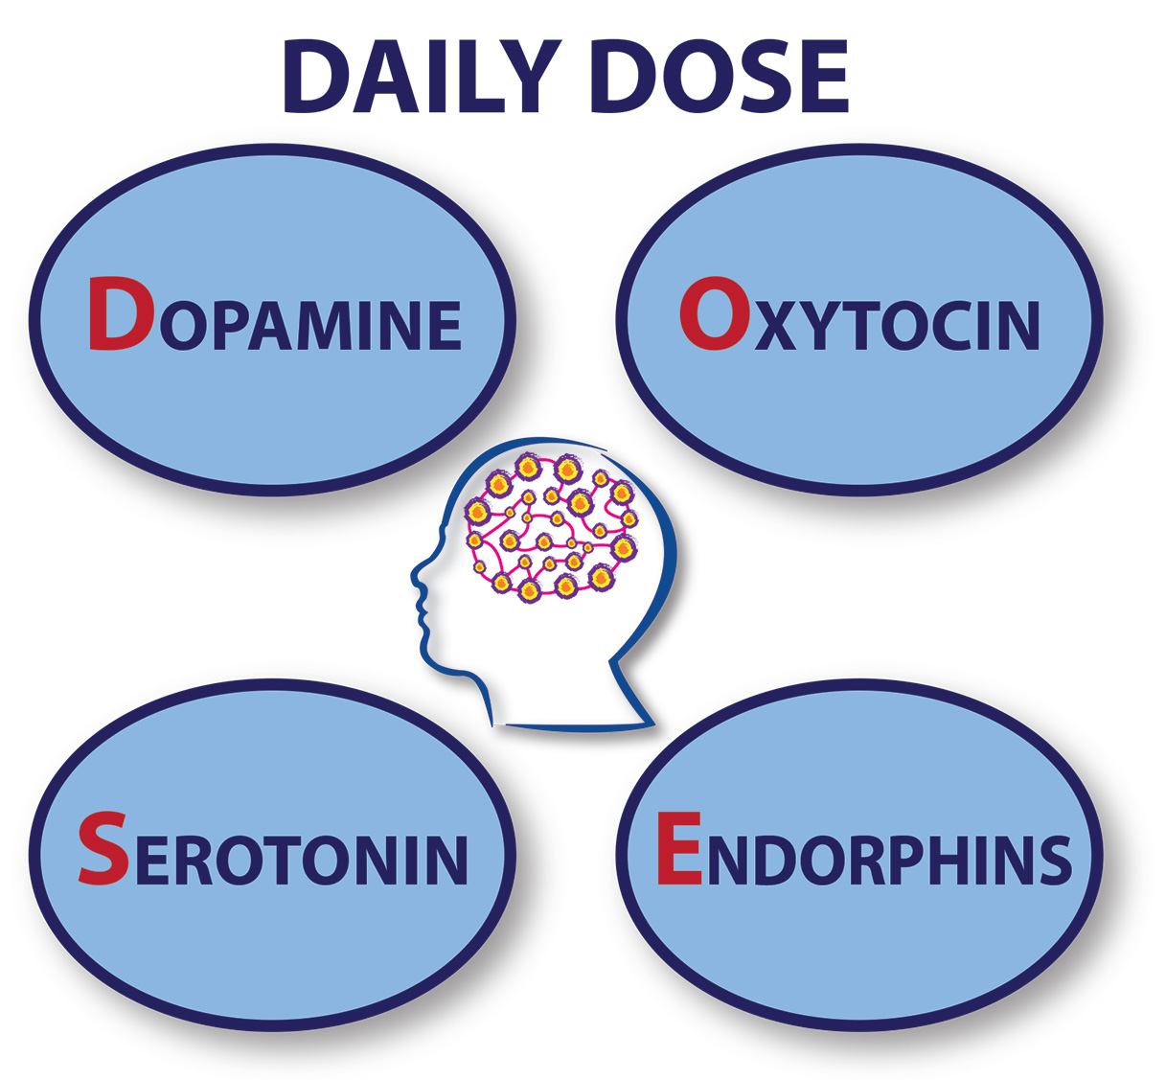
Lesson 1: How to Thrive
Aim to do 3 of your ‘little things’ every day to give you a daily DOSE of the feel-good chemicals –
Dopamine, Oxytocin, Serotonin and Endorphins.
‘Happy Hormones’
Let’s look at their effects…
Slide 24

Slide 25
Lesson 1: How to Thrive
Dopamine
Oxytocin
Serotonin
Endorphins
Slide 25

Slide 26
Lesson 1: How to Thrive
Many factors affect our ability to thrive.
Some are outside of your circle of control and some are within your circle of control.
What factors are outside of your circle of control?
Slide 26

Slide 27
Family background
World events
Challenges of life
Other people’s behaviour
Other people’s opinions
Slide 27

Slide 28
Lesson 1: How to Thrive
Let’s look at the types of factors that are within our circle of control.
What do you think they might be?
Slide 28

Slide 29
My actions
How I respond to challenges
My effort
How I treat others
How I treat myself
How I use my coping skills
My mindset and attitude
Slide 29

Slide 30
Lesson 1: How to Thrive
To thrive, it makes sense to focus your energy on the factors within your circle of control and use your tools as much as possible.
This can give you a
feeling of power
feeling of being energised
feeling of confidence
feeling of choice
Slide 30

Slide 31
Lesson 1: How to Thrive
Reflection 2:
Thriving Self-Assessment:
How often do you use tools to look after each dimension of
your well-being?
Complete the assessment to increase your self-awareness.
Slide 31

Slide 32
Lesson 1: How to Thrive
Closing Quote
Have a look at the Now What? page of your Reflective Journal and consider what immediate action you could take to implement any ideas from this lesson into your
day-to-day life.
Happiness is not something ready made.
It comes from your own actions.
- Dalai Lama
Check out the T2T Digital Page for online articles, videos and websites on the topics covered in this lesson.
www.otb.ie/t2t-a-p
Slide 32

