Slide 1
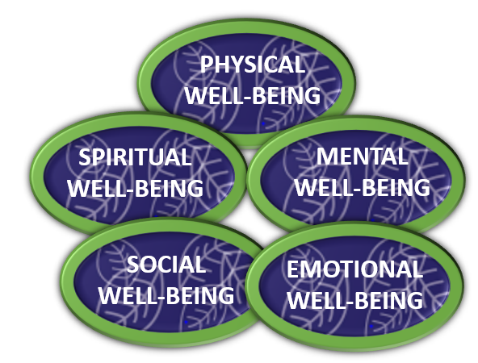
Lesson 2: Tool 1: Manage Your Mood
Recap:
Did you use the Nervous System Check-in?
Did you use any of the calming techniques from Lesson 1?
What effect did this have on your daily mood?
Let’s learn about our first new tool now:
Manage Your Mood.
It helps to support all areas of well-being.
Slide 32

Slide 2
Lesson 2: Tool 1: Manage Your Mood
Lesson 2: Learning Outcomes
That you will:
Understand what a mood is.
Become aware of the factors which influence positive and negative moods.
Become aware of why it is important to learn to manage your mood.
Learn ways to boost your mood based on the release of ‘happy hormones’.
Learn ways to manage a negative or low mood.
Slide 33

Slide 3
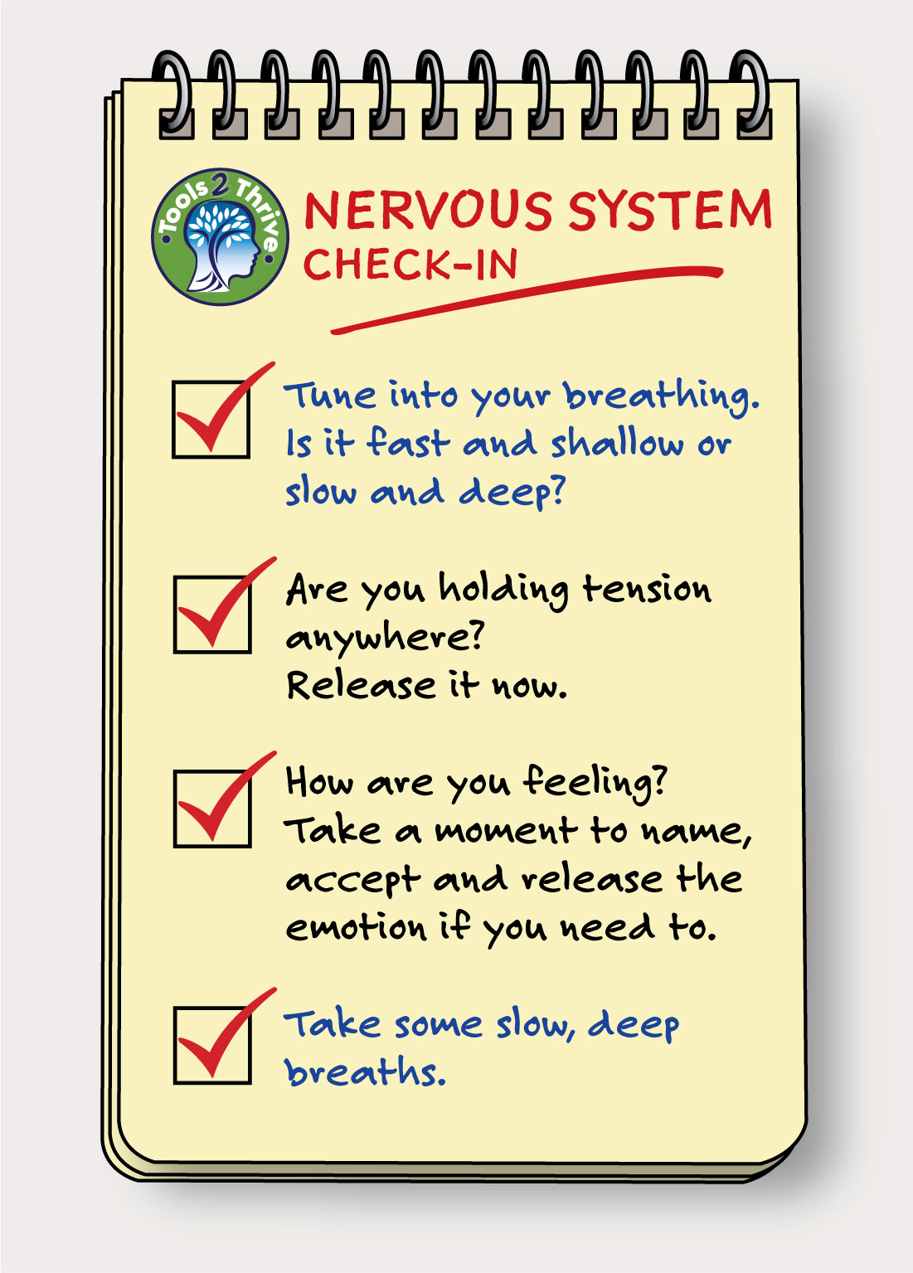
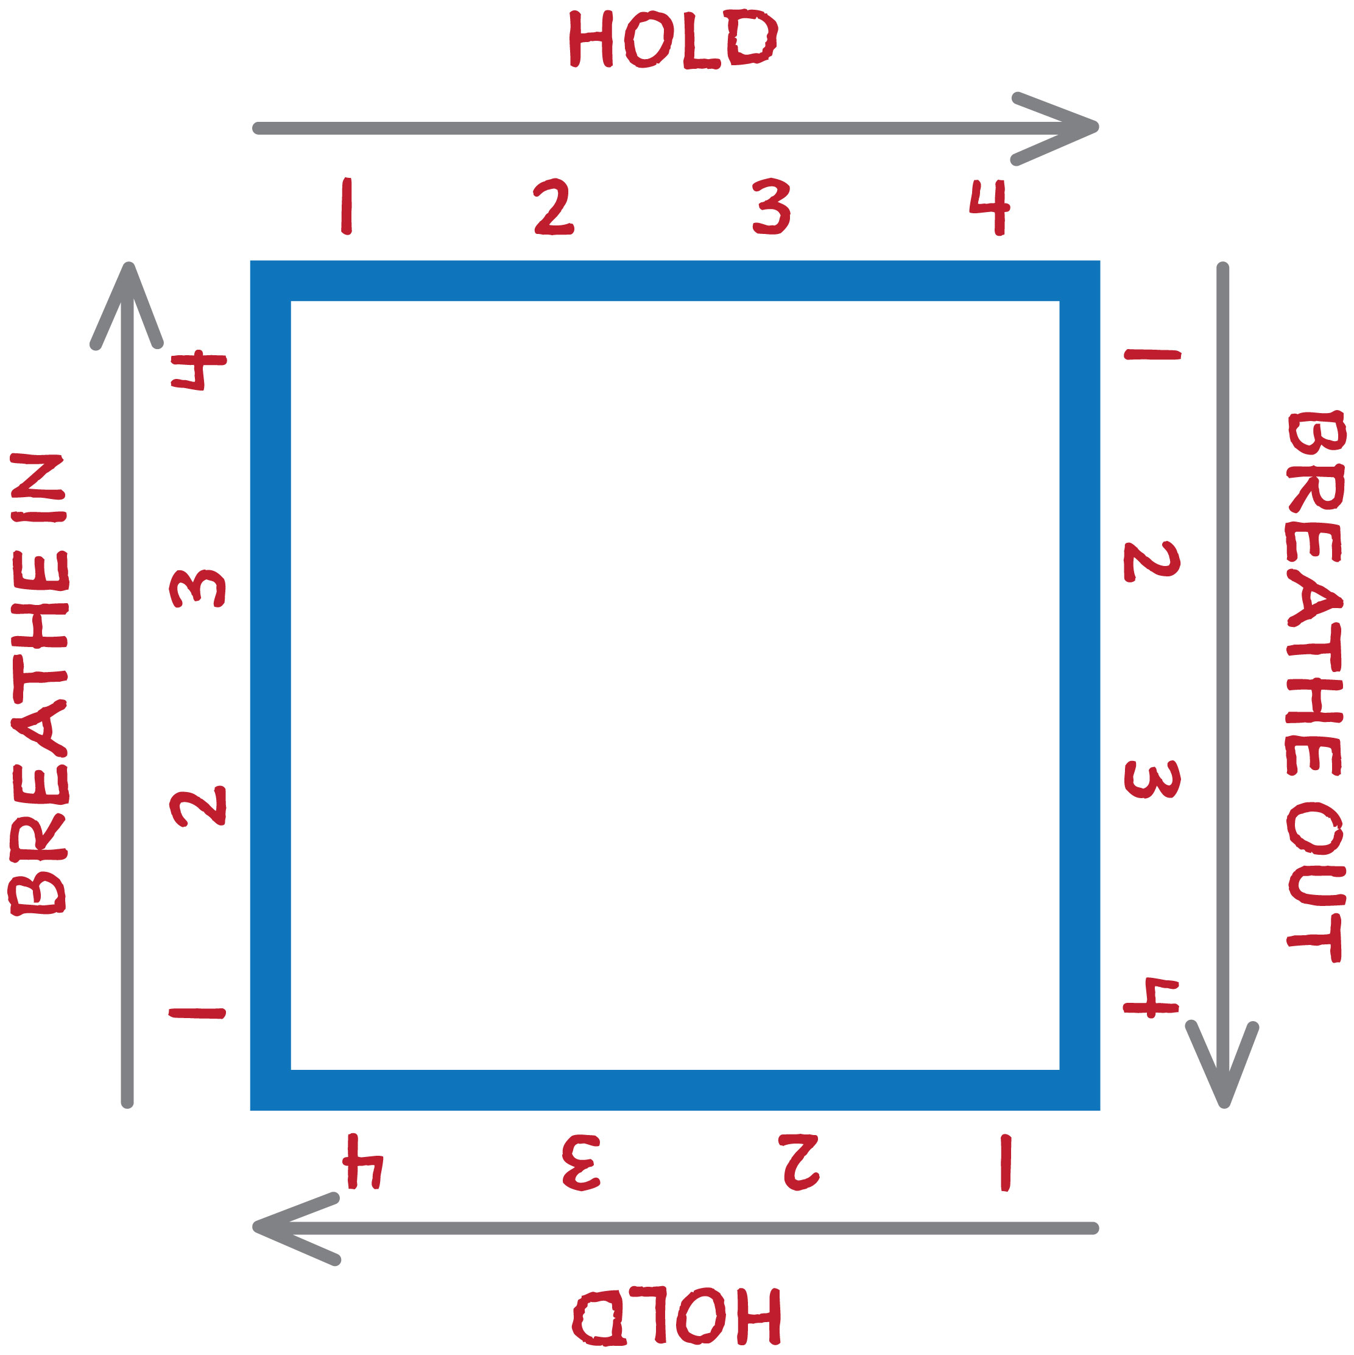
Lesson 2: Tool 1: Manage Your Mood
Before we start, take a moment to do a Nervous System Check-in.
Then, try one minute of Box Breathing and some tension release exercises.
Slide 34

Slide 4
Lesson 2: Tool 1: Manage Your Mood
What is your understanding of moods?
Think of a time when you were recently in a good, positive mood.
What caused it?
How did you feel?
Slide 35

Slide 5
Lesson 2: Tool 1: Manage Your Mood
FACTFILE – Moods:
How we generally feel over certain periods of time.
Can be classified as positive or negative.
Are influenced by many factors, some inside and some outside of our control.
Affect our behaviour and interactions with others.
Affect our experience of life.
Can be boosted in small ways.
Slide 36

Slide 6
Lesson 2: Tool 1: Manage Your Mood
FACTFILE – Moods:
Need to be managed, so that negative moods do not predominate.
If your nervous system is in survival mode a lot of the time, negative moods may be more frequent and more intense. The challenges of 6th year might cause this.
Using the calming techniques from Lesson 1 can help to balance your mood.
Slide 37

Slide 7
Lesson 2: Tool 1: Manage Your Mood
A low or negative mood is like a lens or a filter that you see the world through, so everything appears more negative.
Think for a moment of a time when a low mood affected your view of the world…
How did it impact on your actions and behaviours?
Slide 38

Slide 8
Lesson 2: Tool 1: Manage Your Mood
Watch…
Slide 39
Notes:
www.otb.ie/t2t-negative-self-talk

Slide 9
Lesson 2: Tool 1: Manage Your Mood
Video Follow Up Discussion:
Option for group-work/pair work:
What 5 tips would you give to a friend
who is struggling with a low mood?
Slide 40
Notes:
www.otb.ie/t2t-life-advice

Slide 10
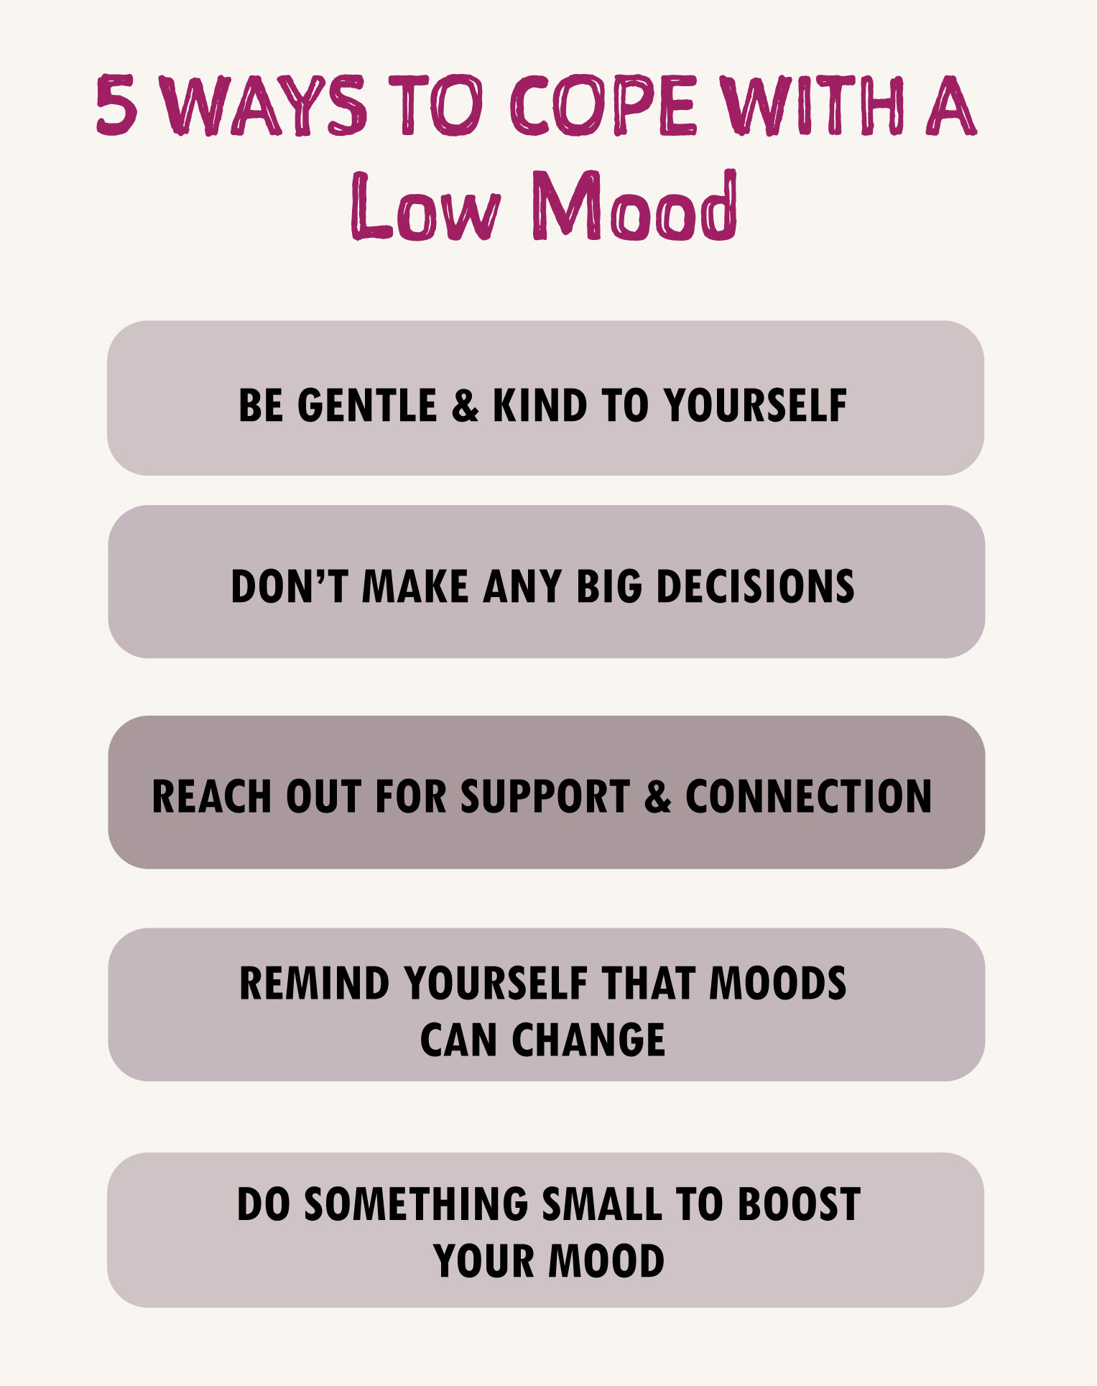
Lesson 2: Tool 1: Manage your Mood
How do your ideas compare to these?
Slide 41
Notes:
www.otb.ie/t2t-life-advice

Slide 11
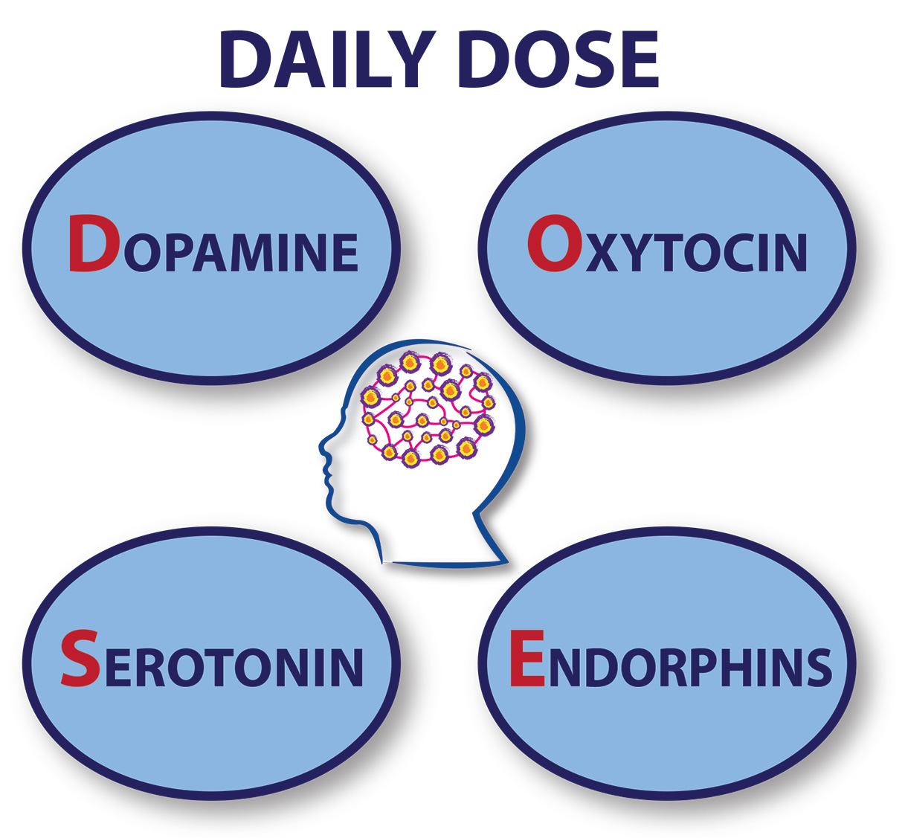
Lesson 2: Tool 1: Manage Your Mood
Many small things can release those ‘happy hormones’ that can boost your mood…
Let’s look at examples of Mood Boosters that help you to get your daily DOSE of happy hormones.
For a reminder and more details of the Happy Hormones, check the back of your Reflective Journal.
Slide 42

Slide 12
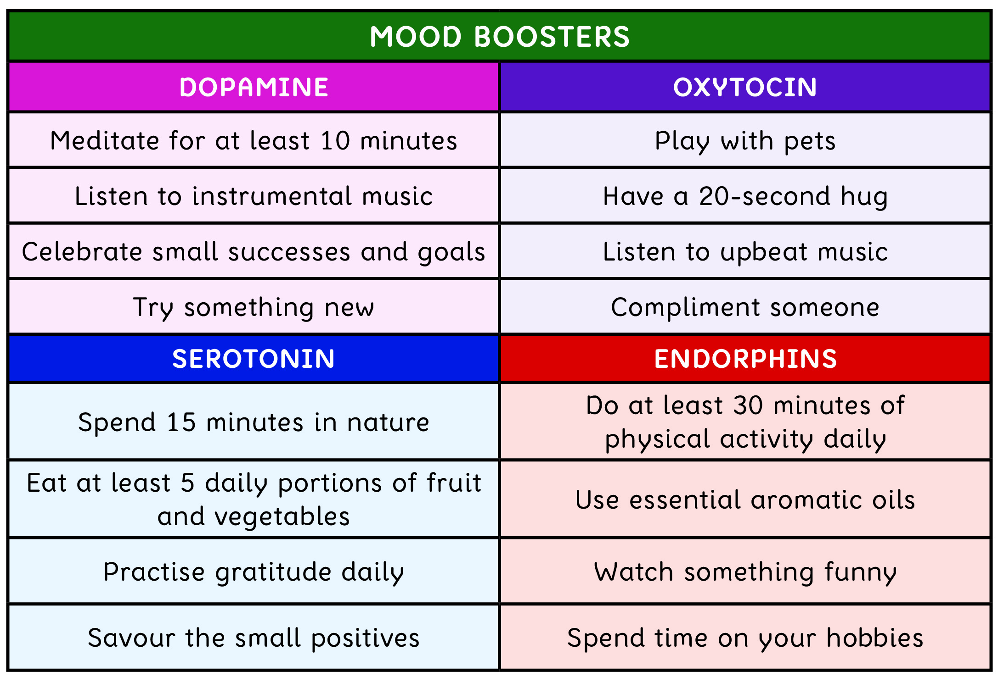
Lesson 2: Tool 1: Manage Your Mood
The following Mood Boosters can help you to get your daily DOSE of happy hormones…
Slide 43

Slide 13
Lesson 2: Tool 1: Manage Your Mood
Reflection 1:
Which of the mood boosters might work for you on a personal level?
What other activities help to boost your mood?
Check out the Pupil Digital Companion Page for an online article on ‘Good Mood Foods’ - otb.ie/t2t-b-p
Slide 44

Slide 14
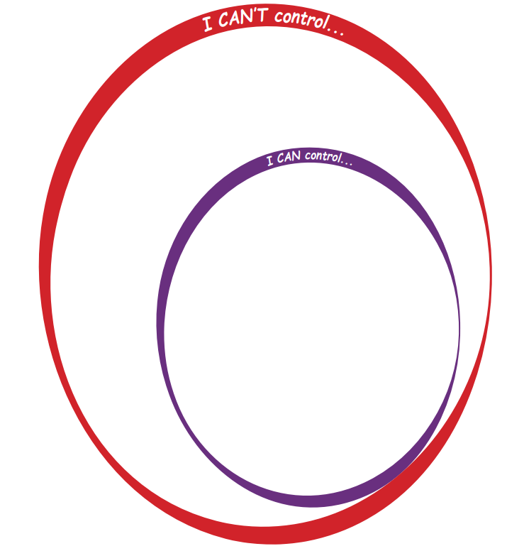
Lesson 2: Tool 1: Manage Your Mood
Many factors affect our mood, some of which are within our control and some of which are outside of our control.
What factors are outside of our control?
Slide 45

Slide 15
Lesson 2: Tool 1: Manage Your Mood
Hormones
How others treat you
External pressures
World events
Other people
Life events
Slide 46

Slide 16
Lesson 2: Tool 1: Manage Your Mood
Life events
Many events in life happen that involve change, loss or heartache.
Can you name any examples?
How can you look after yourself and others during these times?
The 5 ways previously mentioned can help during these difficult life events too.
Slide 47

Slide 17
Lesson 2: Tool 1: Manage Your Mood
What factors are within our control?
Slide 48

Slide 18
Lesson 2: Tool 1: Manage Your Mood
Physical
activity
Unhealthy comparisons
Healthy foods
Amount of sleep
Positive social interactions
Level of hydration
Negative thinking
Amount of screentime
Fresh air and sunlight
Slide 49

Slide 19
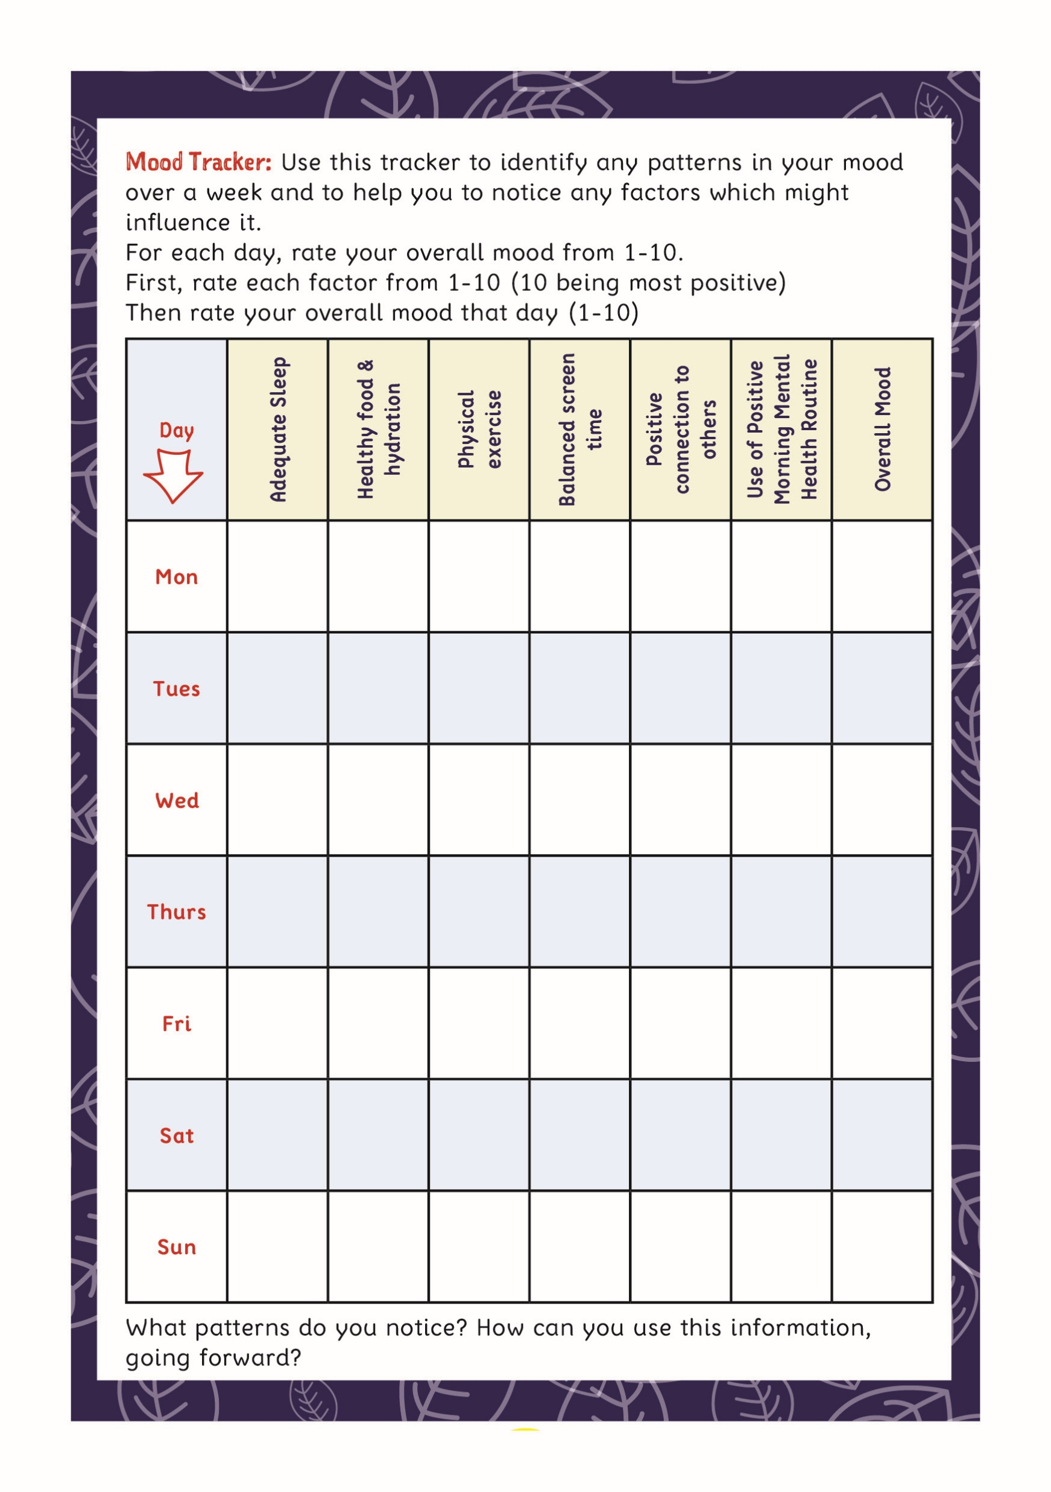
Lesson 2: Tool 1: Manage Your Mood
A Mood Tracker can help you to notice patterns in your mood over time and the factors that may be influencing your positive or negative moods.
Once you notice the patterns, you can then take the necessary steps to manage your mood, by dealing with any factors that are within your control.
Try the Mood Tracker at the back of your Reflective Journal as a starting point.
Slide 50

Slide 20
Lesson 2: Tool 1: Manage Your Mood
Reflection 2:
Consider a recent example of when you were in a low or negative mood for a certain time period.
What factors may have influenced it?
For example: insufficient sleep, too much screentime, feeling overwhelmed, unhealthy diet, lack of exercise, lack of fresh air, relationship problems, unhealthy comparisons with others, feeling unsupported, negative thinking, change or loss.
Slide 51

Slide 21
Lesson 2: Tool 1: Manage Your Mood
Closing Quote:
Have a look at the Now What? page of your Reflective Journal and consider what immediate action you could take to implement any
ideas from this lesson into your daily life.
We have found that decreasing negativity
without increasing positivity is a losing battle.
- Dr. Dan Tomasulo
Check out the Pupil Digital Companion Page for online articles, videos and websites on the topics covered in this lesson.
www.otb.ie/t2t-b-p
Slide 52
Notes:
www.otb.ie/t2t-life-advice

