Slide 1
Empowering Beliefs
Slide 82
Lesson 8
Belief 7:
I Can Make a Difference

Slide 2
How can we Make a Difference?
Slide 83
What do you think ‘making a difference’ means?
Making a difference means doing things which help or improve the lives of others.
Can you name any ways in which you make a difference in anyone else’s life?
All of our small actions everyday can add up to make the world a better place!

Slide 3
Big and Small Ways…
Slide 84
“A series of small steps can often be greater than one enormous leap”
What do you think this statement means?
It means that we can begin to make a difference straight away, in lots of small ways.

Slide 4
Small Ways to Make a Difference
Slide 85
Can you name some small ways you can make a difference and improve other people’s lives everyday?
You could:
Show kindness
listen
Help others
give encouragement….

Slide 5
How Does it Feel?
Slide 86
Can you think of a time when you did something small for someone which made a big difference to them?
Think about how that made you feel.
Maybe it made you feel:
Proud of yourself, helpful, kind, strong, important…

Slide 6
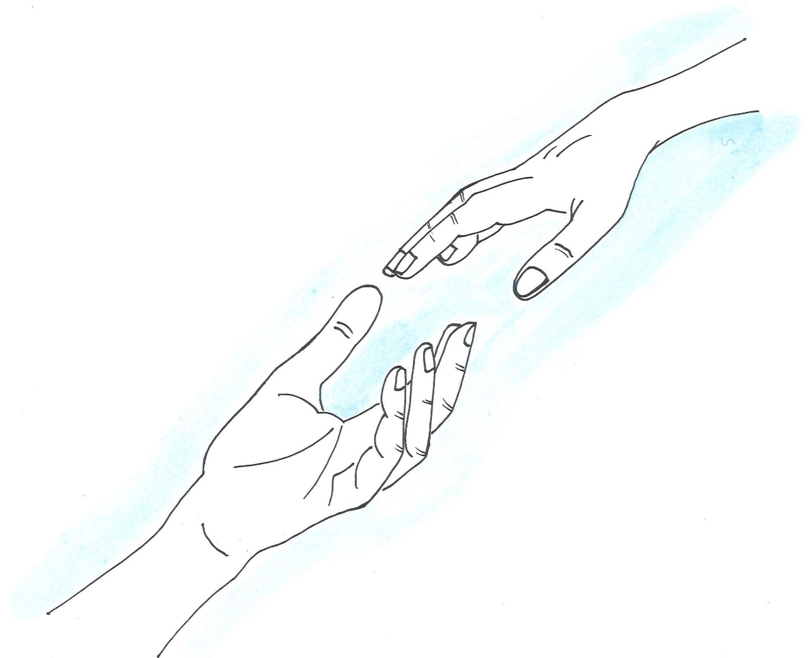
Reaching Out to Make a Difference
Slide 87
We can reach out beyond our immediate circle of friends and family to make a difference too.
Can you think of how we can do this?

Slide 7
What can we do?
Slide 88
We can reach out in lots of ways to make the world a better place.
We can:
Recycle our clothes and toys.
Give to our favourite charities.
Fundraise for causes which we feel are important.
We get more out of giving than we get out of getting

Slide 8
I Can Make a Difference
Slide 89
Now it is time for you to try out this belief for a week.
Think about all the things you can do everyday, big or small, to make the world a better place.
Try to do many of these things everyday and see how you make a difference!

Slide 9
Have a look
Slide 90
This animation shows examples of how children around the world are making a difference and helping to achieve the Global Goals. (4:53)
Notes:
www.otb.ie/wwb-worlds-largest-lesson

Slide 10
Pupil Book Time
Slide 91
Now it’s time to do some activities in our Weaving Well-Being Pupil Books.
We will also have a homework challenge to try this week to help us to create our own well-being.

