Slide 1
By
Fiona Forman
Slide 1

Slide 2
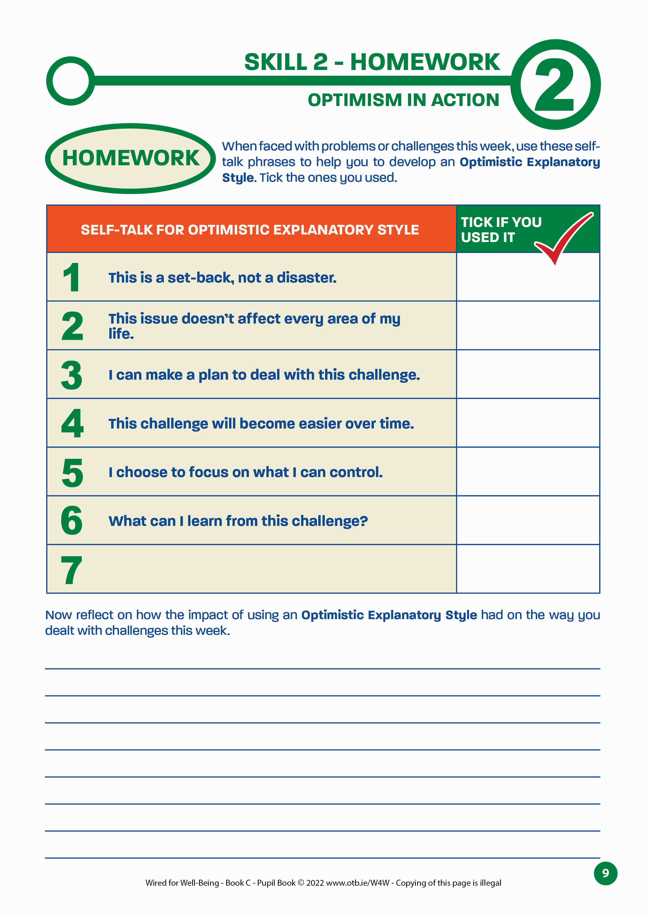
SKILL 3: GET GOOD AT STRESS
Recap:
Did you use the questions to help you develop an Optimistic Explanatory Style this week?
Do you remember the benefits of optimism?
Now it’s time for Skill 3: Get Good at Stress.
Slide 46

Slide 3
SKILL 3: GET GOOD AT STRESS
Learning Outcomes
That you will:
Understand why the way in which we view stress is vital
Understand ways to use self-talk to reframe the stress response as helpful rather than harmful
Know and understand the neurotransmitters released during the stress response and how our thoughts affect this process
Become aware of personal coping strategies that help you to deal with stress
Well-being Indicators:
Slide 47

Slide 4
SKILL 3: GET GOOD AT STRESS
Skill 3: Warm-up Activity
In pairs, take turns to complete these sentences:
I think stress is …
I get stressed when…
The last time I felt stressed was…
Slide 48

Slide 5
SKILL 3: GET GOOD AT STRESS
Now let’s find out how to get good at stress.
Getting good at stress means not just learning to cope with it, but using it in a positive way.
Why do you think this is important for us to get good at stress?
It’s because stress is part of life and when we learn to get good at it, we can actually use it to improve our lives, become more resilient and grow towards our potential.
Slide 49

Slide 6
SKILL 3: GET GOOD AT STRESS
What do you think happens in the body when you feel stressed?
The body releases a number of neurotransmitters including:
Adrenaline – this gets the body ready to deal with the threat by increasing the heart rate to give us more energy
Cortisol – this releases stored glucose in the liver, to give us more energy
These neurotransmitters create the stress response.
How does the stress response feel in your body?
Slide 50

Slide 7
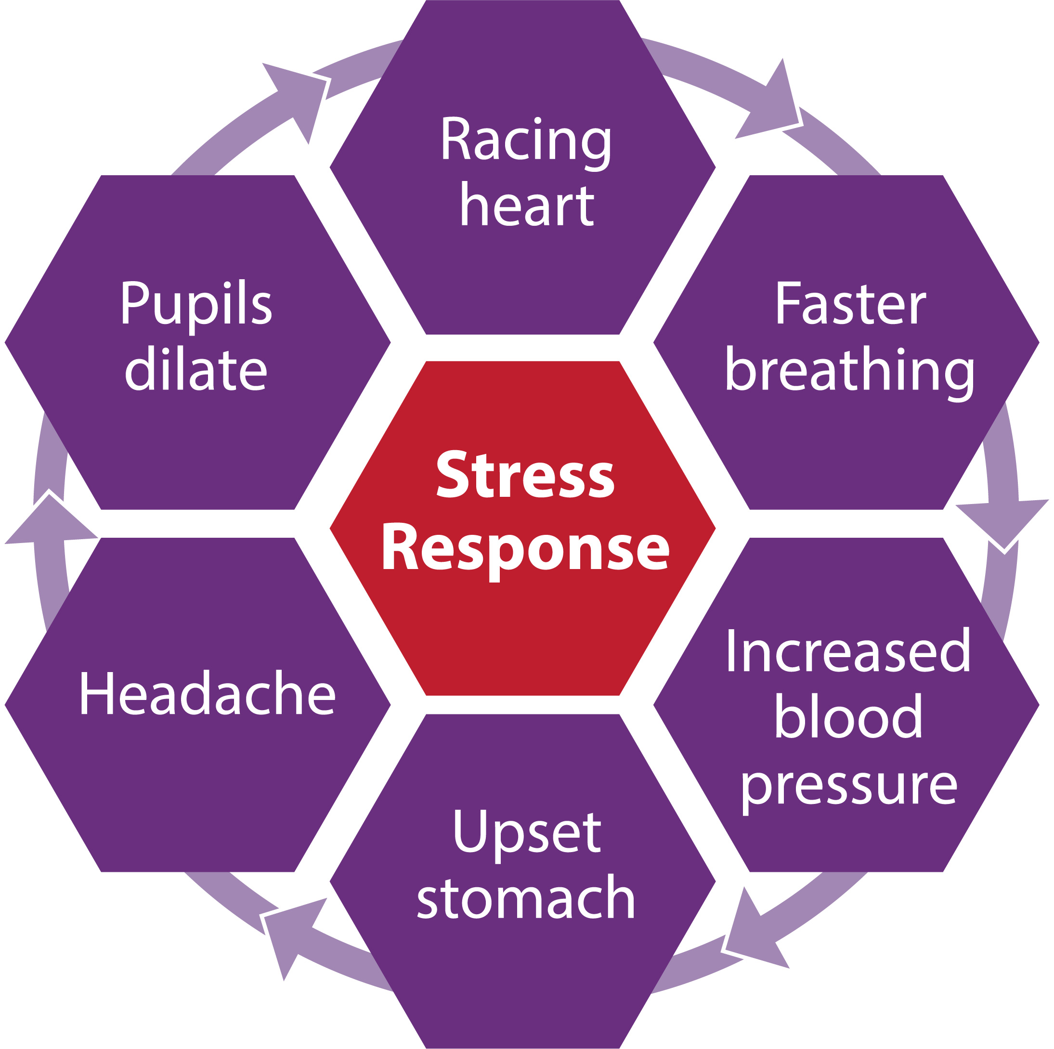
SKILL 3: GET GOOD AT STRESS
When did you last feel stressed like this?
How do these signs of stress in your body make you feel?
Slide 51

Slide 8
SKILL 3: GET GOOD AT STRESS
What are your thoughts on the following quote by stress expert Professor Kelly McGonigal?
When you change your mind about stress, you can change your body’s response to stress.
- Professor Kelly McGonigal
Slide 52

Slide 9
SKILL 3: GET GOOD AT STRESS
How we view the stress response is vital.
When we choose to view the stress response as helpful rather than harmful and change our self-talk about it, we can actually change the stress response of the brain and the body.
Levels of cortisol and adrenaline decrease and more oxytocin is released.
You might remember that oxytocin gives us feelings of connection to others and it also makes us feel brave.
Slide 53

Slide 10
SKILL 3: GET GOOD AT STRESS
When you next feel the stress response, you need to remind yourself that there is nothing wrong – your body is trying to help you.
This will help your body to feel calmer and it will calm the symptoms, so you will feel more in control and able to cope.
Slide 54

Slide 11
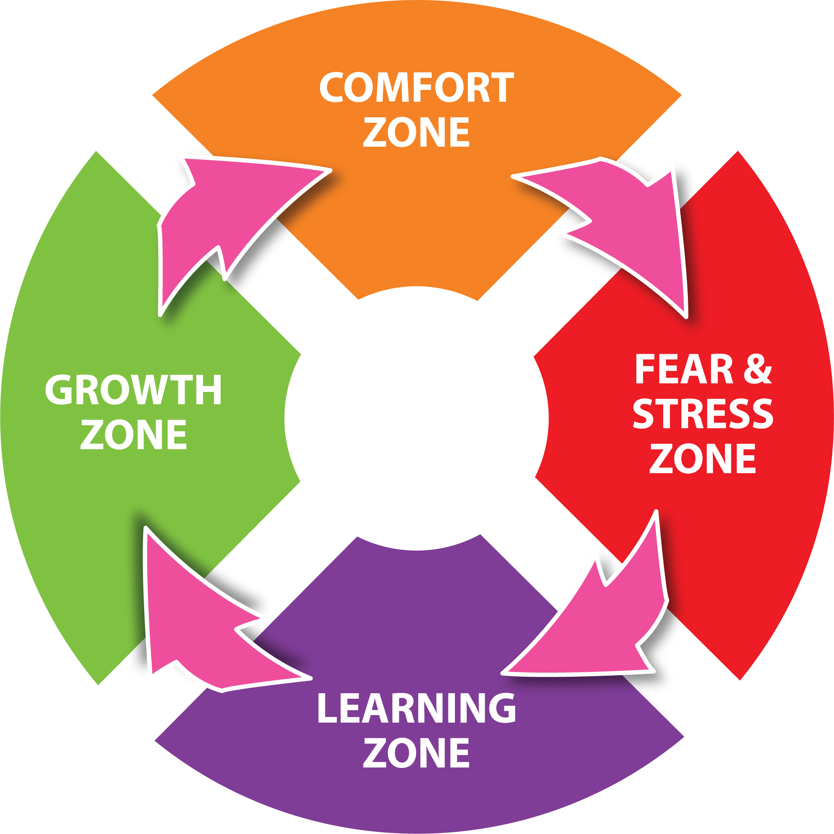
SKILL 3: GET GOOD AT STRESS
You can also remind yourself that feeling stressed is often a sign that you are getting ready to leave your Comfort Zone to do something brave and challenging.
So, what can you say to yourself?
Slide 55

Slide 12
SKILL 3: GET GOOD AT STRESS
I don’t need to panic. My body is getting ready for a challenge.
I can cope with feeling uncomfortable.
My heart is beating faster to help me by giving me more energy.
Slide 56

Slide 13
SKILL 3: GET GOOD AT STRESS
I can trust my body, this response is perfectly normal.
I feel stressed because I care about this.
I feel stressed because I’m getting out of my comfort zone.
Slide 57

Slide 14
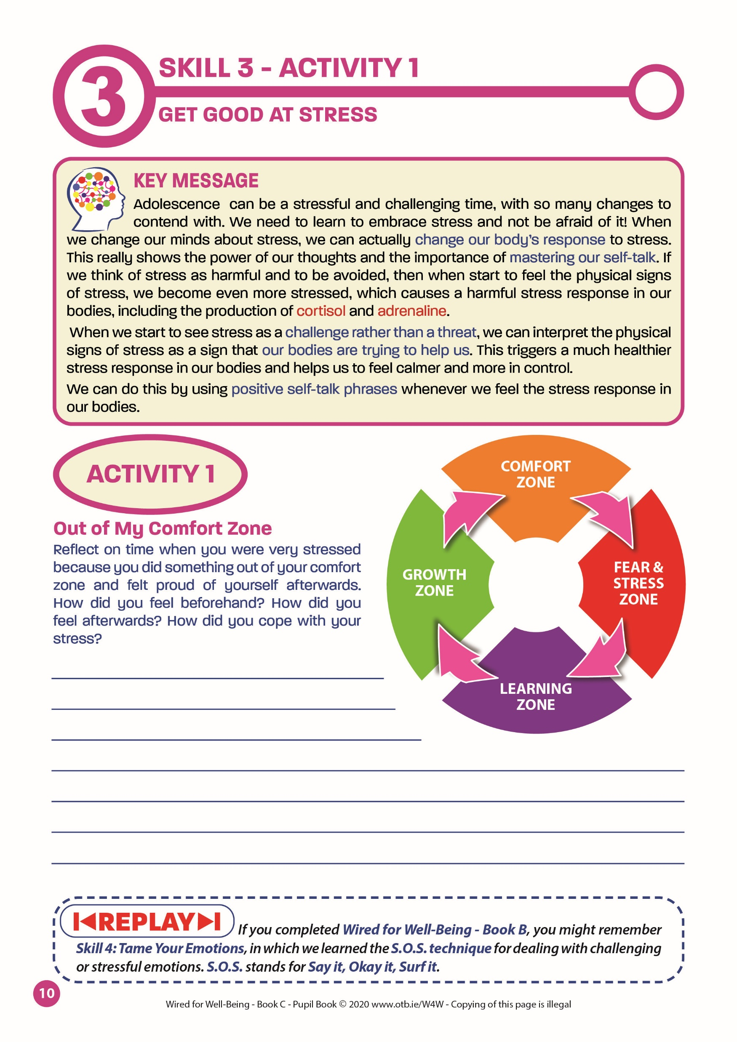
SKILL 3: GET GOOD AT STRESS
Pupil Book – Page 10 – Activity 1
In pairs, reflect on a time when you were stressed about leaving your comfort zone, but were glad that you did afterwards. Write a paragraph about it.
Slide 58

Slide 15
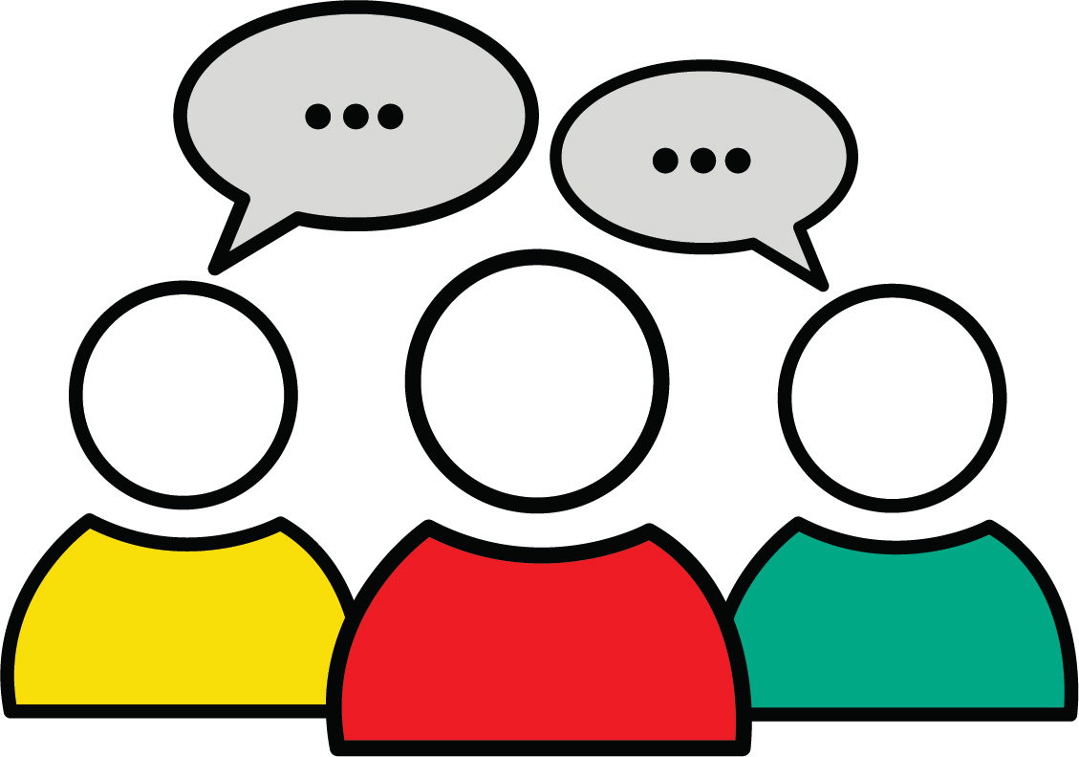
SKILL 3: GET GOOD AT STRESS
Feedback:
Out of My Comfort Zone
Slide 59

Slide 16
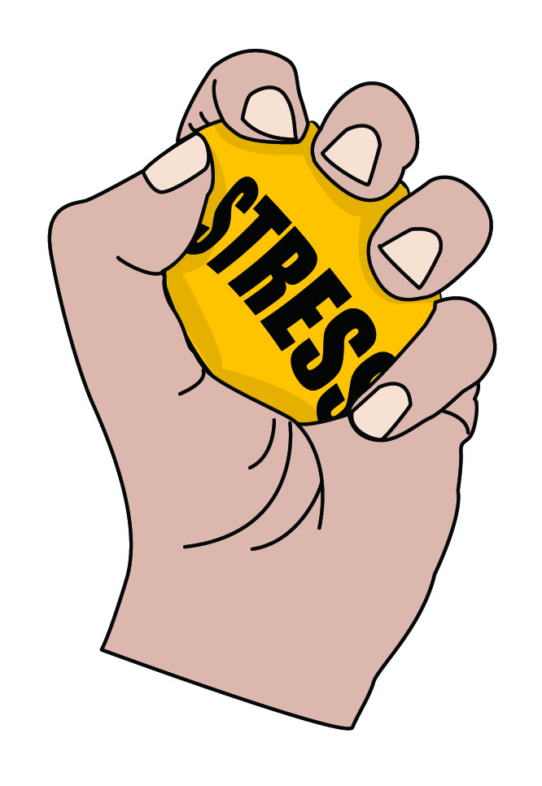
SKILL 3: GET GOOD AT STRESS
Finally, it’s good to know that there are lots of other things we can do to get good at stress, so that we are not afraid of it or use too much of our energy trying to avoid it.
You are probably aware of many of them.
Reflect now on what helps you to feel strong and equipped to deal with stress.
Let’s look at some well-known ones now and consider whether they could work for you.
Slide 60

Slide 17
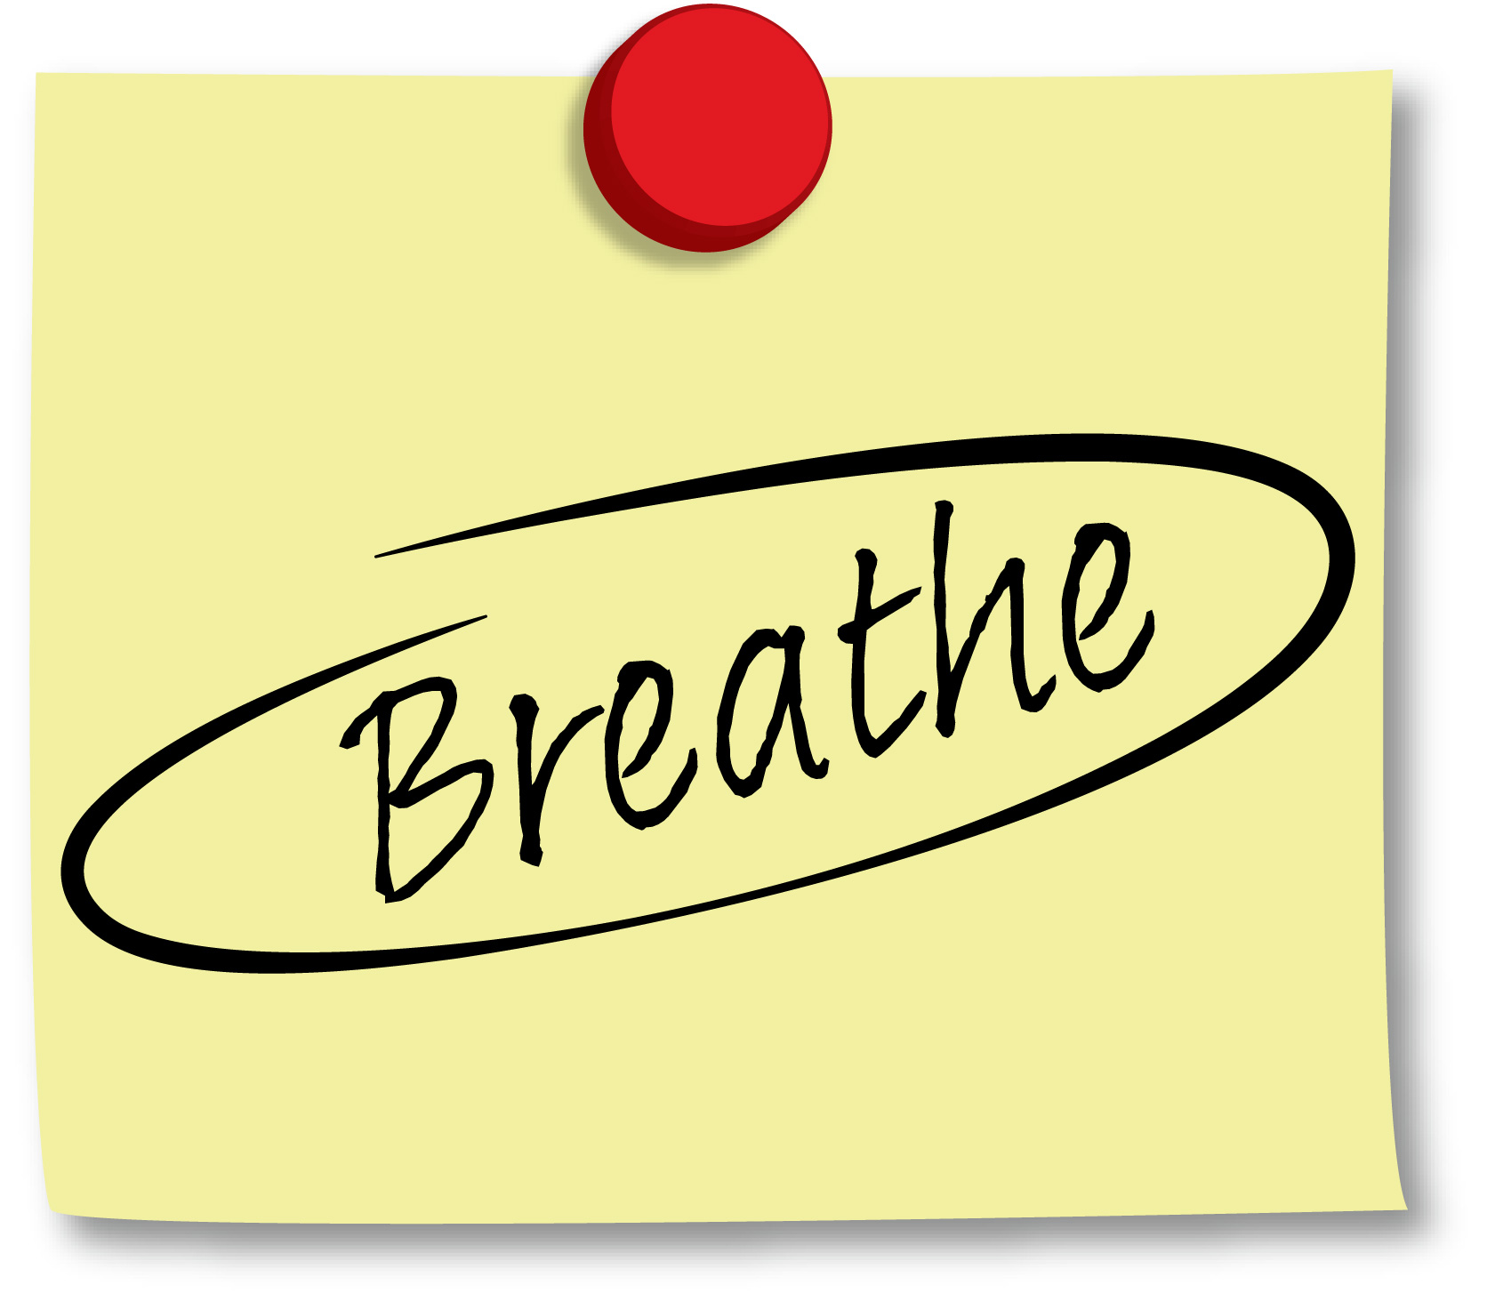
SKILL 3: GET GOOD AT STRESS
Getting enough sleep
Physical exercise
Talking to friends/family
Breathing & relaxation exercises
Healthy eating
What else helps you to get good at stress?
Slide 61

Slide 18
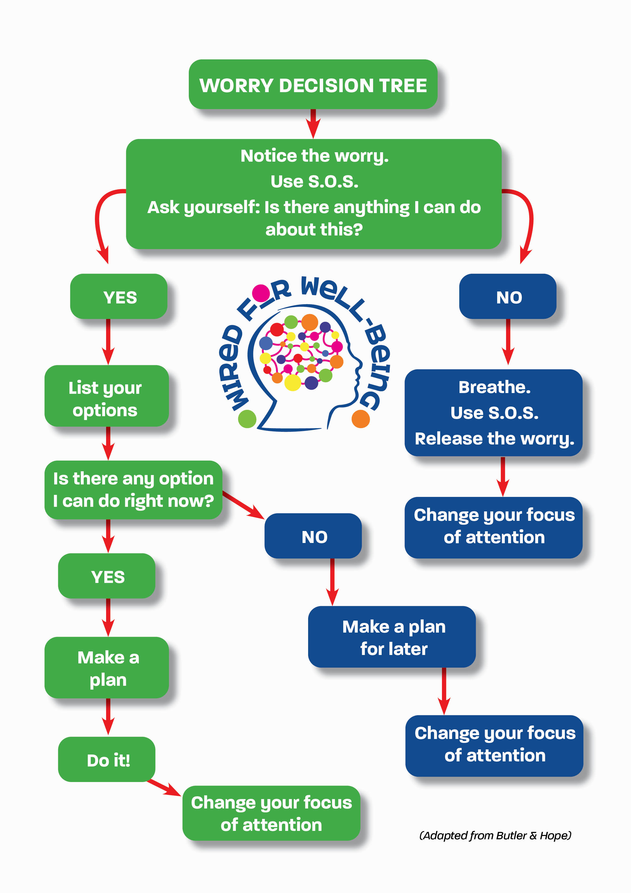
SKILL 3: GET GOOD AT STRESS
If you are stressed because of a particular worry, try using this Worry Decision Tree (Pupil Book page 11) to help you to take action.
Slide 62

Slide 19
SKILL 3: GET GOOD AT STRESS
Take a look!
In this video, Professor Kelly McGonigal explains what happens in our brains when we start to view the stress response as helpful rather than harmful.
www.otb.ie/w4w-Make-Stress-Your-Friend
Slide 63
Notes:
www.otb.ie/w4w-Make-Stress-Your-Friend
https://youtu.be/x_DMyF3GjCk

Slide 20
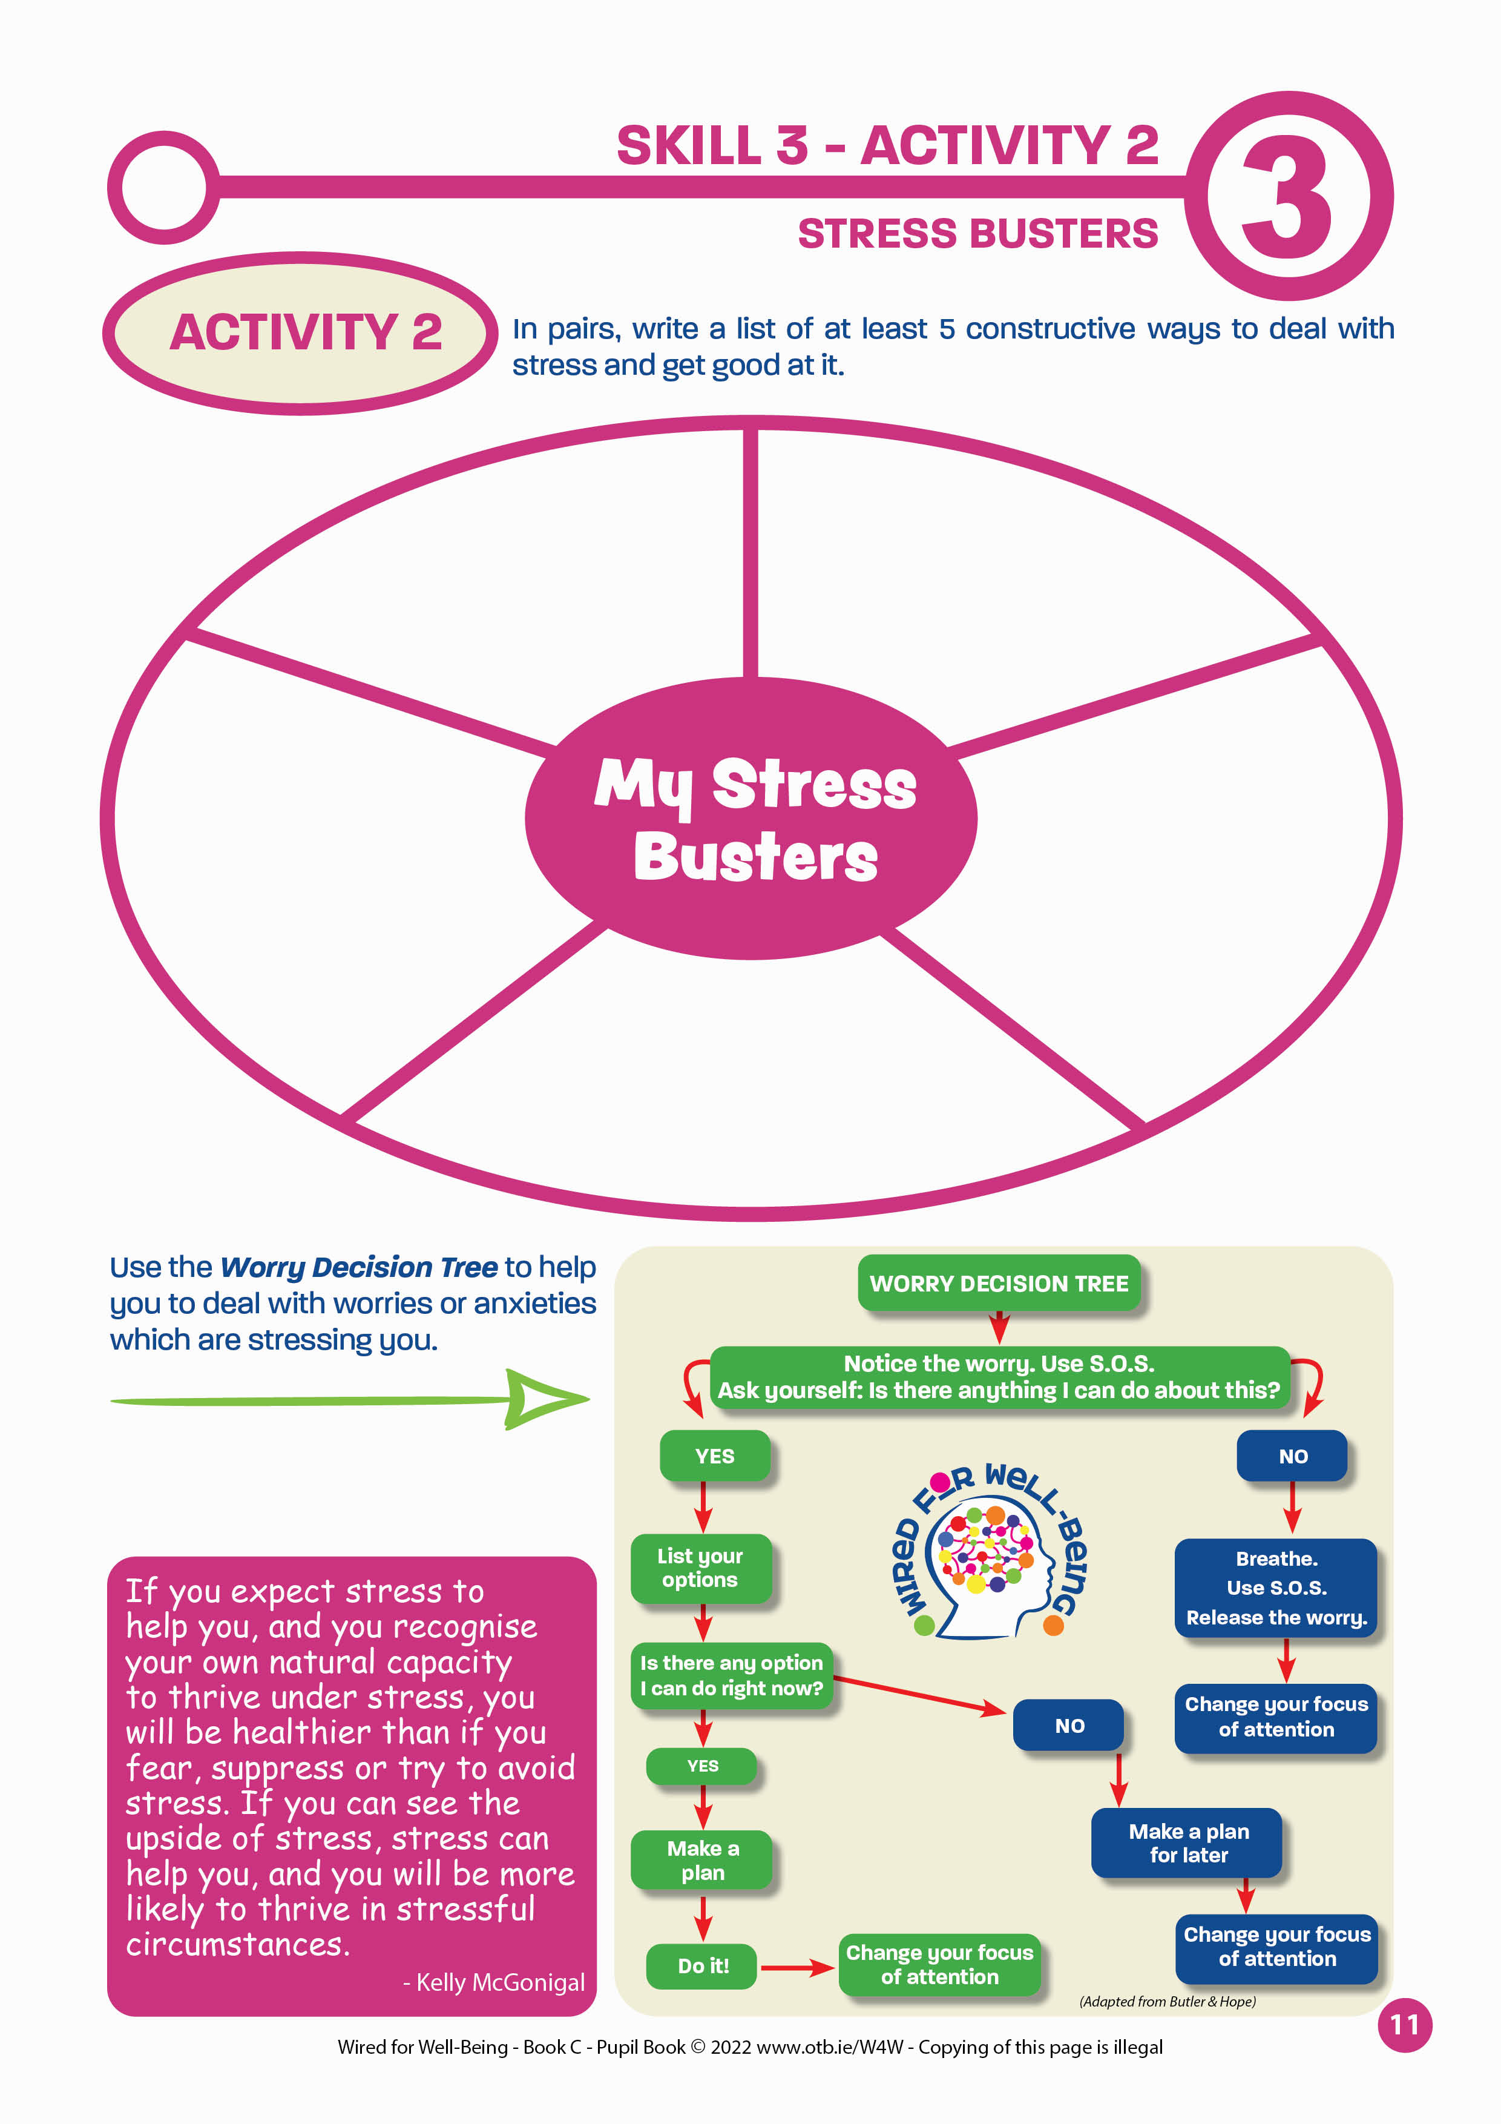
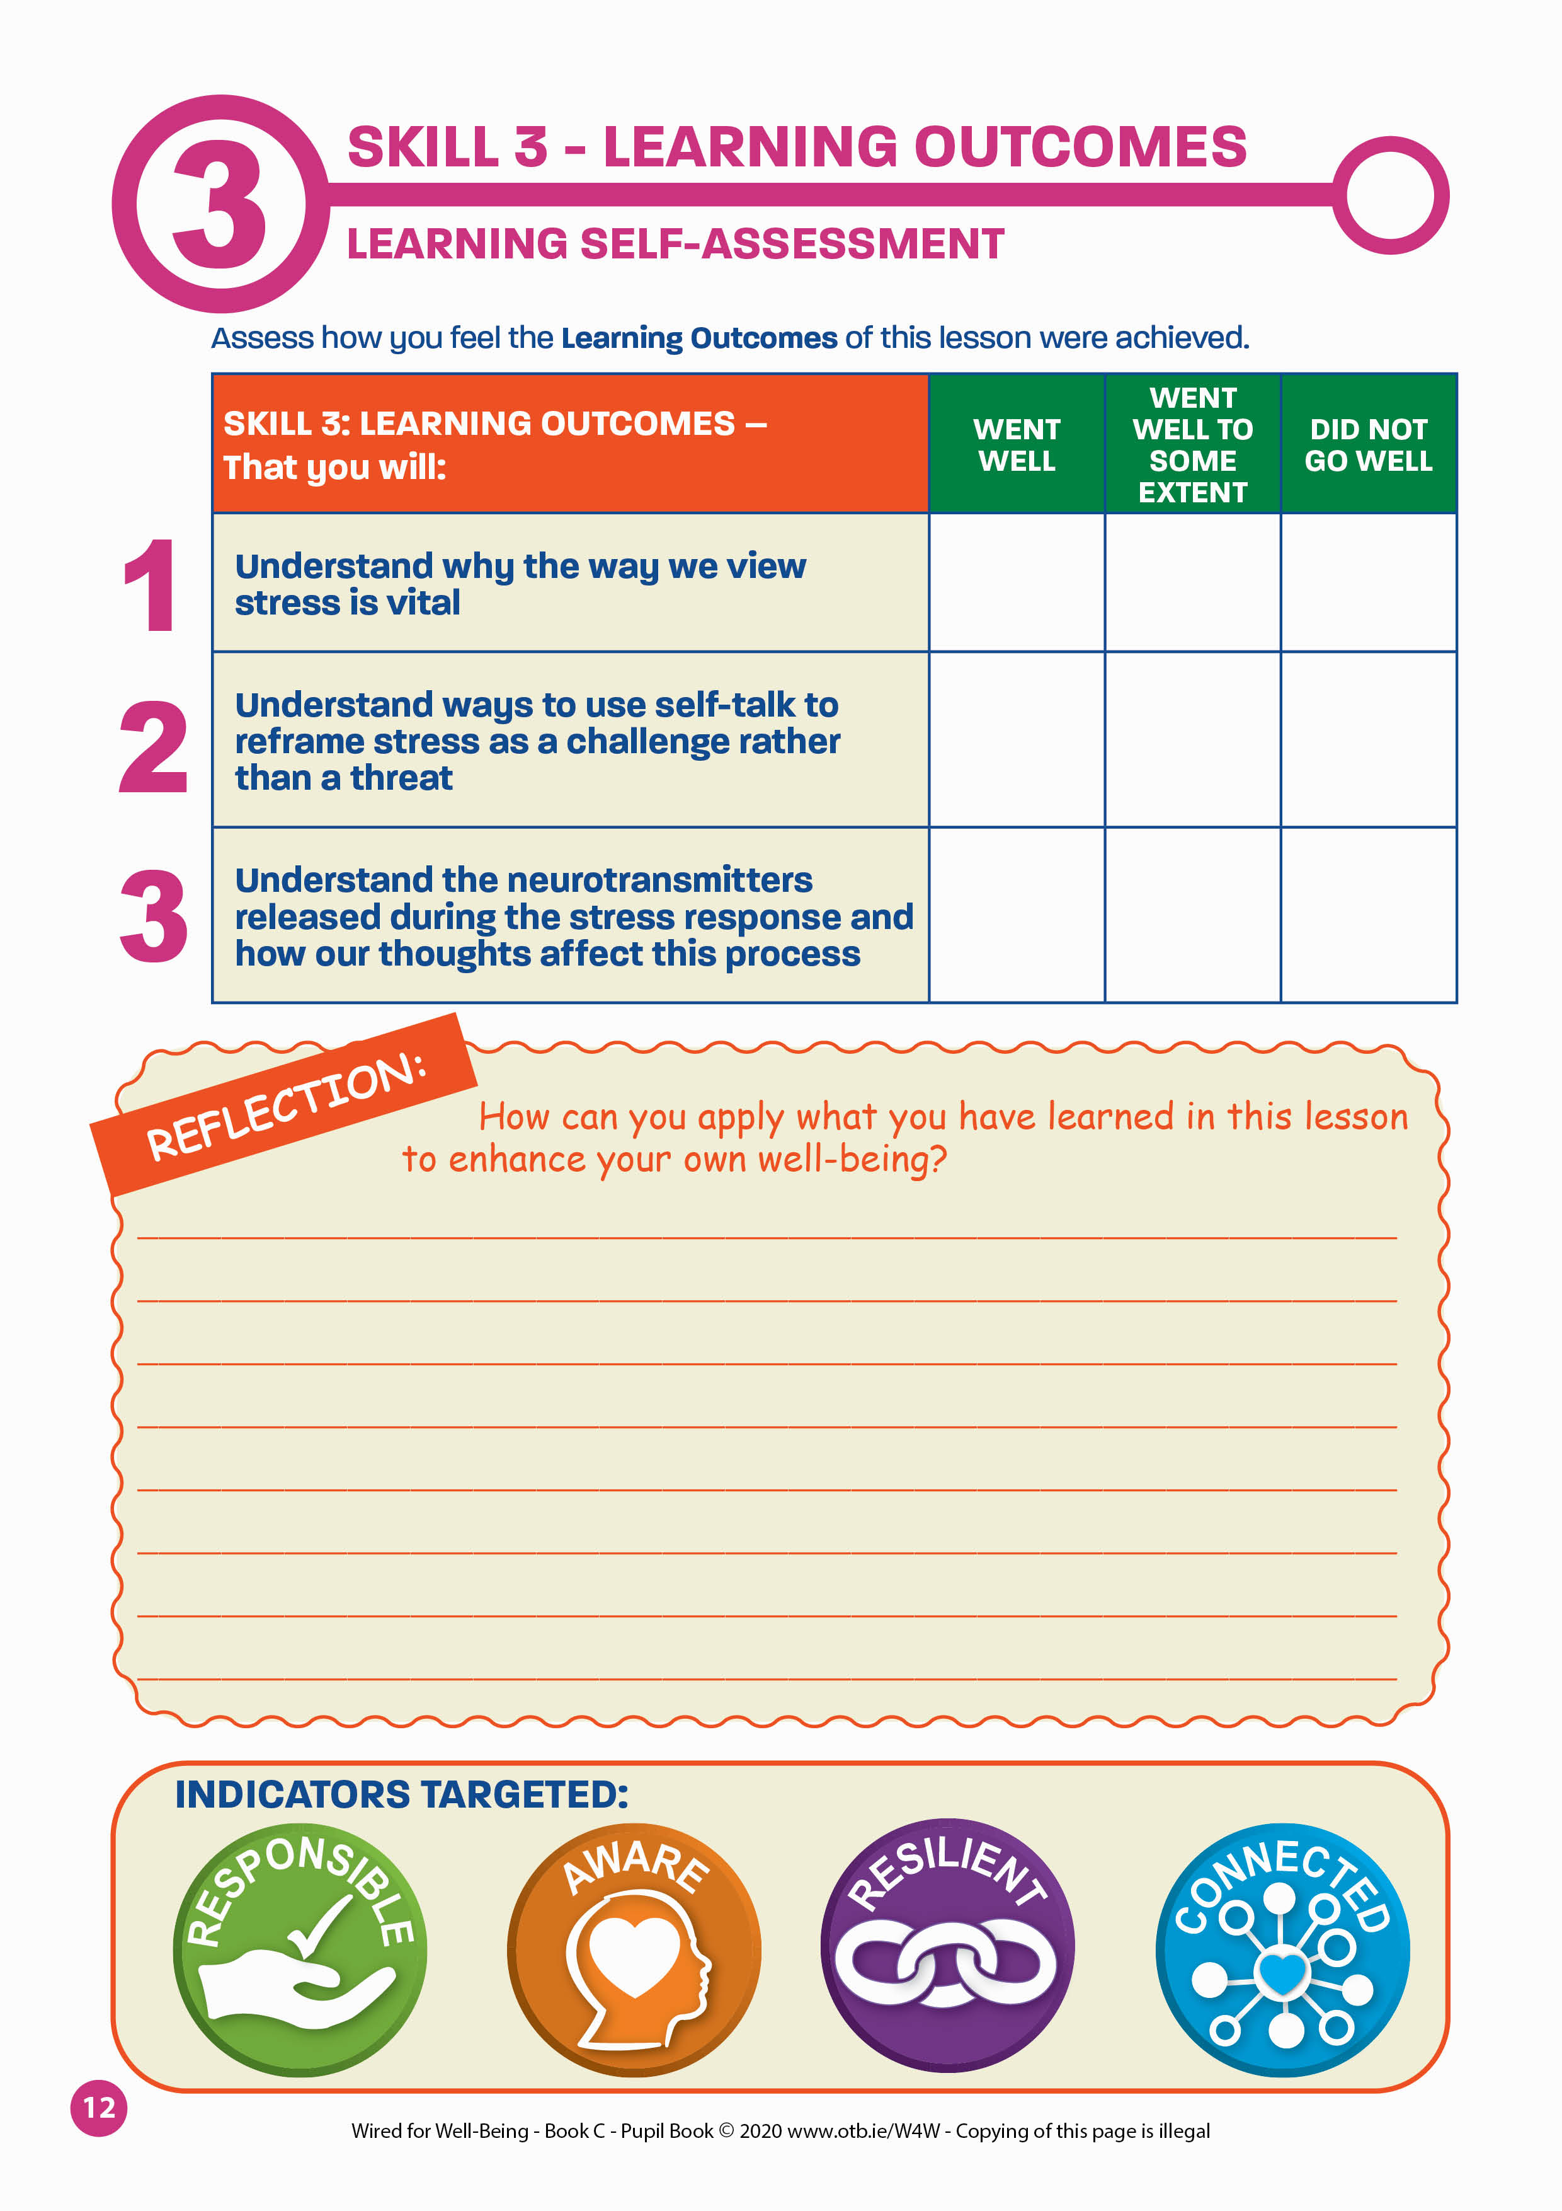
SKILL 3: GET GOOD AT STRESS
Closing Activities:
1. Read the Key Message of this lesson again – Pupil Book page 10
2. Complete Activity 2 – Pupil Book page 11
3. Complete your Learning Self-Assessment – Pupil Book page 12
Slide 64

Slide 21
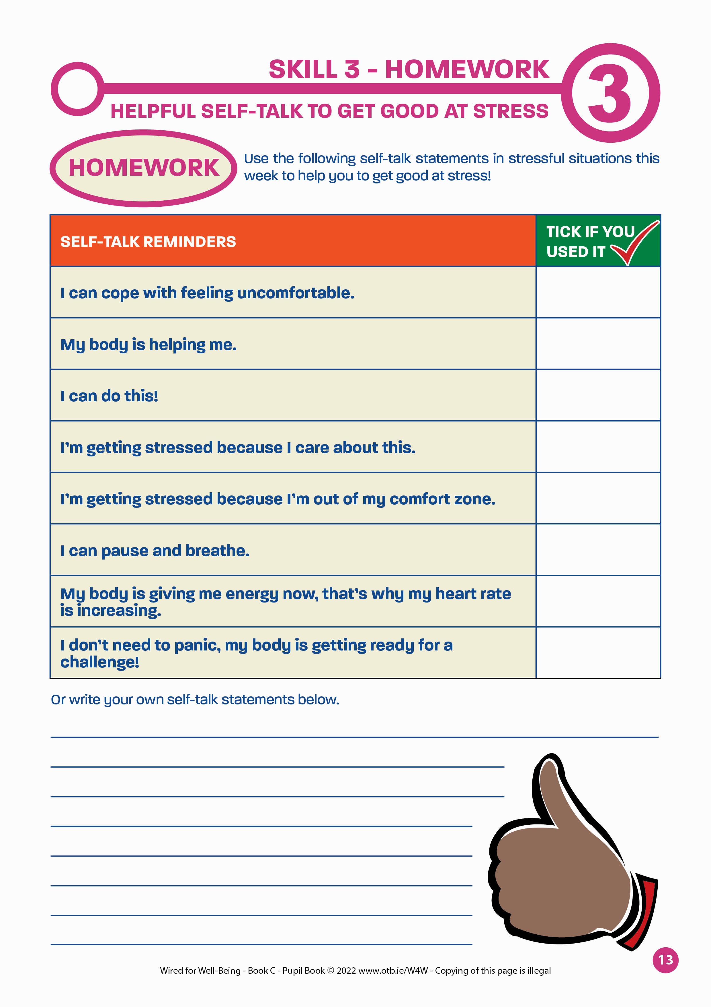
SKILL 3: GET GOOD AT STRESS
At home this week: Pupil Book page 13
One of the benefits of embracing stress is that you find the strength to pursue goals that are difficult but meaningful.
- Kelly McGonigal
Slide 65

