Slide 1
Welcome to Well-Being
1
Feeling good with Mo and Ko!
Notes:
Welcome to Well-Being – Feeling good with Mo and Ko!

Slide 2
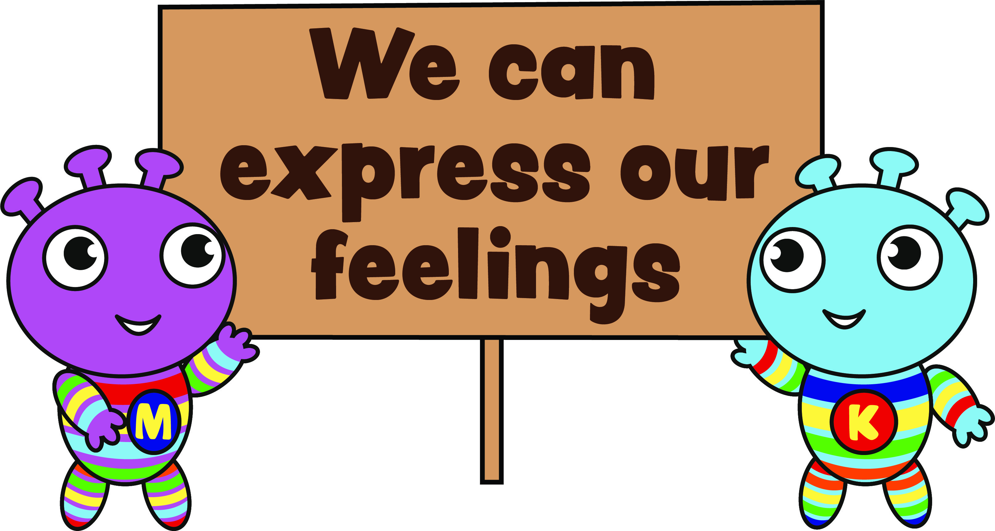
Lesson 3: We can express our feelings
23
Notes:
Mo, Ko and Bo-Bo are back this week to help us to be our best selves and to feel happy, kind, strong, brave, loving and well. How did you do in the challenge? Did you use your words to name your feelings? Did it help you to feel a little bit better?
This week Mo and Ko want us to know lots of ways to express our feelings. What do you think that means?

Slide 3
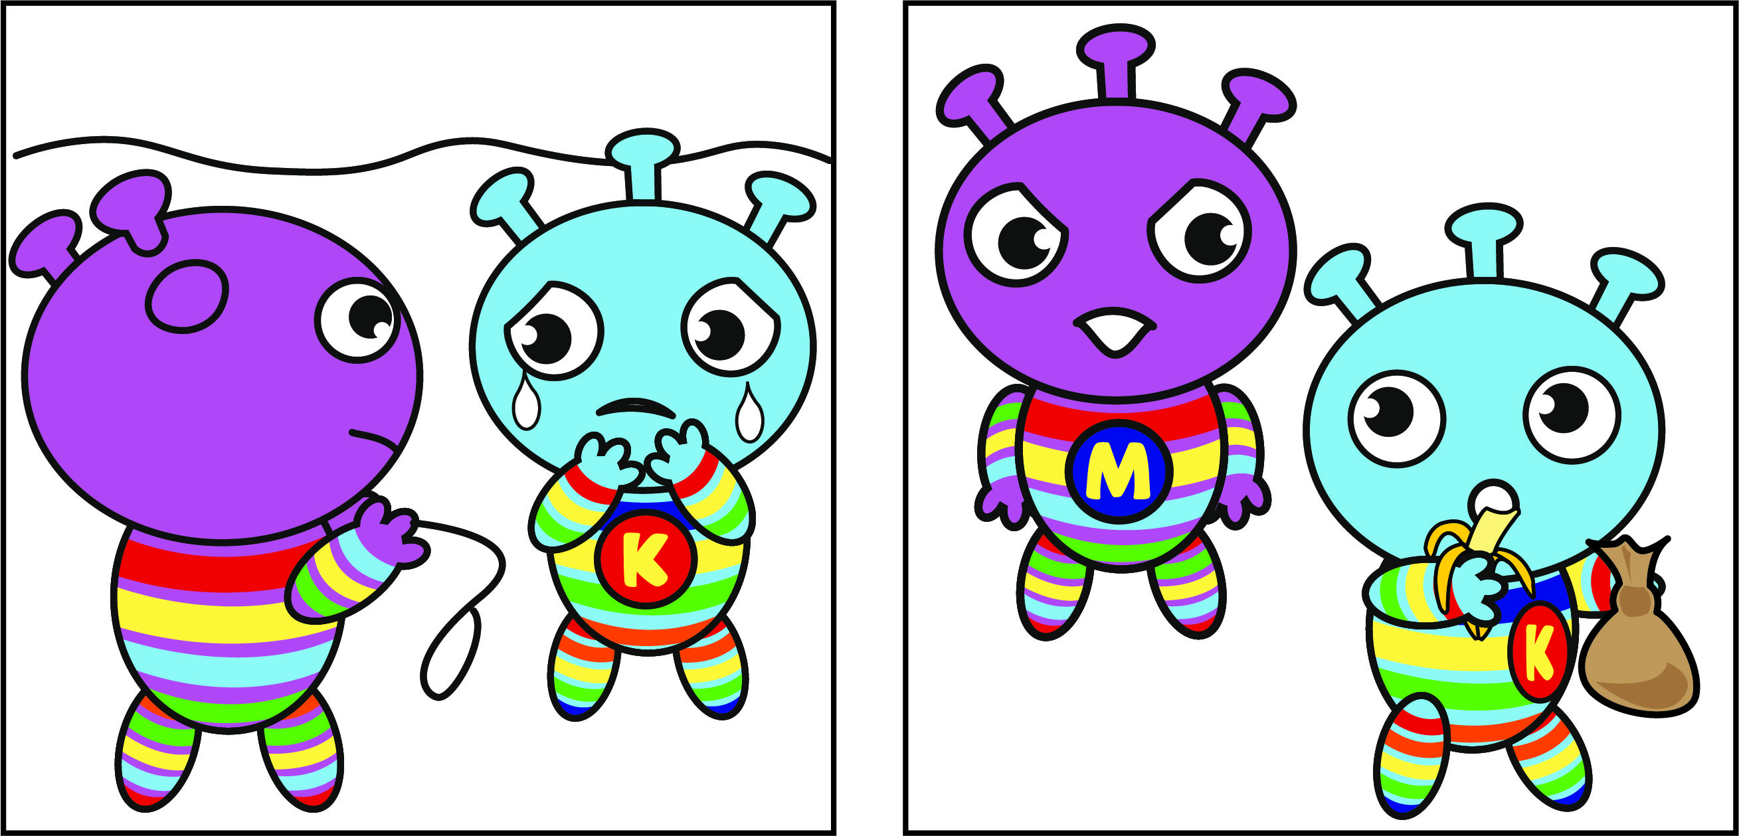
We can express our feelings
24
Notes:
When we express our feelings it means that we let them out and show them instead of keeping them inside ourselves. It feels good to express how we feel, especially with our big feelings. Ko expressed their worry when they lost Bo-Bo by crying and talking to Mo. Mo expressed their anger to Ko, when Ko wouldn’t share their treats, by using their words. When did you express your feelings? What did you do? How did it feel to express them?

Slide 4
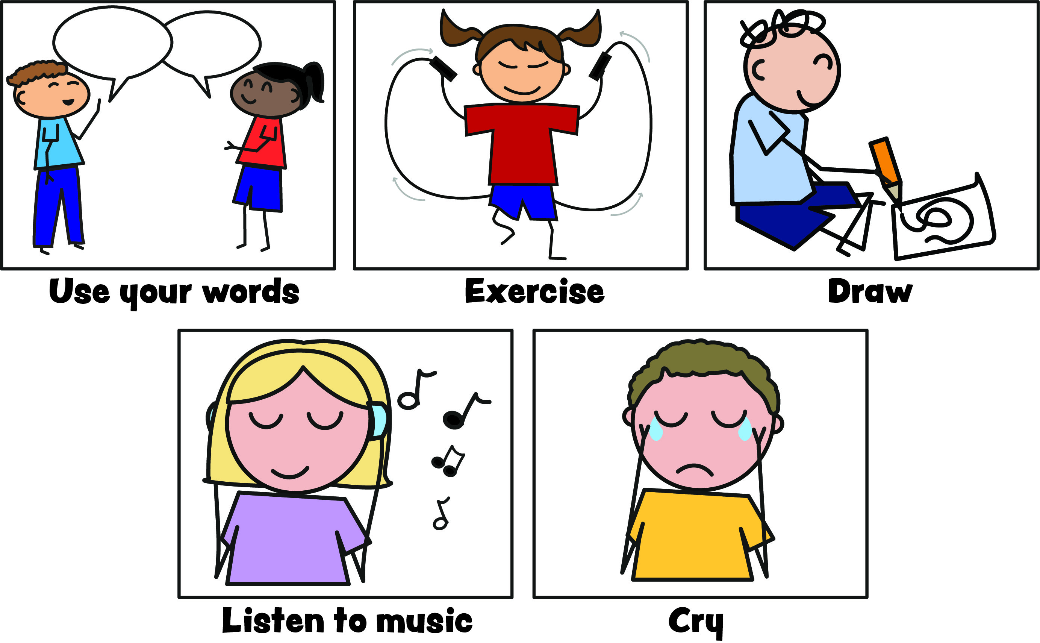
We can express our feelings
25
Notes:
Can you name some helpful ways to express our feelings? You could – use your words, exercise, draw, listen to music or cry.

Slide 5
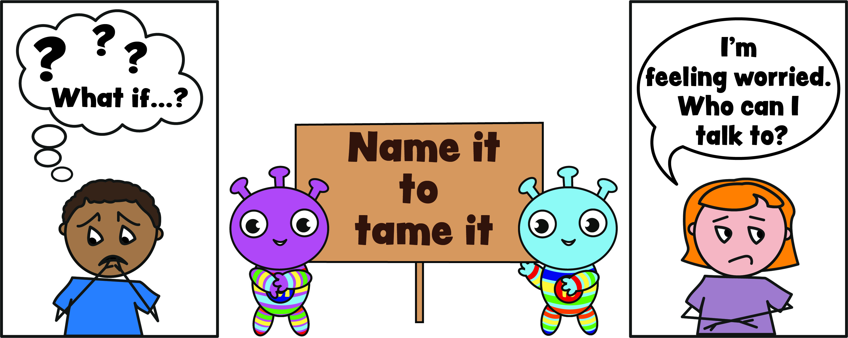
Name it to tame it
26
Notes:
When we use our words to name how we are feeling, especially if it is a big feeling, it can help us to ‘tame’ the feeling and then it will feel less wild and strong. So even if you say to yourself ‘I’m feeling worried’ it can help that feeling of worry to get a little smaller. Name it to tame it!

Slide 6
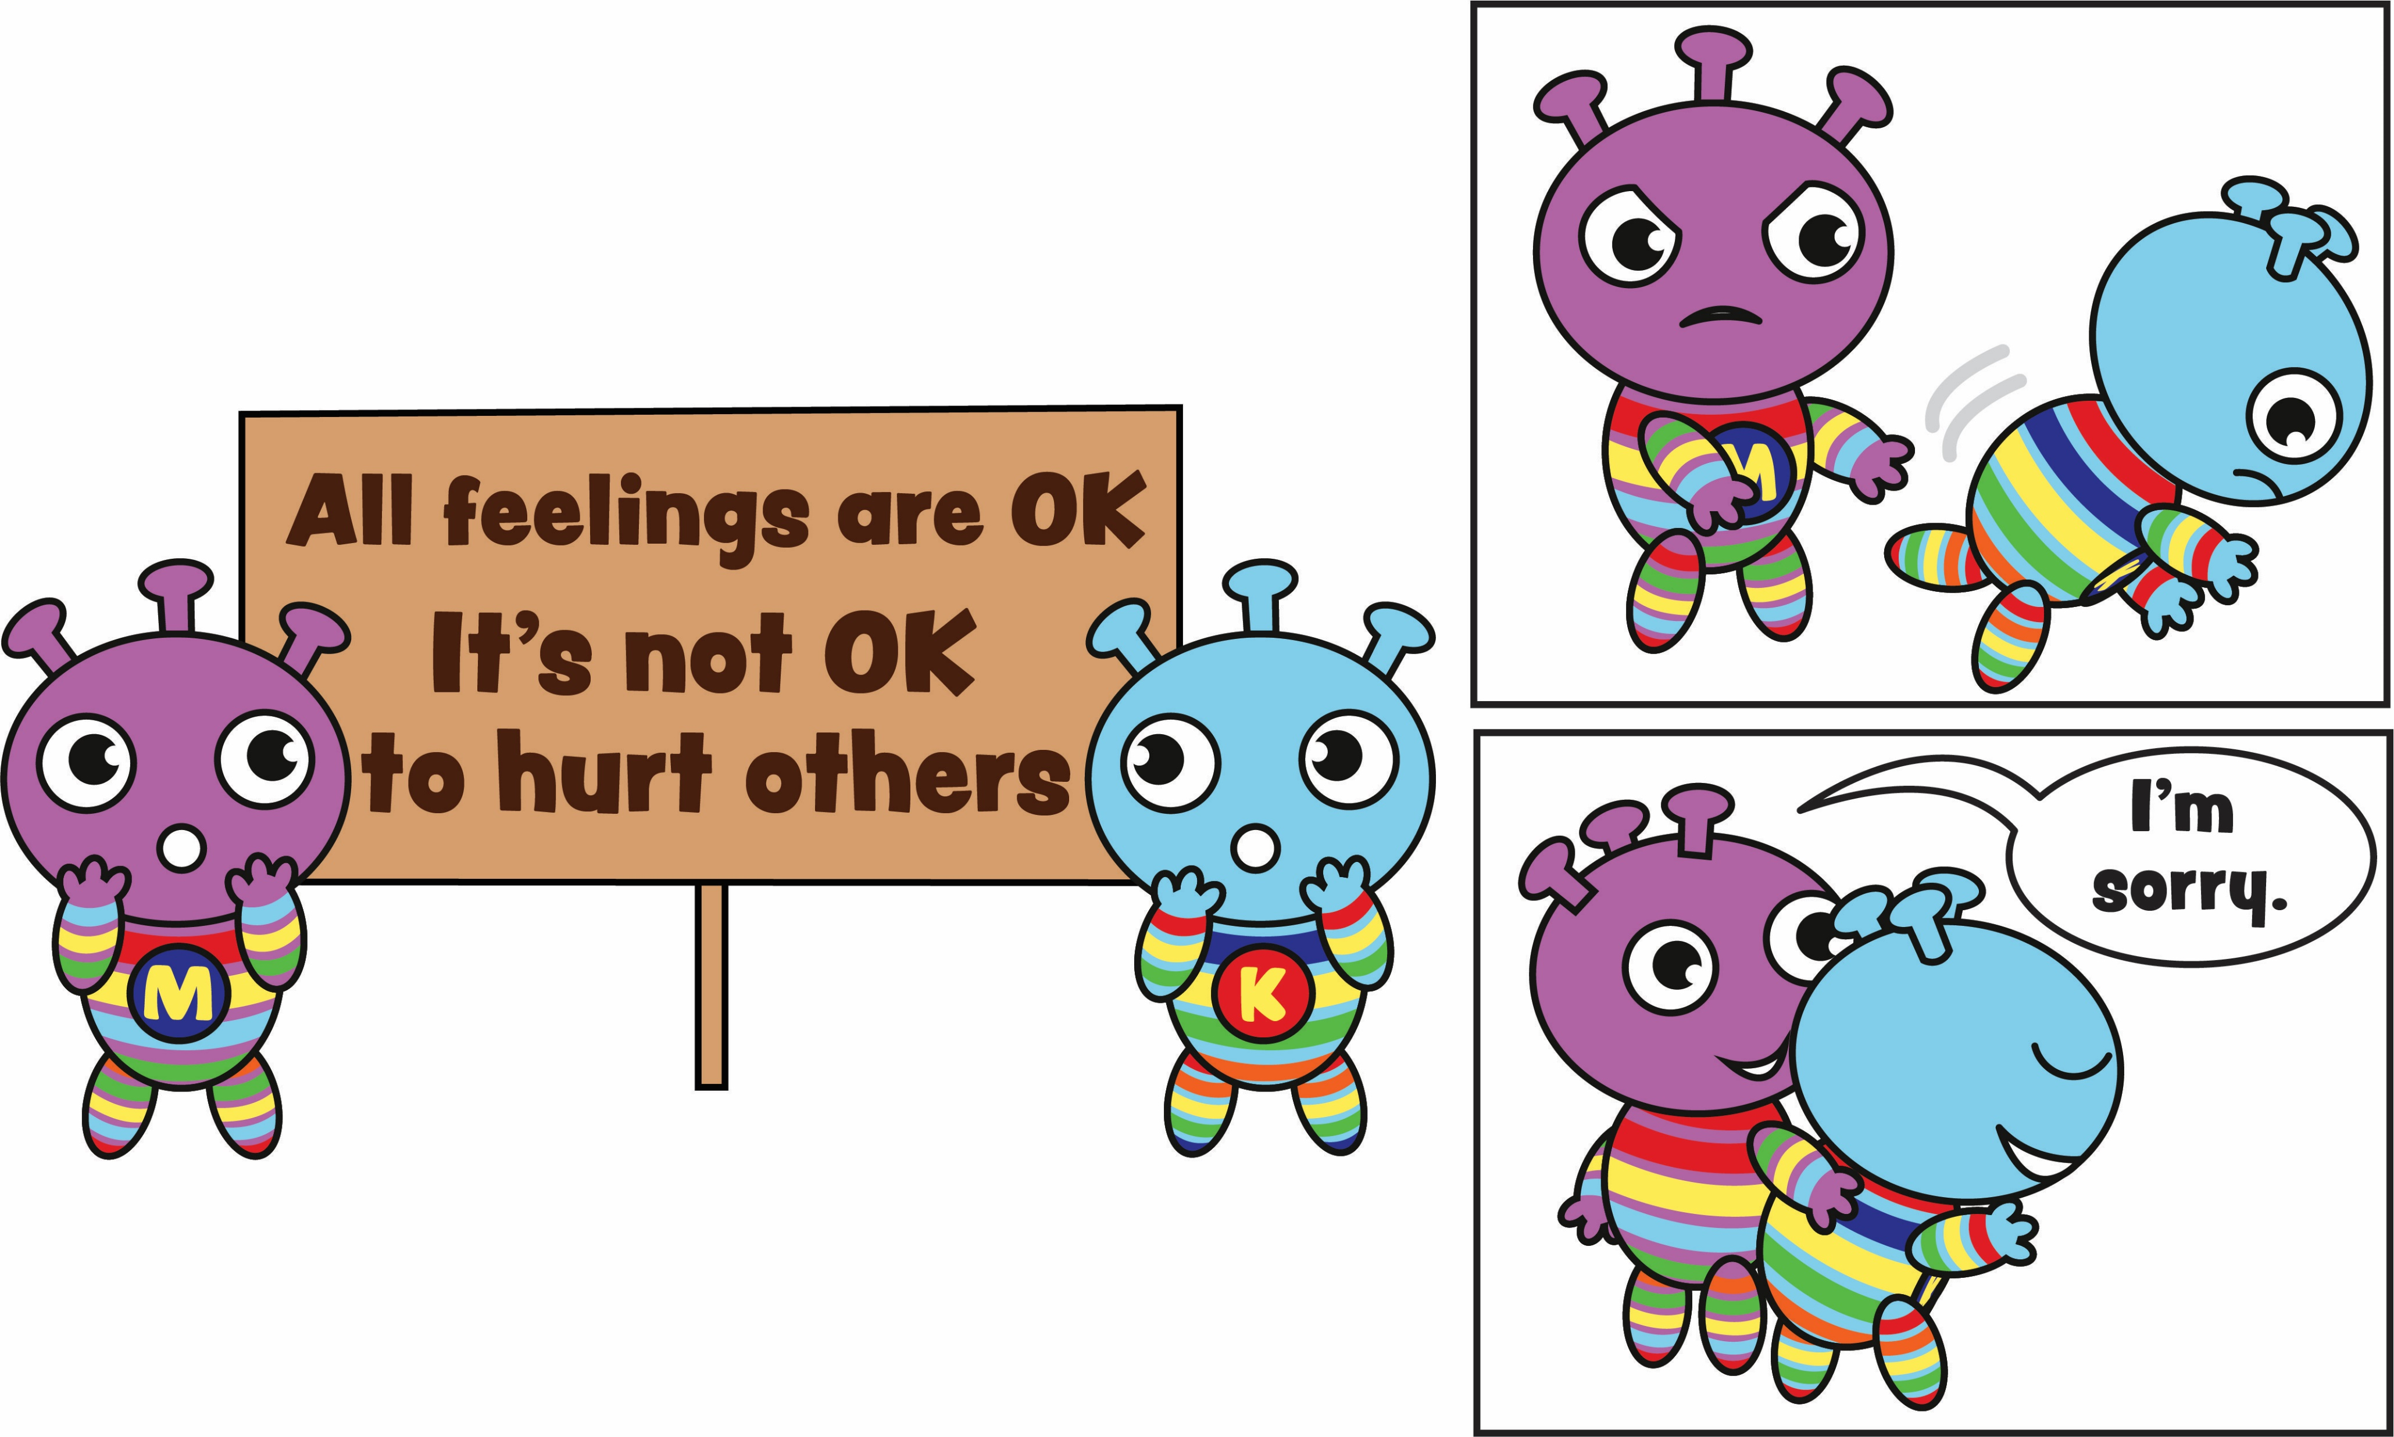
We can express our feelings
27
Notes:
There are helpful and unhelpful ways to express our big feelings. It’s not helpful to hurt others or ourselves when we are expressing our feelings. Can you think of a time when you used an unhelpful way to express your emotions? Mo pushed Ko once because they were very angry. That was not helpful at all and Ko was very upset and angry too. They used their words and Mo said sorry and after a while, they both felt a bit better.

Slide 7
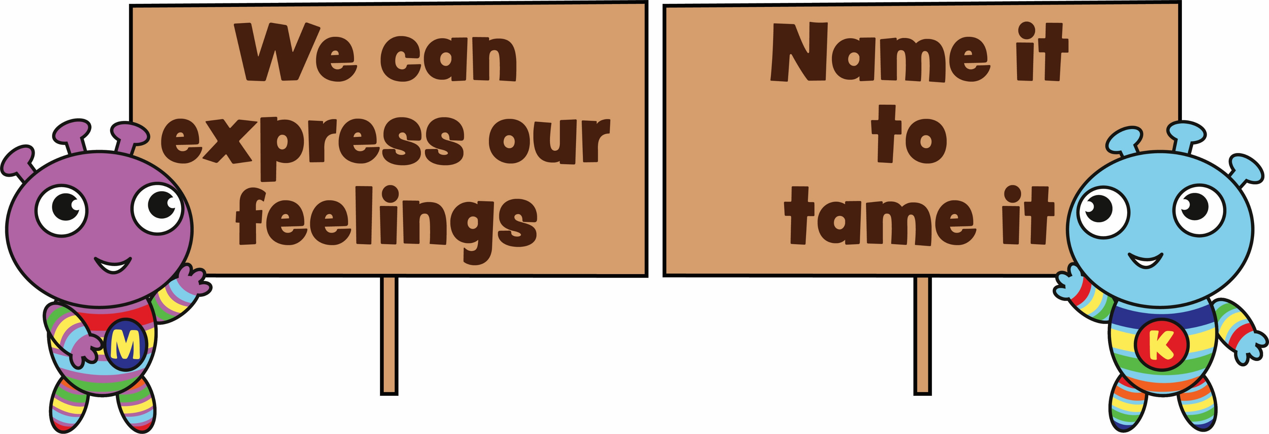
Mo and Ko’s challenge
28
Notes:
This week Mo and Ko challenge you to express your feelings in helpful ways every day. Use ‘Name it to tame it’ too.

Slide 8
Look and listen
29
Notes:
Strike your best robot pose in this catchy Calm it Down song and dance. Dance and sing along with these children as they stop and name their feelings to help them calm down. Name it to tame it! (2:05)
www.otb.ie/w2w-calm-it-down

Slide 9
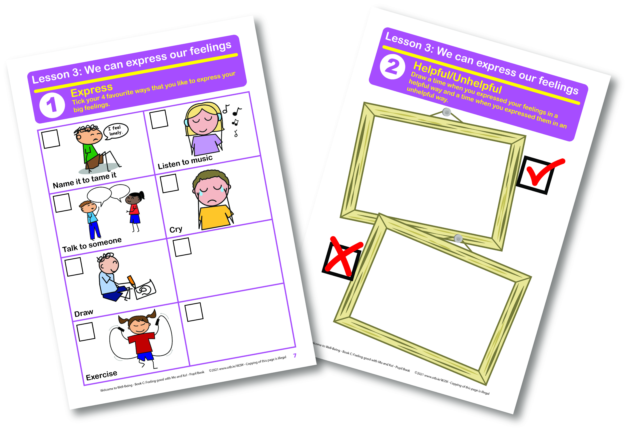
Pupil book time
30
Notes:
Now it’s time for our Pupil Books.
On page 7 tick the ways that you like to express your big feelings.
Then on page 8, draw a time when you expressed your feelings in a helpful way and a time when you expressed them in an unhelpful way.

Slide 10
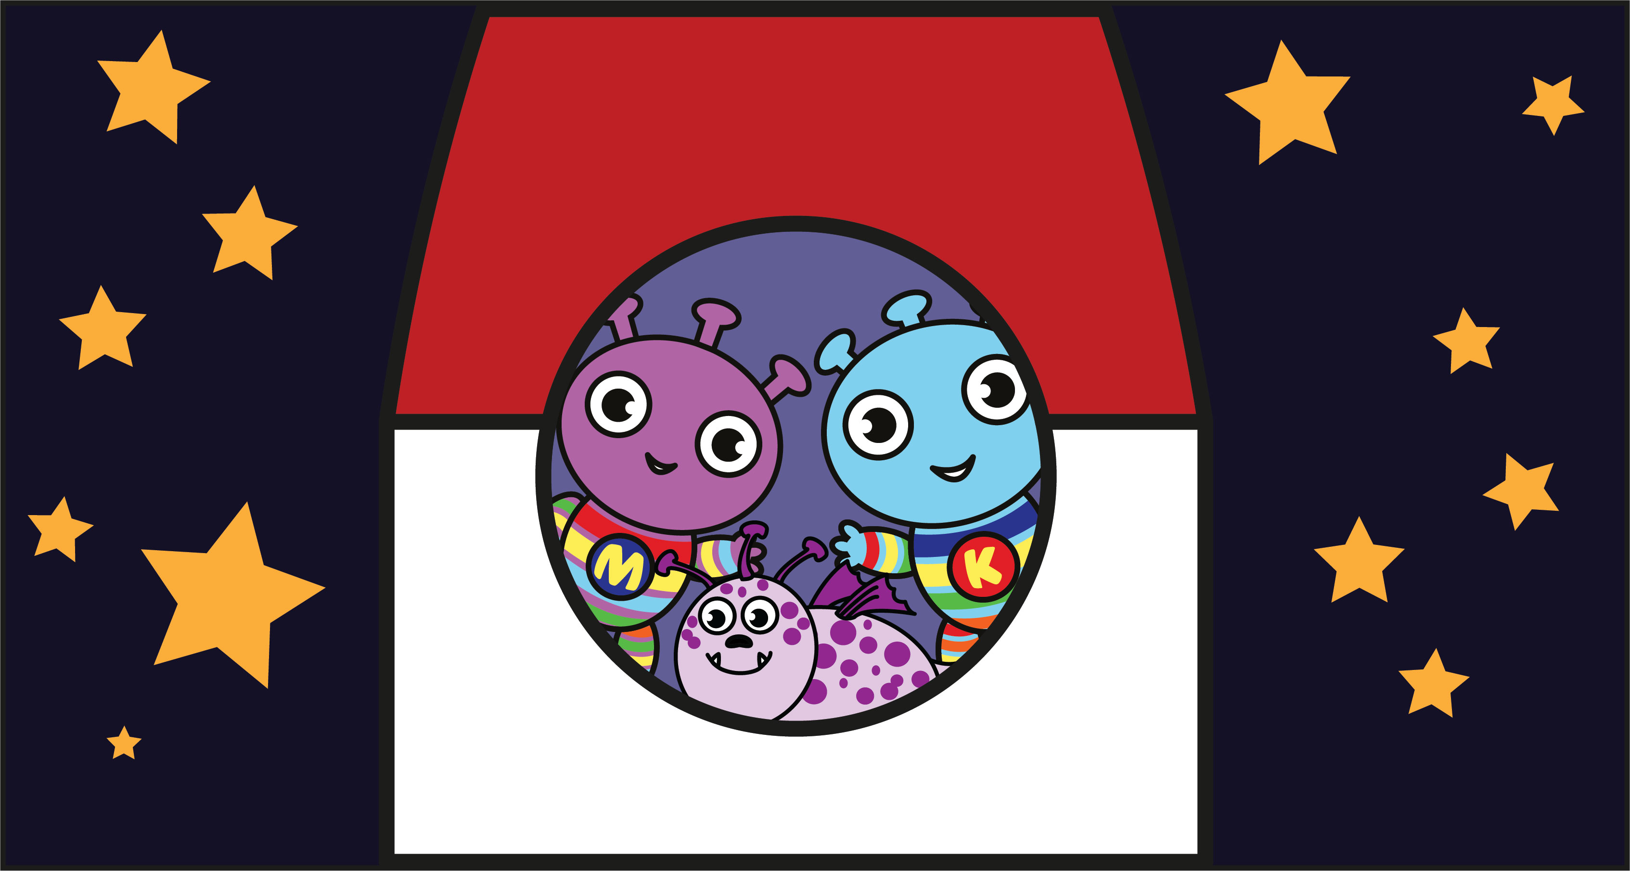
Goodbye Mo and Ko
98
Notes:
Now it is time to say goodbye to Mo, Ko and Bo-Bo. We will remember everything they told us. Goodbye and thank-you Mo, Ko and Bo-Bo!

