Slide 1
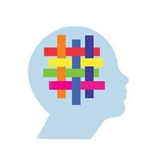
Weaving Well-Being: Background, Overview and Implementation Guide
By Fiona Forman
Notes:
Hello and welcome to this background, overview and implementation guide to the Weaving Well-Being programme. I’m Fiona Forman, a primary school teacher and co-author of the programme.

Slide 2
Outline of Presentation
Background to the Weaving Well-Being Programme
Defining well-being
Why focus on well-being in schools?
Overview of Positive Psychology
Structure of the Weaving Well-Being programme
Programme overview (2nd – 6th)
Incremental approach
Implementation Guide
Notes:
The presentation will begin with some background information on the Weaving Well-Being programme. We will continue by defining well-being in order to get a clear sense of the concept. Next, a short synopsis of Positive Psychology, which is the science of well-being, will be outlined, as the programme is based on this relatively new branch of psychology.
The structure of the programme will then be explained, followed by a brief overview of each of the different programme levels.
Finally, the incremental approach of the programme and an implementation guide will be outlined.

Slide 3
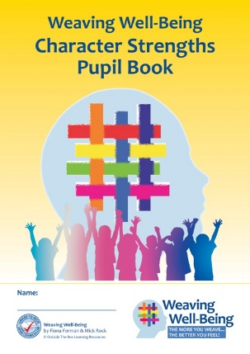
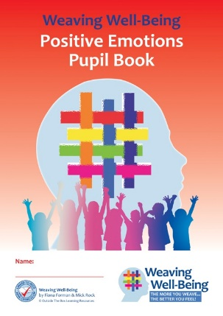
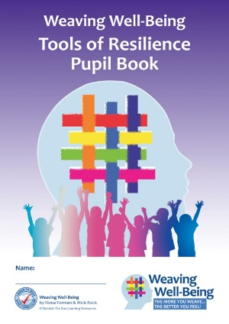
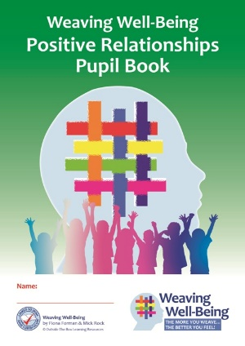
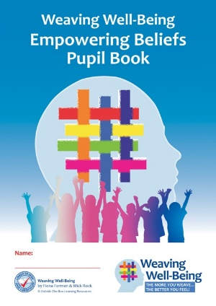
Background to Weaving Well-Being
Irish designed SPHE programme, based on concepts from Positive Psychology, the science of well-being
Positive Education programme
Multi-year programme – 2nd to 6th Class
Authors - Fiona Forman & Mick Rock - M. Sc. Applied Positive Psychology
Notes:
Weaving Well-Being is an Irish designed SPHE programme, based on concepts from Positive Psychology, which is the science of well-being.
It is a multi-year programme for second to sixth class.
My co –author Mick Rock and I both hold Masters Degrees in Applied Positive Psychology from the University of East London, and the programme draws extensively from this base along with my practical classroom experience.

Slide 4
Background to Weaving Well-Being
Developed in the classroom over a 3 year period
Piloted in several schools nationwide
Positive Feedback:
Very teacher- friendly
Enjoyed by children and teachers alike
Extremely positive feedback from parents
Children found it beneficial on many levels
Launched in April 2017
Notes:
The programme was developed in my classroom over a three year period. It was then piloted in several schools nationwide. Feedback from teachers, parents and children was very positive. The programme was viewed as being very teacher-friendly. It was enjoyed by children and teachers alike.
There was positive feedback from parents, many of whom felt it was an essential addition to their children’s education.
Children also found it beneficial on many levels.
The full programme was subsequently launched in Drumcondra Education Centre in April 2017

Slide 5
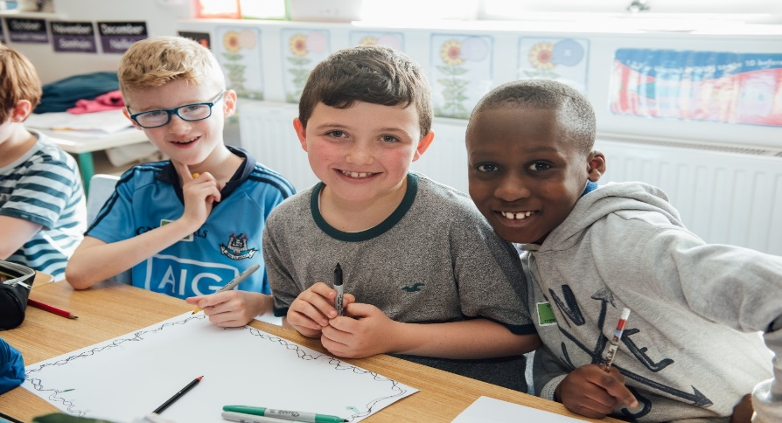
Background to Weaving Well-Being
Aim:
To enhance children’s well-being by teaching them evidence-based skills and strategies from Positive Psychology, to help them to become resilient and flourishing members of society
Notes:
The overall aim of the programme is to enhance children’s well-being by teaching them evidence-based skills and strategies from Positive Psychology, to help them to become resilient and flourishing members of society.

Slide 6
Defining Well-Being
“A state of Well-Being in which the individual realises his or her own abilities; can cope with the normal stresses of life; can work productively and fruitfully and is able to make a contribution to his or her own community”
(WHO, 2001)
Notes:
As our aim is to enhance well-being, it is helpful to begin with a definition of this concept. A commonly-used definition of well-being from the World Health Organisation is:
A state of Well-Being in which the individual realises his or her own abilities; can cope with the normal stresses of life; can work productively and fruitfully and is able to make a contribution to his or her own community”
(WHO, 2001). This definition of well-being is referenced in the 2015 DES publication ‘Guidelines for Mental Health Promotion- Well-Being in Primary Schools’. The Weaving Well-Being programme is based on this definition of well-being. We can see it encompasses the multi-dimensional nature of well-being, including the social, emotional and physical elements, and also refers to the concept of resilience.

Slide 7
Language of Well-Being for Children
Well-being means feeling good and strong in our minds and bodies, having energy, getting along with and helping others, knowing our strengths and feeling proud because we are doing our best. It means we can cope with the little problems and disappointments of life. It means enjoying life, being grateful for what we have and accepting ourselves just as we are!
Weaving Well-Being
Notes:
The Weaving Well-being programme has adapted and expanded the World Health Organisation’s definition in order to introduce children to the language of well-being.
Well-being means feeling good and strong in our minds and bodies, having energy, getting along with and helping others, knowing our strengths and feeling proud because we are doing our best. It means we can cope with the little problems and disappointments of life. It means enjoying life, being grateful for what we have and accepting ourselves just as we are!”
This definition of well-being is used throughout the programme from second to sixth class. The aim is to give children an understanding of what well-being feels like so that they can monitor their own well-being and also take action to improve and enhance it.

Slide 8
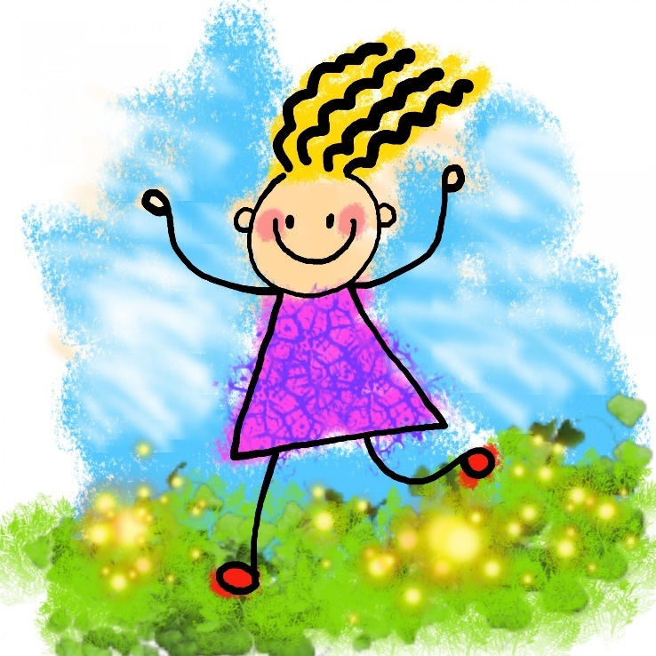
Why Focus on Well-being in Schools?
The first aim of the SPHE curriculum is
‘to promote the personal development and well-being of the child’
-SPHE Curriculum, p.9
Notes:
Let’s take a look now at some important reasons for focusing on well-being in schools. We can see that the first aim of the SPHE curriculum is ‘to promote the personal development and well-being of the child.’

Slide 9
Why Focus on Well-being in Schools?
Emotional well-being in childhood is the strongest childhood predictor of a successful and satisfying life in adulthood, with the child’s intellectual development being the weakest predictor.
(Layard, Clark, Cornaglia & Vernoit, 2014)
Notes:
Here is a key message from research –
‘Emotional well-being in childhood is the strongest childhood predictor of a successful and satisfying life in adulthood, with the child’s intellectual development being the weakest predictor’
We can think about the implications for the educational system and see that focusing on children’s well-being is a worthwhile and justifiable aim which can bring benefits to their long-term futures.

Slide 10
Why Focus on Well-being in Schools?
Emotional well-being is also the strongest predictor of a successful and satisfying life in adulthood
More powerful a predictor than income, educational level, physical health, family status or employment
(Layard, Clark, Cornaglia & Vernoit, 2014)
Notes:
The same research showed that emotional well-being is also the strongest predictor of a successful and satisfying life in adulthood and is more powerful a predictor than income, educational level, physical health, family status or employment.
This gives us another powerful reason to focus on well-being in schools!

Slide 11
Why Focus on Well-being in Schools?
Research also shows that well-being programmes are most effective when delivered by teachers themselves, as opposed to outside experts.
(Durlak, Weissberg, Taylor, Dymnicki, & Schellinger, 2011)
Notes:
Research also shows that well-being programmes are most effective when delivered by teachers themselves, as opposed to outside experts.
It is reassuring for us as teachers to know this. We are highly skilled and also have the connection and relationship with the children which is so vital in delivering any programmes.

Slide 12
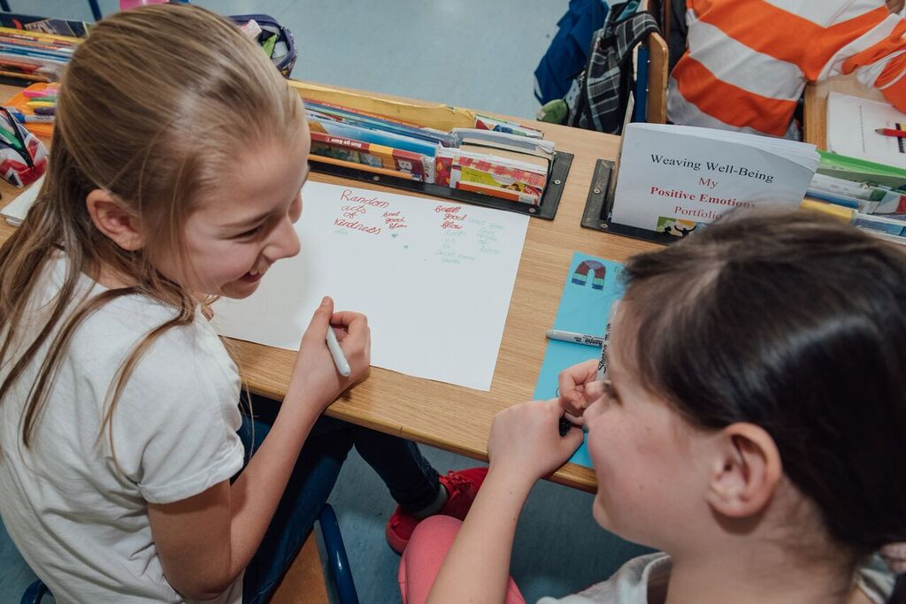
Why Focus on Well-being in Schools?
Child Well-Being Outcomes:
Happy Children:
Higher school achievement
Success in a wide variety of life domains, including relationships and resilience
(Waters, 2011; Alexander, 2002)
Notes:
Research shows that well-being in children is associated with many other successful outcomes such as higher school achievement and
success in a wide variety of life domains, including relationships and resilience.

Slide 13
Why Focus on Well-being in Schools?
Worrying statistics:
By age 13 years, 1 in 3 young people in Ireland is likely to have experienced some type of mental disorder
By the age of 24 years, that rate will have increased to over 1 in 2
Up to one third of young Irish adolescents and over one half of young Irish adults are at increased risk of mental ill-health into their adult years
(Cannon, Coughlan, Clarke, Harley & Kelleher, 2013)
Notes:
Let’s look now at some recent worrying statistics on the well-being of young people in Ireland.

Slide 14
Why Focus on Well-being in Schools?
Promoting children’s well-being in order to enhance their emotional and social competence is an important measure in the prevention of such disorders
(O’ Connell, Boat & Warner, 2009)
The Weaving Well-Being programme takes a preventative approach and aims to equip children with skills to enhance their well-being and mental health.
Notes:
Promoting children’s well-being in order to enhance their emotional and social competence is an important measure in the prevention of such disorders
(O’ Connell, Boat & Warner, 2009)
The Weaving Well-Being programme takes such a preventative approach and aims to equip children with skills to enhance their well-being and mental health.

Slide 15
Positive Psychology
Positive Psychology is ‘the science and practice of improving well-being’
(Lomas, Hefferon & Ivtzan, 2014)
Notes:
We will now take a look some of the key aspects of Positive Psychology, as this forms the basis of the Weaving Well-Being Programme. Positive Psychology can be defined as the ‘science and practice of improving well-being’. It is an evidence-based discipline in which all of the skills, strategies and interventions have been tested and researched.

Slide 16
Positive Psychology
Continuum of Mental Health
Notes:
Positive Psychology was founded by Professor Martin Seligman, of the University of Pennsylvania, in 1998. His insight was that psychology up to that point was deficit-based and there was a need for more research on the factors which contribute to mental health and well-being.
This continuum of mental health shows the important roles of both clinical psychology and Positive Psychology. Clinical psychology is concerned with bringing people from a minus level to the point of zero, which indicates the absence of disease.
However, absence of disease is not mental health, so this is where Positive Psychology comes in. Its aim is to bring people from that neutral or zero point right up to an optimal level of flourishing.

Slide 17
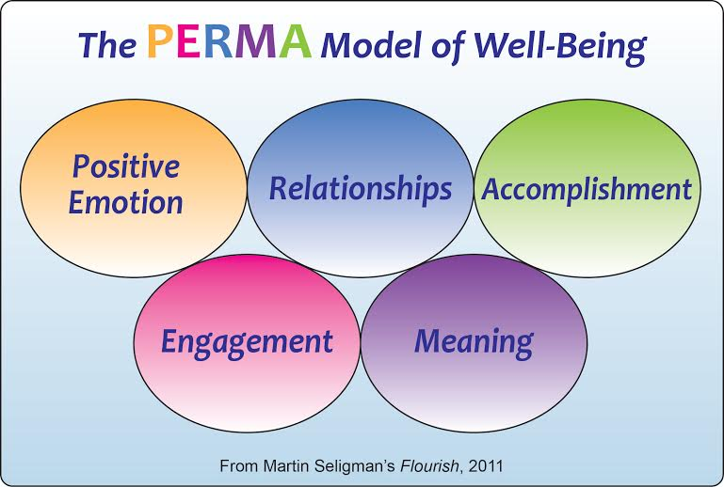
Positive Psychology
The Weaving Well-Being programme is underpinned by Seligman’s PERMA theory of well-being, with an added focus on resilience.
Notes:
Martin Seligman’s PERMA theory is one of the best-known theories of well-being. Seligman suggests that well-being is a dynamic process composed of five particular components – Positive Emotions, Engagement with life through the use of personal Character Strengths, Relationships, Accomplishment and Meaning.
The Weaving Well-Being programme is underpinned by this theory, with an added focus on resilience.

Slide 18
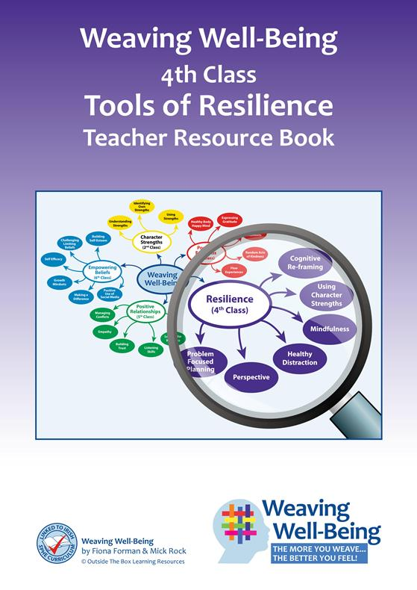
Structure of the Programme
Ten week programme
Teacher Book with CD
Pupil Book
One lesson weekly over ten consecutive weeks
Notes:
We will now take a look at the structure of the programme. Each level consists of a 10-week programme which is designed to be taught as one lesson weekly over 10 consecutive weeks.
There is a Teacher Resource Book which contains background information, lesson plans with SPHE strands and strand units and a CD . The CD contains a PowerPoint for each lessons and also printable posters. Guided meditations are also included for some levels of the programme. There is also an accompanying Pupil book for each level.

Slide 19
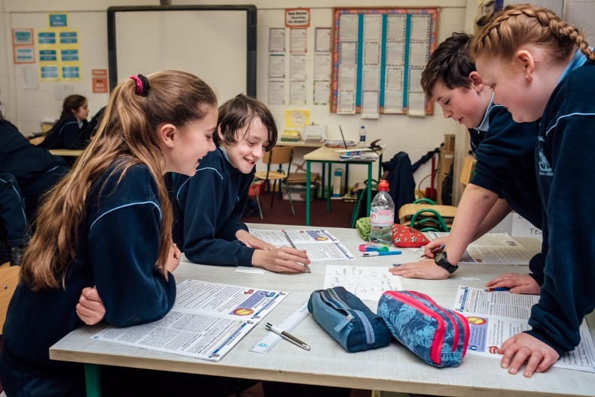
Structure of the Programme
Each level is stand alone
Designed to build concepts and skills incrementally over the 5 year period
Springboard for ‘weaving’ and embedding the skills and strategies into the everyday life of the children
Notes:
Each level is stand alone, however it also designed to build concepts and skills incrementally over the 5 year period.
It can be used as a springboard for ‘weaving’ and embedding the skills and strategies into the everyday life of the children.

Slide 20
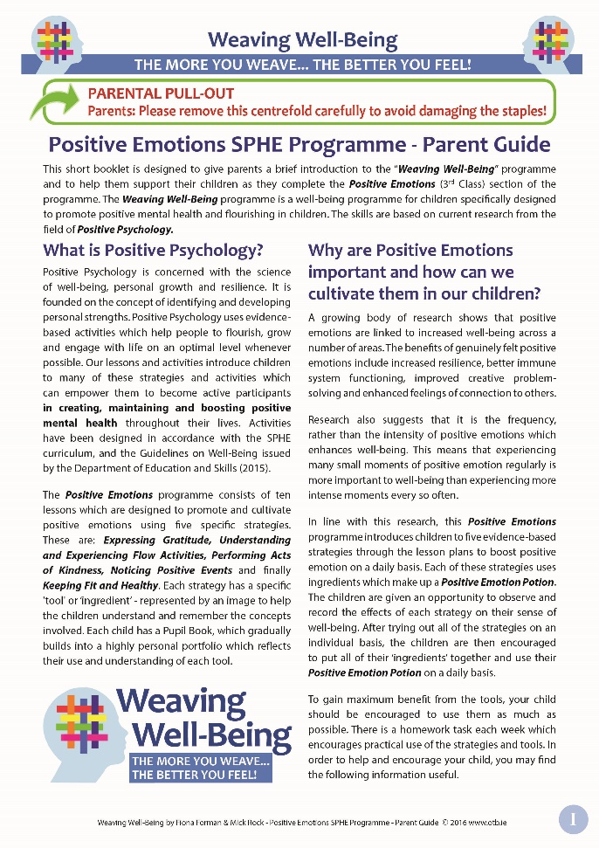
Structure of the Programme
A 4-page pull-out Parent Guide is contained in the centre of each Pupil Book
Suggestions for developing concepts in the home environment
Children can be reminded to ask their parents to detach the guide, to refer to on a weekly basis
Notes:
A pull-out Parent Guide is contained in each Pupil Book
This provides background information and offers suggestions for developing concepts in the home environment.
During the first lesson, children can be reminded to ask their parents to detach the guide to refer to on a weekly basis

Slide 21
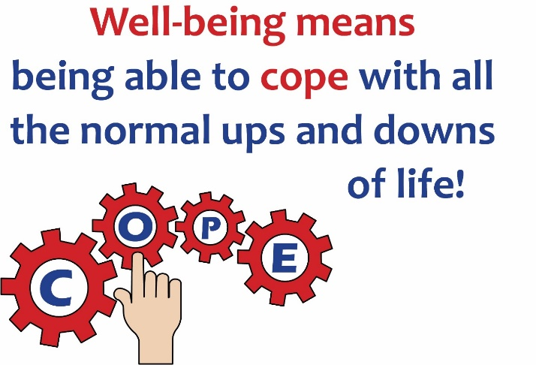
Structure of the Programme
Key features of each lesson:
Introductory PowerPoint
2 activities in the Pupil Book
Homework activity
Suggestions for integration with other curricular areas
Photocopiable worksheets
Videos and multi–media links
Posters
Notes:
Each lesson plan has an introductory PowerPoint
There are also 2 activities in the Pupil book, a
Homework Activity
Suggestions for integration with other curricular areas
Photocopiable worksheets
Videos (which include footage taken in Irish schools) and multi-media links.
Posters for classroom use are also included

Slide 22
Programme Overview
Notes:
Here is an overview of the entire programme, from second to sixth class. This diagram shows the programme overview and the focus of each year level. For second class, the focus is Character Strengths, for third it’s Positive Emotions, for fourth it’s Resilience, for fifth it’s Positive Relationships and for sixth it’s Empowering Beliefs.
We can see many elements of Seligman’s PERMA theory included across the different levels.

Slide 23
Programme Overview
Each level has a specific theme with related symbols and imagery.
Notes:
Each level has a specific theme with related symbols and imagery to make the lessons child-centred, appealing and easier for children to understand and absorb.

Slide 24
Programme Overview
2nd Class: Character Strengths
Theme: Treasure.
Each of the 24 strengths is presented as a treasure coin.
Notes:
Let’s now look at the theme of each year level. For 2nd Class, the focus is on Character Strengths and
the theme is Treasure. Each of the 24 strengths of Positive Psychology, for example, curiosity, creativity, bravery, kindness, optimism, teamwork, is presented as a treasure coin.

Slide 25
Programme Overview
3rd Class: Positive Emotions
Theme: Positive Emotion Potion
5 activities which enhance Positive Emotions are presented as ingredients in a ‘Positive Emotion Potion’
Notes:
For 3rd Class, the focus is Positive Emotions and the theme is ‘Positive Emotion Potion’
5 evidence-based activities which enhance Positive Emotions, including gratitude and flow, are presented as ingredients in a ‘Positive Emotion Potion’

Slide 26
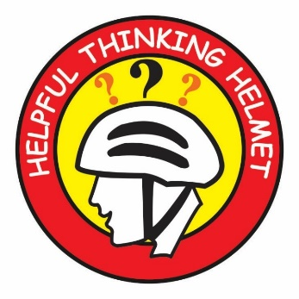
Programme Overview
4th Class: Tools of Resilience
Theme: Tools
6 resilience strategies are presented as ‘tools’, which the children can select from and use to cope with everyday challenges and disappointments
Notes:
For 4th Class the focus is Resilience and the theme is Tools. 6 resilience strategies, including mindfulness, perspective and healthy distraction are presented as ‘tools’ which the children can select from and use to cope with everyday challenges and disappointments.

Slide 27
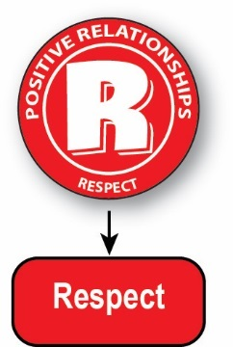
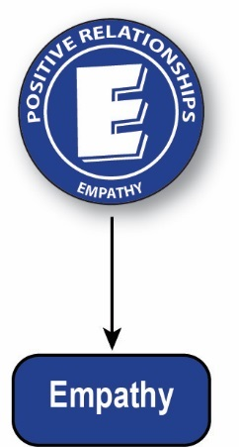
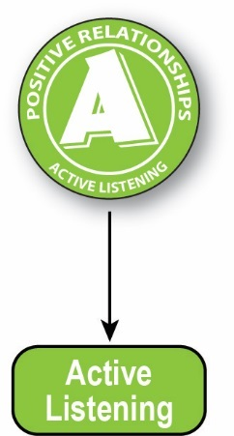
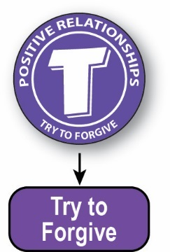
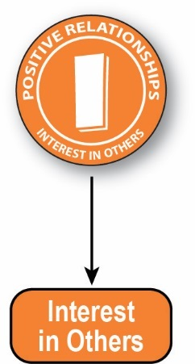
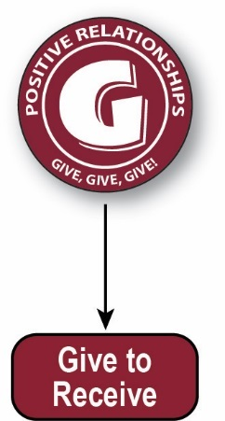
Programme Overview
5th Class: Positive Relationships
Theme: Steps to Positive Relationships
8 steps are presented. The first letters of each step combine to form the word ‘Relating’
Notes:
In 5th Class, the focus is Positive Relationships.
The theme is Steps to Positive Relationships. 8 steps to nurture relationships, including empathy and conflict resolution, are presented and the first letters of each step combine to form the word ‘Relating’

Slide 28
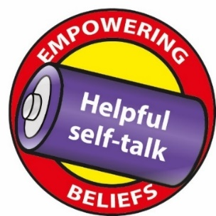
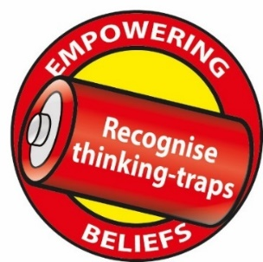
Programme Overview
6th Class: Empowering Beliefs
Theme: Batteries.
Eight beliefs are presented as batteries which give us energy to help us to reach our potential.
Notes:
Finally, in 6th Class the focus is on Empowering Beliefs.
The theme is batteries. Eight positive beliefs, including topics such as self-acceptance and helpful self-talk, are presented as batteries which give us energy to help us to reach our potential.

Slide 29
Overview of Lesson Plans
Notes:
This diagram, which is included in all of the Teacher Resource Books, gives an overview of all the lesson plans of the programme at a glance.

Slide 30
Incremental Approach
Notes:
An incremental approach is used to develop and reinforce key concepts across the year levels. This chart, which is in all Teacher Resource Books, shows these key concepts which are growth mindset, language of well-being, self-efficacy, character strengths, cognitive reframing, emotional competence, social competence and making a difference. An explanation of each concept is also included in the Teacher Resource Books.

Slide 31
Incremental Approach
The incremental approach is developed in a number of ways
A ‘Flashback Box’ is used throughout the programme
This reinforces skills by reminding children of previous lessons which are linked to the concept
Notes:
The incremental approach is developed in a number of ways. For example, A ‘Flashback’ box in the Pupil Books reminds them of previous knowledge or links to one of the earlier programmes which they may have studied. In this case, a brief discussion or recap on what the children remember from the prior programme can help to embed and deepen understanding of the concept involved.

Slide 32
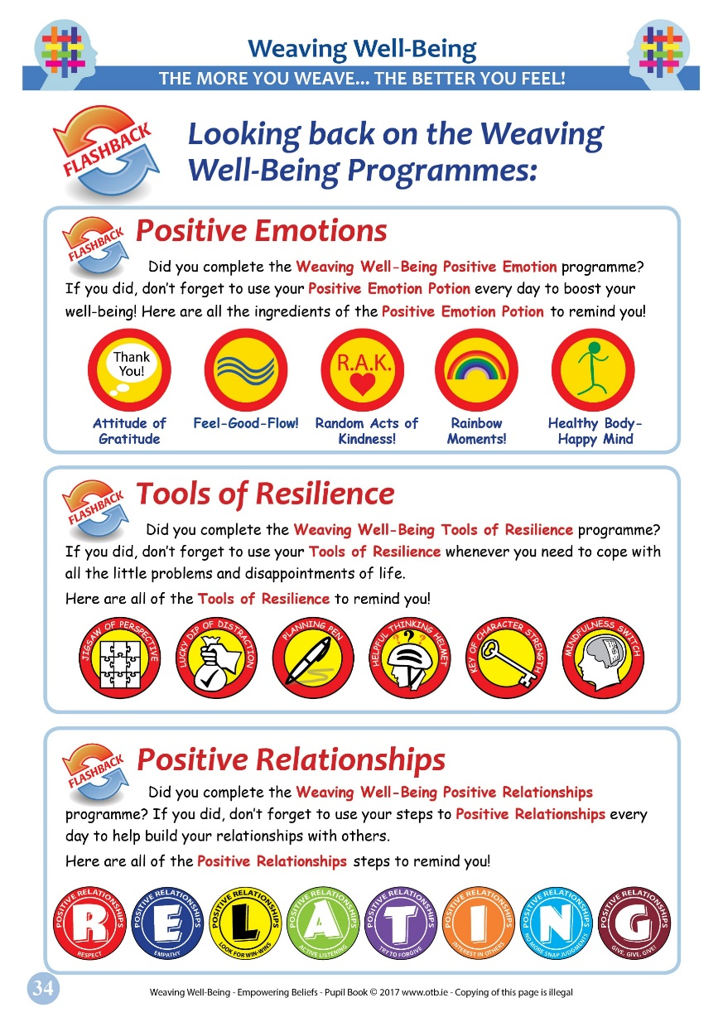
Incremental Approach
The back of each Pupil book also contains displays of the previous levels of the programme
Can be referenced and discussed at the teacher’s discretion
Notes:
The back of each Pupil book also contains displays of the previous levels of the programme
These can be referenced and discussed at the teacher’s discretion.

Slide 33
Implementation
If possible, deliver the programme in Term 1 or 2 (allows time for the concepts to become embedded over the rest of the year)
Deliver ‘Booster Sessions’ in Terms 2 or 3 – show the PowerPoints again and carry out some of the supplementary activities
Encourage parental involvement – refer to the Parental Guide
Notes:
Implementation of the programme is very straightforward as there is a PowerPoint for each lesson.
If possible, deliver the programme in Term 1 (allows time for the concepts to become embedded over the rest of the year)
Deliver ‘Booster Sessions’ in Terms 2 or 3 – show the PowerPoints again and carry out some of the supplementary activities
Encourage parental involvement also by referring to the Parental Guide

Slide 34
Implementation
Once the 10 lessons are completed, encourage the children to use the skills and concepts in daily life
Allows for the transfer of skills and helps concepts to become internalised
Displaying the classroom posters and referring to them frequently can help this process
Notes:
Once the 10 lessons are completed, encourage the children to use the skills and concepts in daily life.
This allows for the transfer of skills and helps concepts to become internalised
Displaying the classroom posters and referring to them frequently can help this process

Slide 35
Initial Independent Research
Tools of Resilience – (Mary I. Masters Dissertation) showed
up to 75% decrease on anxiety scores and
Enhanced levels of:
Positivity
Confidence
Autonomy
Self-efficacy
Problem-solving
Language of well-being
More research is planned for the near future.
Notes:
The first independent research on the Tools of Resilience programme as part of a Masters Dissertation from MIC college, Limerick recently showed decreases of up to 75% on children’s anxiety scores and
Enhanced levels of:
Positivity
Confidence
Autonomy
Self-efficacy
Problem-solving
Language of well-being
More research is planned for the near future.

Slide 36
Further Information
Further information can be obtained from our publishers’ website www.otb.ie/wwb
Orders can also be placed through this website
For updates, follow us on social media:
Twitter - @Weaving_Wb
https://twitter.com/Weaving_Wb
Facebook – Weaving Well-Being
https://www.facebook.com/weavingwb/
Notes:
Further information can be obtained from our publishers’ website www.otb.ie/wwb
Orders can also be placed through this website
For updates, relevant articles and further suggestions follow us on social media:
Twitter - @Weaving_Wb
https://twitter.com/Weaving_Wb
Facebook – Weaving Well-Being
https://www.facebook.com/weavingwb/

Slide 37
References
Alexander, T. (2002). A bright future for all. Mental Health Foundation: London.
Cannon, M., Coughlan, H., Clarke, M., Harley, M., & Kelleher, I. (2013). The Mental Health of Young People in Ireland: A report of the Psychiatric Epidemiology Research across the Lifespan (PERL) Group.
Durlak, J. A., Weissberg, R. P., Dymnicki, A. B., Taylor, R. D., & Schellinger, K. B. (2011). The impact of enhancing students’ social and emotional learning: A meta‐analysis of school‐based universal interventions. Child Development, 82(1), 405-432.
Layard, R., Clark, A. E., Cornaglia, F., Powdthavee, N., & Vernoit, J. (2014). What predicts a successful life? A life‐course model of well‐being. The Economic Journal, 124(580).

Slide 38
References
Lomas, T., Hefferon, K., & Ivtzan, I. (2014). Applied positive psychology: Integrated positive practice. Sage.
O’Connell, M. E., Boat, T., & Warner, K. E. (2009). Committee on the Prevention of Mental Disorders and Substance Abuse Among Children, Youth, and Young Adults: Research Advances and Promising Interventions. Preventing mental, emotional, and behavioral disorders among young people: Progress and possibilities.
Seligman, M. E. (2011). Flourish: A visionary new understanding of happiness and well-being. Simon and Schuster.
Waters, L. (2011). A review of school-based positive psychology interventions. The Educational and Developmental Psychologist, 28(2), 75-90.

