Slide 1
Positive Relationships
Slide
16
Lesson 2
Step 1: Respect

Slide 2
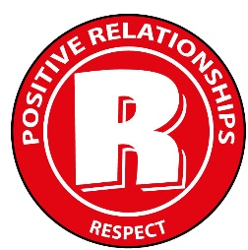
Respect
Slide
17
What do you think the word ‘respect’ means?
We can think of respect in two ways:
A feeling of admiration for someone you really look up to.
A way of treating people based on the idea that we are all equal and important. This means accepting people as they are and recognising their rights and needs.
This programme is based on the second meaning.

Slide 3
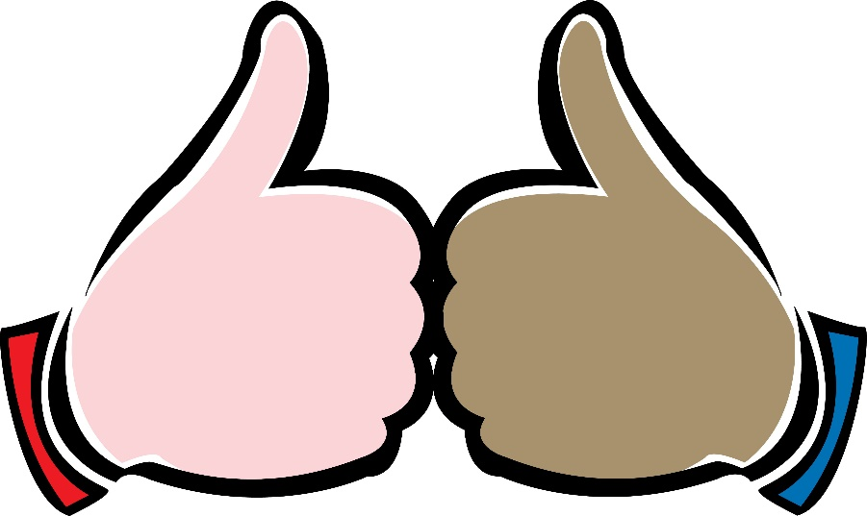
Treating Others with Respect
Slide
18
Let’s think about what it means to show others respect.
When we show respect to others, we value their rights and feelings.
We show that we understand that we are all equally important.
We can accept that others are different and may have different opinions to us.

Slide 4
Why is Respect so Important in Relationships?
Slide
19
Why do you think that respect is so important in relationships?
Respect is important in relationships because it is an attitude and a way of behaving which values people’s feelings.
Everybody has the right to feel equal and important in their own way.

Slide 5
How Does it Feel?
Slide
20
Now think about a friend who treats you with respect. Remember this means they show you that you are important and equal to them.
Think for a minute… How does
this make you feel?
Share your thoughts in pairs or with the class.
It can make you feel…
Important, valued, accepted, equal, strong, like you matter…
Never think you are worth any more or any less than another person

Slide 6
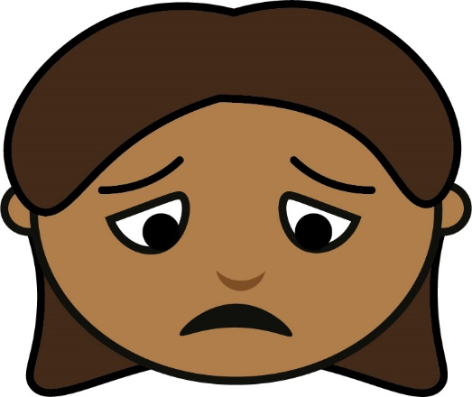
What Does Disrespect Feel Like?
Slide
21
Have you ever felt disrespected by someone?
Think for a minute… How did that make you feel?
Maybe it made you feel…
Small, useless, weak, unimportant, worthless, unaccepted…

Slide 7
Respectful Relationships
Slide
22
We can see how respect and disrespect make people feel.
So for healthy and positive relationships with others, we need to start with an attitude of respect.
Next we are going to look at a list of guidelines (do’s and don’ts) for treating others with respect.
Before we do that, what do you think should be on the list?

Slide 8
Guidelines for Treating Others with Respect
Slide
23
Do:
Treat others the way you would like to be treated. Remember that everyone is equal and important, even if they are different to you.
Listen carefully.
Think about how people feel.
Remember the rights of others.
Don’t:
Make people feel small or bad about themselves.

Slide 9
Self-Respect
Slide
24
Don’t forget to treat yourself with respect too!
How can you treat yourself with respect?
Make good choices about your health and well-being.
Act in ways which make you happy about the kind of person you are becoming!
Respect Yourself
Use Self-Kindness
Respect Your Future Self

Slide 10
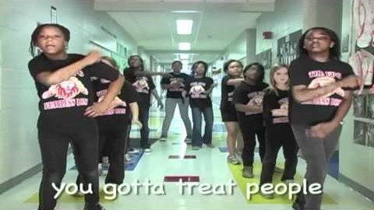
Have a look!
Slide
25
Lets watch a video about respect.
Notes:
www.otb.ie/wwb-respect-rap

Slide 11
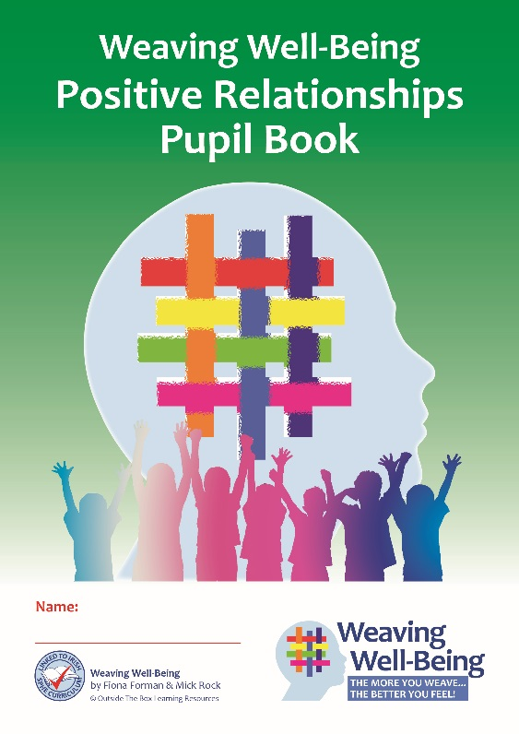
Pupil Book Time
Slide
26
Now it’s time to do some activities in our Weaving Well-Being Pupil Books.
We will also have a homework challenge to try this week to help us to create our own well-being.

