Slide 1
Lesson 2 Jigsaw of Perspective
Slide
9

Slide 2
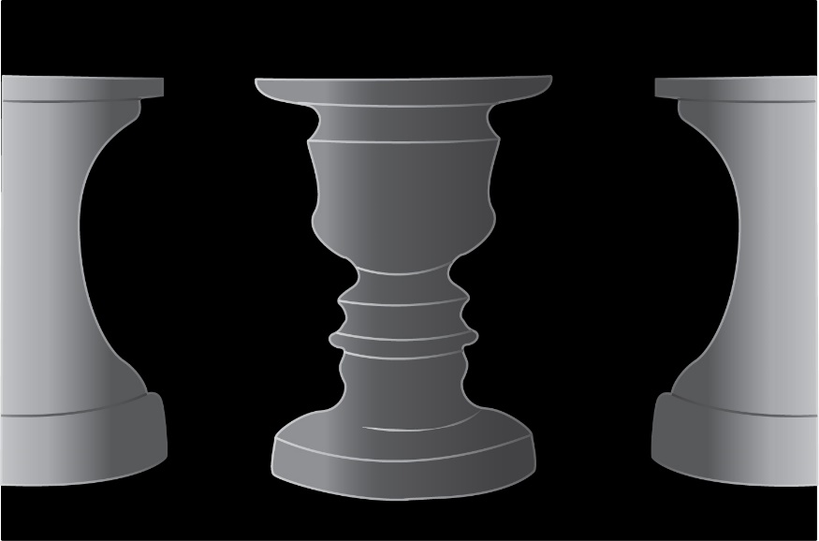
What is Perspective?
Slide
10
Perspective means how you see things, and think about things.
What do you see when you first look at this picture?
Some people see a vase, some people see two faces!
It can be helpful for us to remember that we don’t always see the full picture at first!

Slide 3
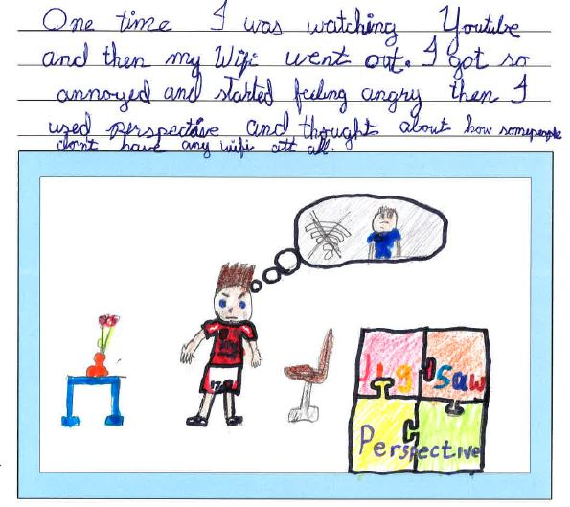
How Perspective Helps Us..
Slide
11
The same is true about how we sometimes
see our problems and disappointments.
When we are upset or annoyed, sometimes we only see our problem and we forget to see and think about all the other good things that we have in our lives.
It’s a bit like only seeing one piece of a jigsaw, and not seeing the full picture!

Slide 4
The Jigsaw of Perspective
Slide
12
We can think of all the wonderful
things in our lives as parts of a jigsaw.
If we have a problem or worry, we can think of it as only one piece of the jigsaw.
The same is true if we have a fight or conflict with our friends and/or family.
We can think of the conflict as one piece of the jigsaw, but try to
remember all the other good pieces. This can help us not to blow
things out of proportion!

Slide 5
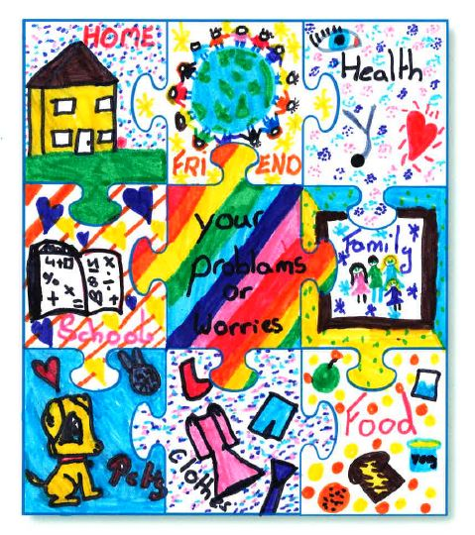
Making and Using Your Jigsaw of Perspective
Slide
13
Now it’s time to make and use your own
Jigsaw of Perspective.
In your Pupil Book, look at the blank jigsaw.
Now think about all the things in your life
which you are lucky to have - family, friends,
home, toys, books, pets, etc.
Draw and write them on the blank pieces of your jigsaw. Use lots of colour!
The next time you over-react to a little problem or worry
and need help to see the big picture, look at your Jigsaw of Perspective,
or even just think about it! Time for our Pupil Book…..

Slide 6
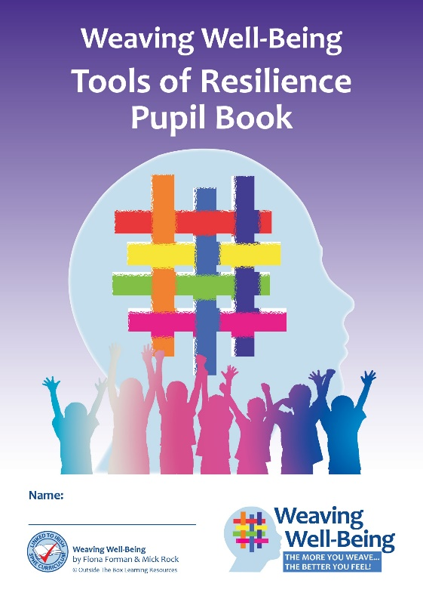
Pupil Book Time
Slide
14
Now it’s time to do some activities in our Weaving Well-Being Pupil Books.
We will also have a home-work challenge to try this week to help us to create our own well-being.

