Slide 1
Positive Emotions
Slide
46
Lesson 7
Ingredient 4
Rainbow Moments

Slide 2
Our Next Ingredient….
Slide
47
Can you remember our first three ingredients?
Let’s talk about how you have been using them.
It’s now time to learn about our next ingredient:
Rainbow Moments!

Slide 3
What are Rainbow Moments?
Slide
48
Rainbow Moments are all of those lovely little moments during the day when things go well for us. Can you think of any examples?
You play a fun game at break, you watch a great movie, you spend time with your friend,
you notice something beautiful, someone
is kind or helpful to you, you feel proud
of yourself for finishing something
difficult...

Slide 4
Rainbow Moments….
Slide
49
Even a bad day has Rainbow Moments!
The trick is to train your mind to notice them!
Our minds are already very good at noticing the bad things that happen, and thinking about them too much.
So let’s re-train it!

Slide 5
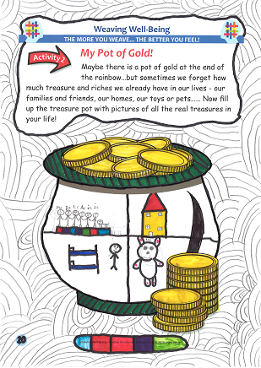
Let’s Notice our Rainbow Moments..
Slide
50
Your challenge this week is to re-train your mind so that it starts to notice your
Rainbow Moments!
Let’s try to notice three each day
and write them down. Good Luck
and enjoy your challenge!

Slide 6
Have a look!
Slide
51
Let’s watch a video of children talking about their own Rainbow Moments and how they make them feel.

Slide 7
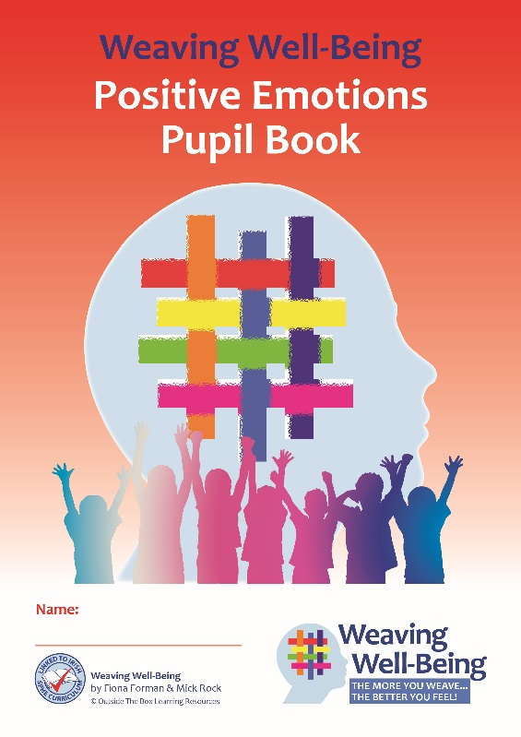
Pupil Book Time
Slide
52
Now it’s time to do some activities in our Weaving Well-Being Pupil Books.
We will also have a home-work challenge to try this week to help us to create our own well-being.

