Slide 1
Character Strengths
Slide
1
Lesson 1
What is Well-Being?
Part 1

Slide 2
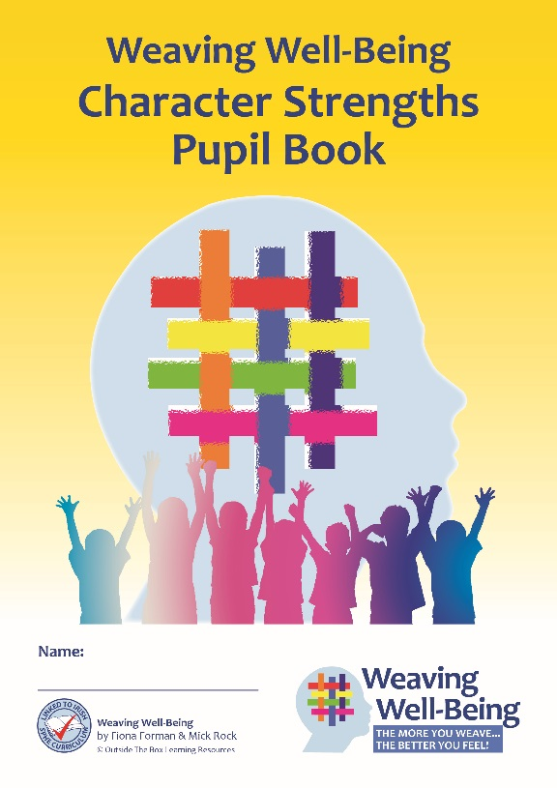
Welcome
Slide
2
Welcome to the Weaving Well-Being Character Strengths programme.
Soon we will be learning all about Well-Being and Character Strengths!

Slide 3
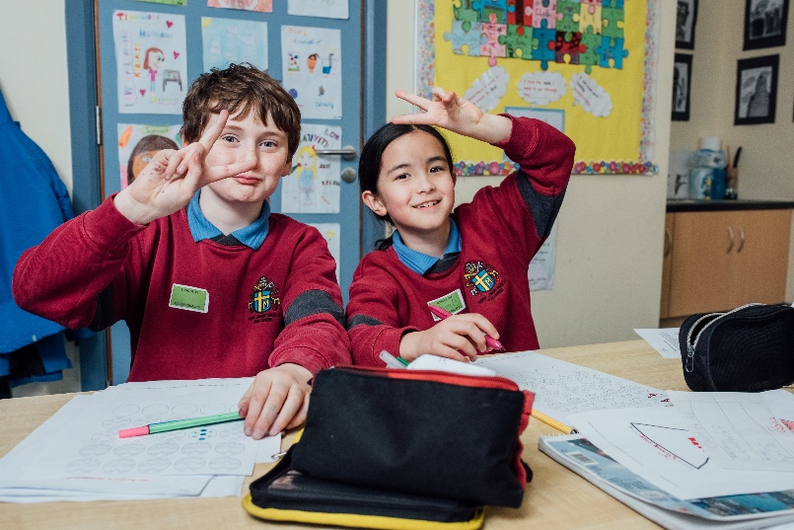
What is Well-Being?
Slide
3
What do you think Well-Being means?
It’s about things like feeling happy and strong, and enjoying your life.
Can you name some things you do which make you feel happy?

Slide 4
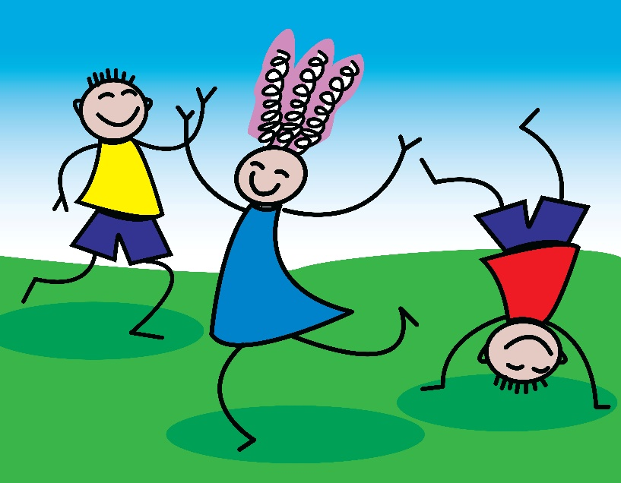
What is Well-Being?
Slide
4
There are lots of different signs of well-being.
Let’s look at 3 signs of well-being now.
As we look at each sign, you can decide whether this was something you had thought of already!

Slide 5
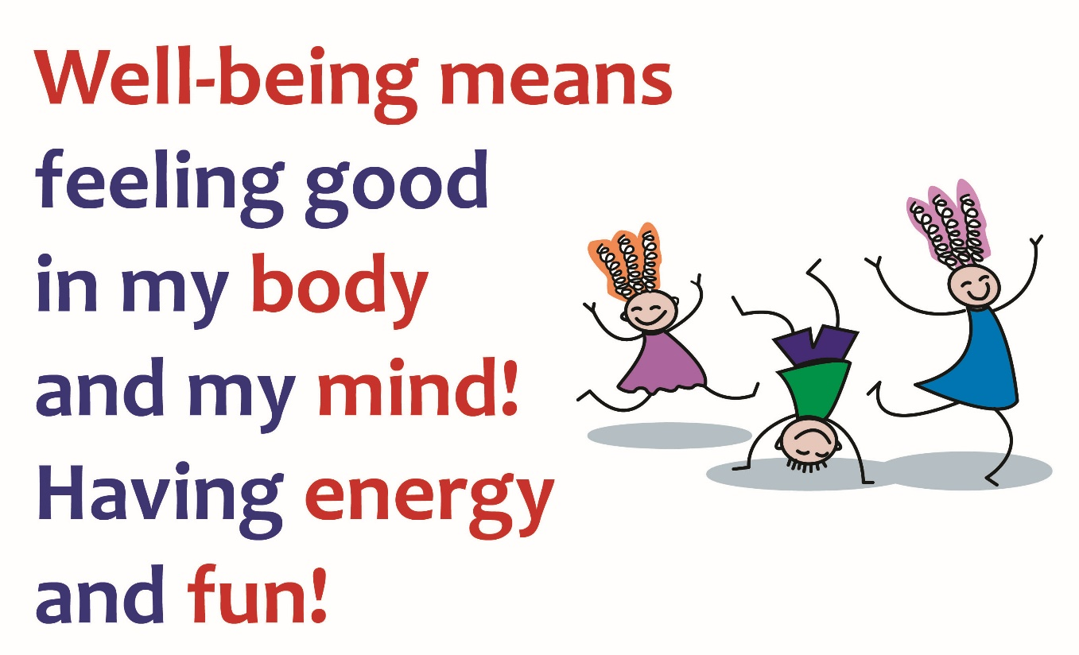
Signs of Well-Being
Slide
5
Do you think this is an important part of your well-being? Why?

Slide 6
Signs of Well-Being
Slide
6
What gives you energy?
What do you do to have fun?

Slide 7
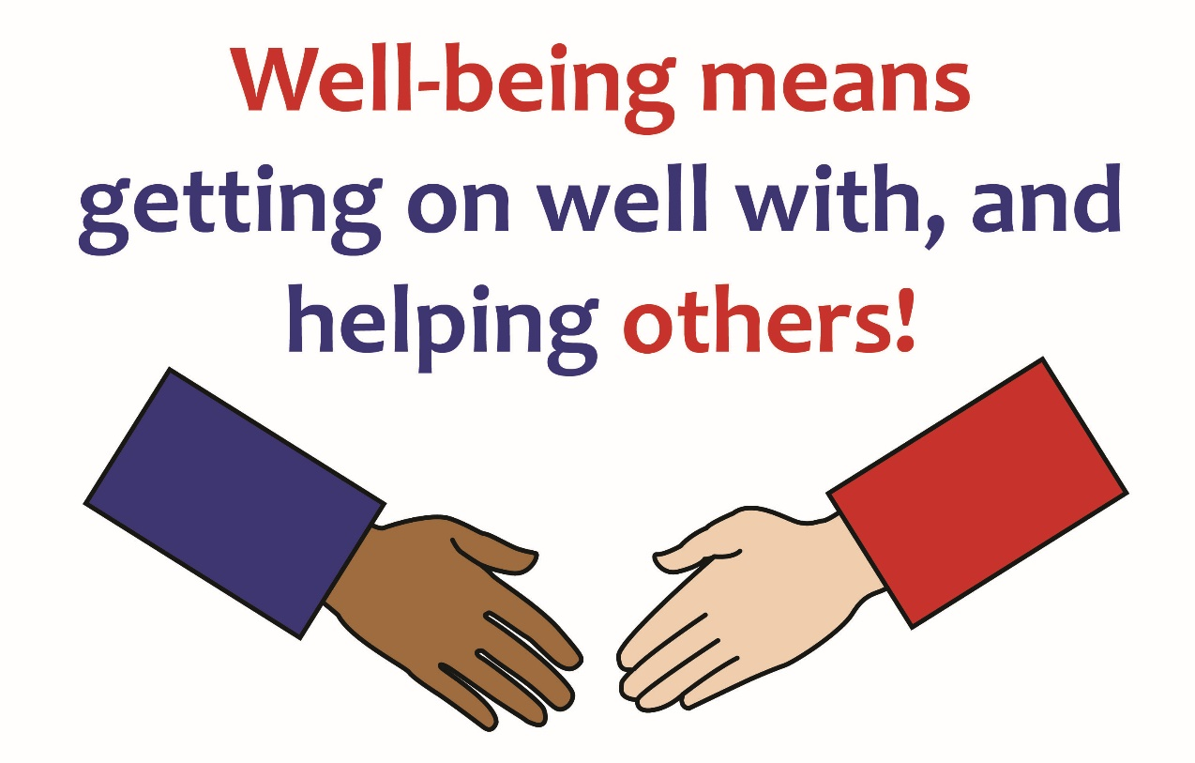
Signs of Well-Being
Slide
7
Do you think this is an important part of your well-being? Why?

Slide 8
Signs of Well-Being
Slide
8
Are you happy when you are getting along with others?
How does helping others make you feel?

Slide 9
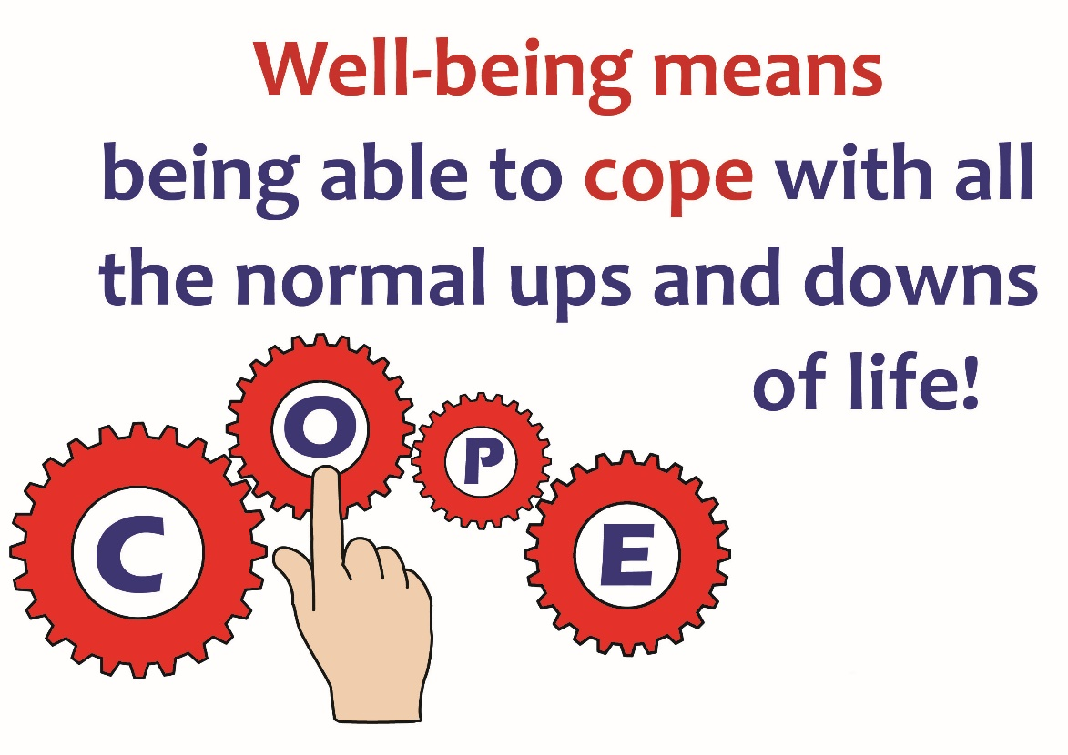
Signs of Well-Being
Slide
9
Do you think this is an important part of your well-being? Why?

Slide 10
Signs of Well-Being
Slide
10
We all have ups and downs in our life – this is very normal!
Do you remember a time you were able to cope when something did not go well for you?

Slide 11
Well-Being
Slide
11
Here are the 3 signs of well-being we learned about this week.
Next week we will learn about some more!
Now let’s listen to a rap about the signs of well-being!

Slide 12
Have a look!
Slide
12
This video shows children performing the Weaving Well-Being Rap which tells us how we can help our well-being every day (2:41).
Notes:
www.otb.ie/wwb-rap

Slide 13
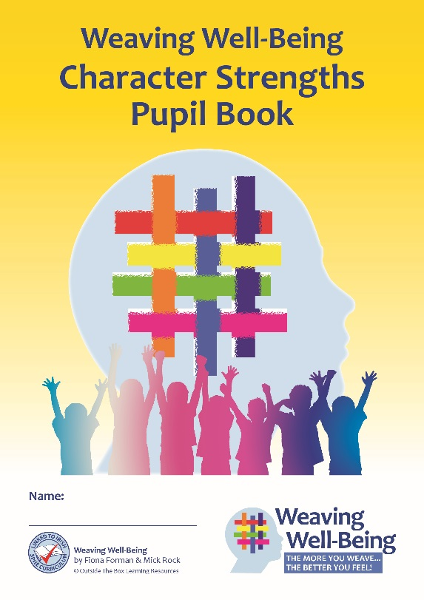
Pupil Book Time
Slide
13
Now it’s time to do some activities in our Weaving Well-Being Pupil Books.
We will also have a home-work challenge to try this week, to help us to create our own well-being.
So now let’s start Weaving our Well-Being!

