Slide 1
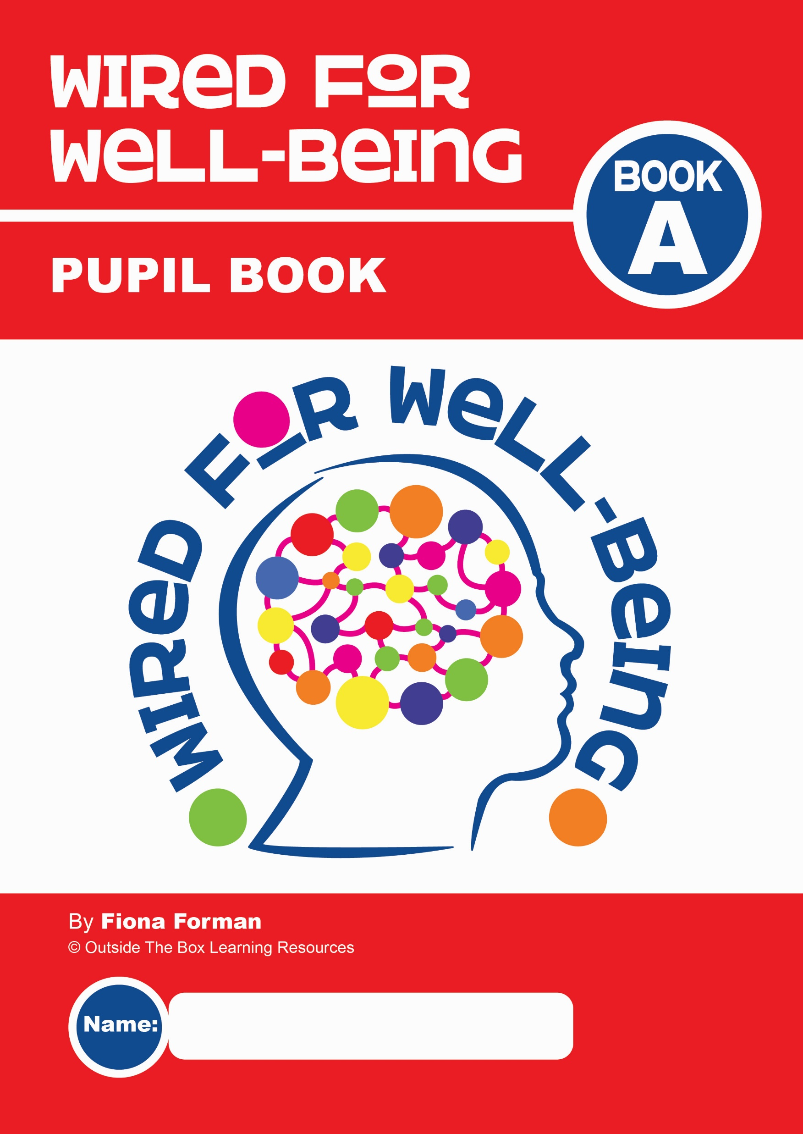
By
Fiona Forman
Slide 1

Slide 2
SKILL 1: UNDERSTAND YOUR WELL-BEING!
Welcome to:
Aim:
To help you to understand and improve your own well-being
Slide 2

Slide 3
SKILL 1: UNDERSTAND YOUR WELL-BEING!
Why do you think we should spend time learning about how to improve our well-being?
Research shows that people with high levels of well-being are:
Happier
More resilient
More successful in life
Healthier
More confident
More caring and more helpful to others
Slide 3

Slide 4
SKILL 1: UNDERSTAND YOUR WELL-BEING!
Did you know that adolescence is an especially important time for you to learn about well-being?
Why do you think that is?
It’s because during adolescence you:
Face a lot of changes
Have more challenges
Have more opportunities
Develop habits that will last into adulthood
Slide 4

Slide 5
SKILL 1: UNDERSTAND YOUR WELL-BEING!
Let’s learn a little about the Wired for Well-Being Programme
8 Lessons
New well-being skill in each lesson
2 activities per lesson in your Pupil Book
Your goal is to try the skill out for the week, reflect on how it affects your mood and well-being and record it in your Pupil Book
Like any new skill, it takes time and effort to see results and improvements!
The more effort you put in, the more benefits you will get!
Slide 5

Slide 6
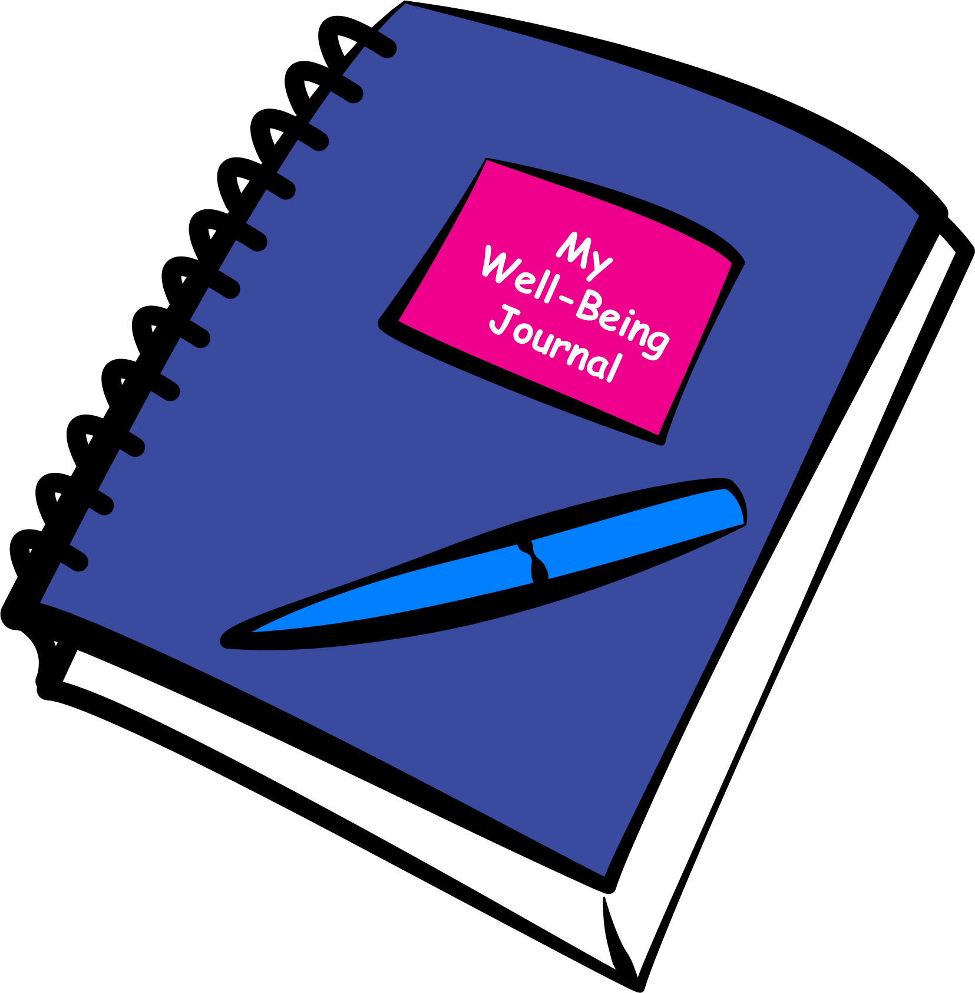
SKILL 1: UNDERSTAND YOUR WELL-BEING!
Well-Being Journal
It’s useful for you to also use a notebook as your own personal Well-Being Journal
Use it to reflect on and record any thoughts, quotes or ideas on a personal level
You will also need it from Lesson 4 onwards to continue some of the activities of the programme
There is a list of Well-Being Prompts at the back of the Pupil Book – try them out!
It’s completely confidential for your own use at home!
Slide 6

Slide 7
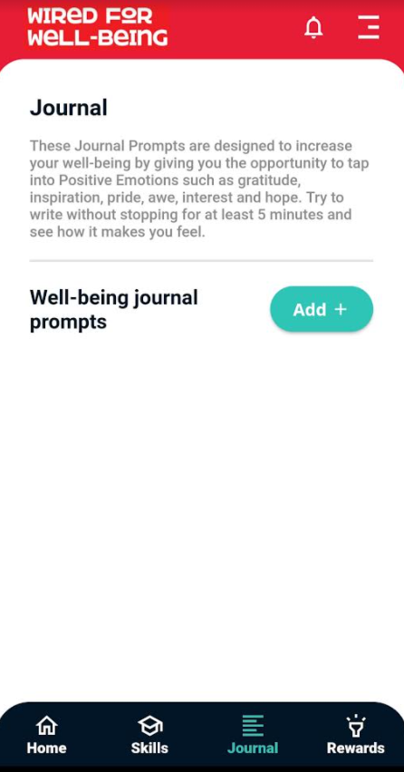
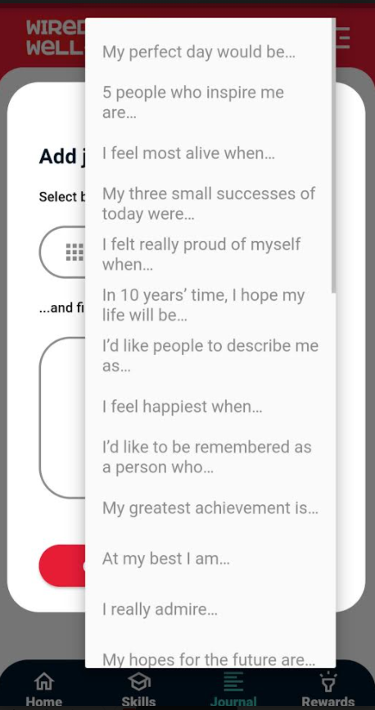
SKILL 1: UNDERSTAND YOUR WELL-BEING!
If you are using the Wired for Well-Being App, you will see that there is a journal feature on the home screen for you to use.
You might prefer to use this instead of the Well-Being Journal!
Slide 7

Slide 8
SKILL 1: UNDERSTAND YOUR WELL-BEING!
Many activities and skills improve our well-being.
Some can actually change or rewire the structure of our brains!
This is called neuroplasticity – (more in lesson 2).
We can learn how to become Wired for Well-Being!
So, let’s get started on Skill 1 - Understand Your Well-Being!
Slide 8

Slide 9
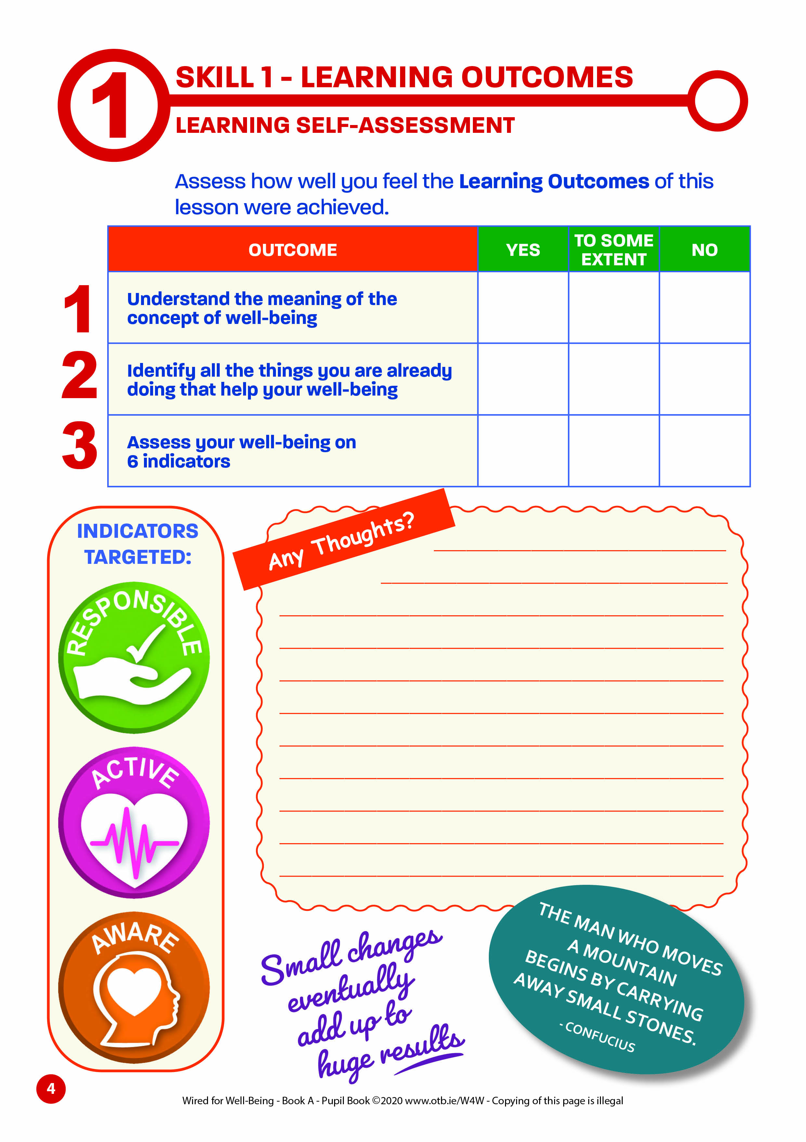
SKILL 1: UNDERSTAND YOUR WELL-BEING!
Learning Outcomes
That you will:
Understand the meaning of the concept of well-being
Identify all the things you are already doing that help your well-being
Assess your well-being on 6 indicators
Think about these outcomes during each lesson – at the end of each one there is a self-assessment in your Pupil Book for you to reflect on how well you think they were achieved.
Slide 9

Slide 10
SKILL 1: UNDERSTAND YOUR WELL-BEING!
Skill 1: Warm-up Activity: Well-being Word Challenge
Let’s have a warm up activity before we start!
The next slide has a Well-Being Word-Cloud.
Study it for 30 seconds for inspiration.
In pairs, brainstorm and write down as many well-being words as you can within another 30 seconds...
They don’t have to be from the word-cloud!
See which pair can get the most words!
Get ready!
Slide 10

Slide 11
Slide 11

Slide 12
SKILL 1: UNDERSTAND YOUR WELL-BEING!
Now write down as many well-being words as you can for the next 30 seconds!
Which pair got the most?
Was it difficult?
Maybe it was hard as we’re not used to thinking about our well-being!
Your brain is now thinking about well-being and what it means!
What does well-being mean to you?
Slide 12

Slide 13
SKILL 1: UNDERSTAND YOUR WELL-BEING!
Feedback:
Did you consider that well-being has lots of different parts or dimensions – multi-dimensional?
Sometimes the words mental-health or mental well-being are used when we talk about well-being. Mental health is a really important part of it!
The other dimensions include:
PHYSICAL WELL-BEING
EMOTIONAL WELL-BEING
SPIRITUAL WELL-BEING
SOCIAL
WELL-BEING
Slide 13

Slide 14
SKILL 1: UNDERSTAND YOUR WELL-BEING!
All of these parts combine and overlap to help us to feel good about ourselves in our day-to-day lives.
PHYSICAL
SPIRITUAL
SOCIAL
Let’s take a quick look at each part now.
EMOTIONAL
MENTAL
Slide 14

Slide 15
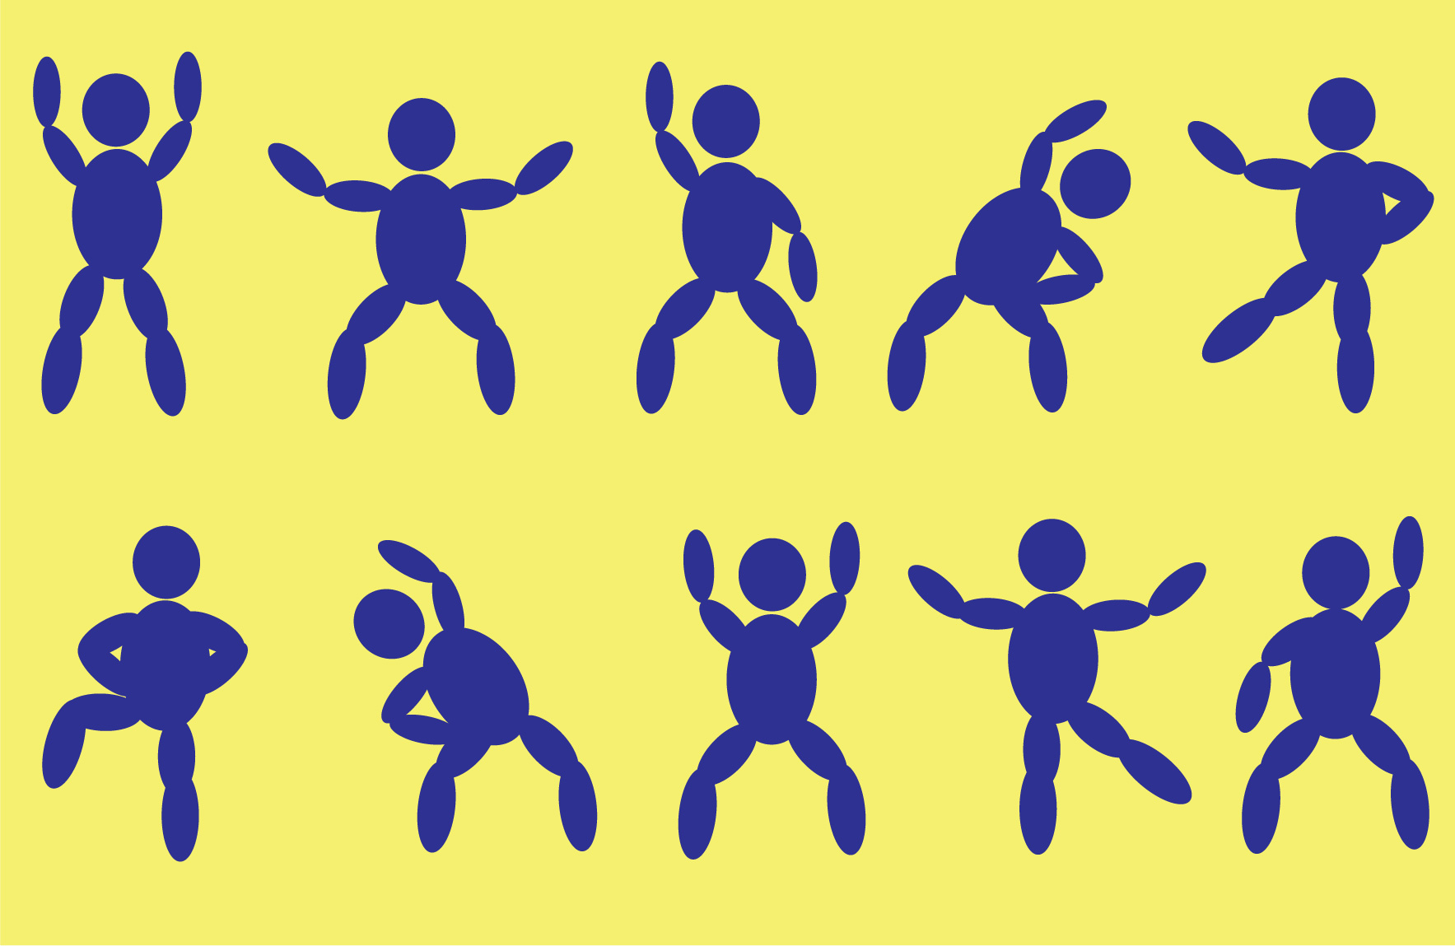
SKILL 1: UNDERSTAND YOUR WELL-BEING!
PHYSICAL WELL-BEING
Keeping your body strong and healthy through physical activity, sleep and healthy eating.
Looking after our physical well-being can benefit our mental, social and emotional well-being too!
Slide 15

Slide 16
SKILL 1: UNDERSTAND YOUR WELL-BEING!
Keeping your mind healthy, through becoming aware of your thoughts and learning how they affect your feelings and behaviour.
MENTAL
WELL-BEING
DON’T BELIEVE
EVERYTHING
YOU THINK
Slide 16

Slide 17
SKILL 1: UNDERSTAND YOUR WELL-BEING!
Understanding and dealing with your emotions in helpful, rather than unhelpful ways.
EMOTIONAL WELL-BEING
Although being happy is really important, it’s not normal or possible to be happy all the time!
It’s normal to have lots of different emotions, to feel sad, angry, disappointed, frustrated, worried etc. That’s what makes us human!
not to
feel okay!’
‘It’s okay
Slide 17

Slide 18
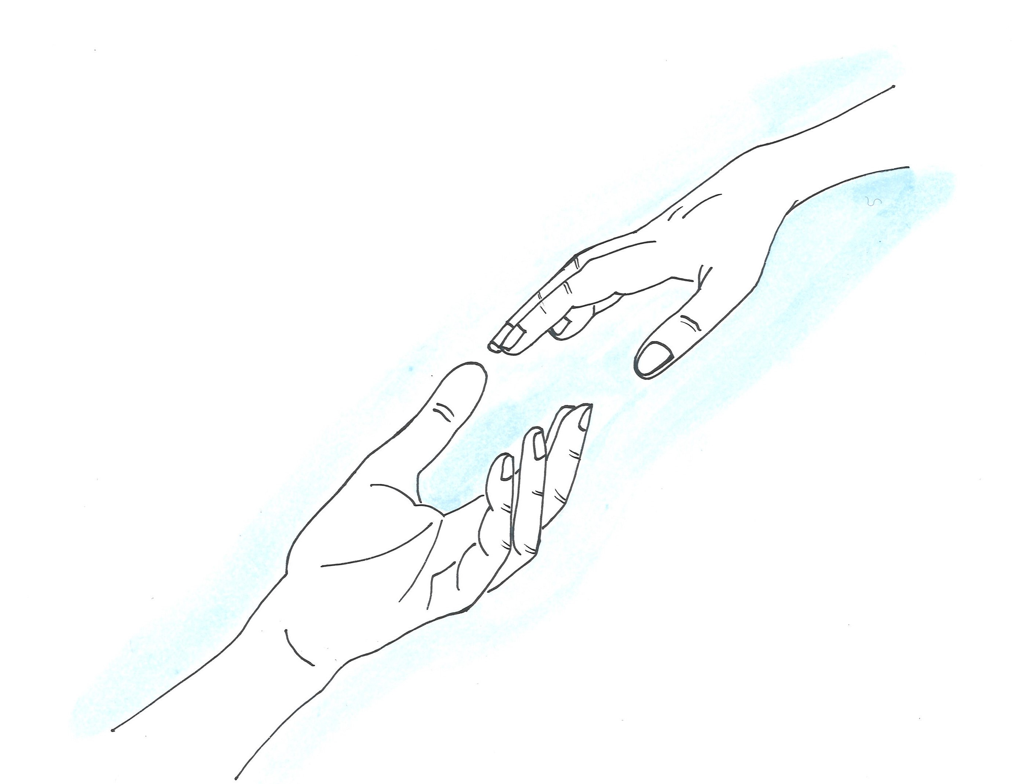
SKILL 1: UNDERSTAND YOUR WELL-BEING!
Keeping your relationships with other people positive through giving and receiving support, friendship, love and care.
SOCIAL
WELL-BEING
It’s not the amount of relationships that we have that’s important, it’s the quality of them that matters!
Slide 18

Slide 19
SKILL 1: UNDERSTAND YOUR WELL-BEING!
SPIRITUAL
WELL-BEING
Doesn’t necessarily mean that you are religious…
It means that you have purpose and meaning in your life, you feel connected to something bigger than just yourself!
It’s so important for us not to become too narrowly focused on ourselves!
Slide 19

Slide 20
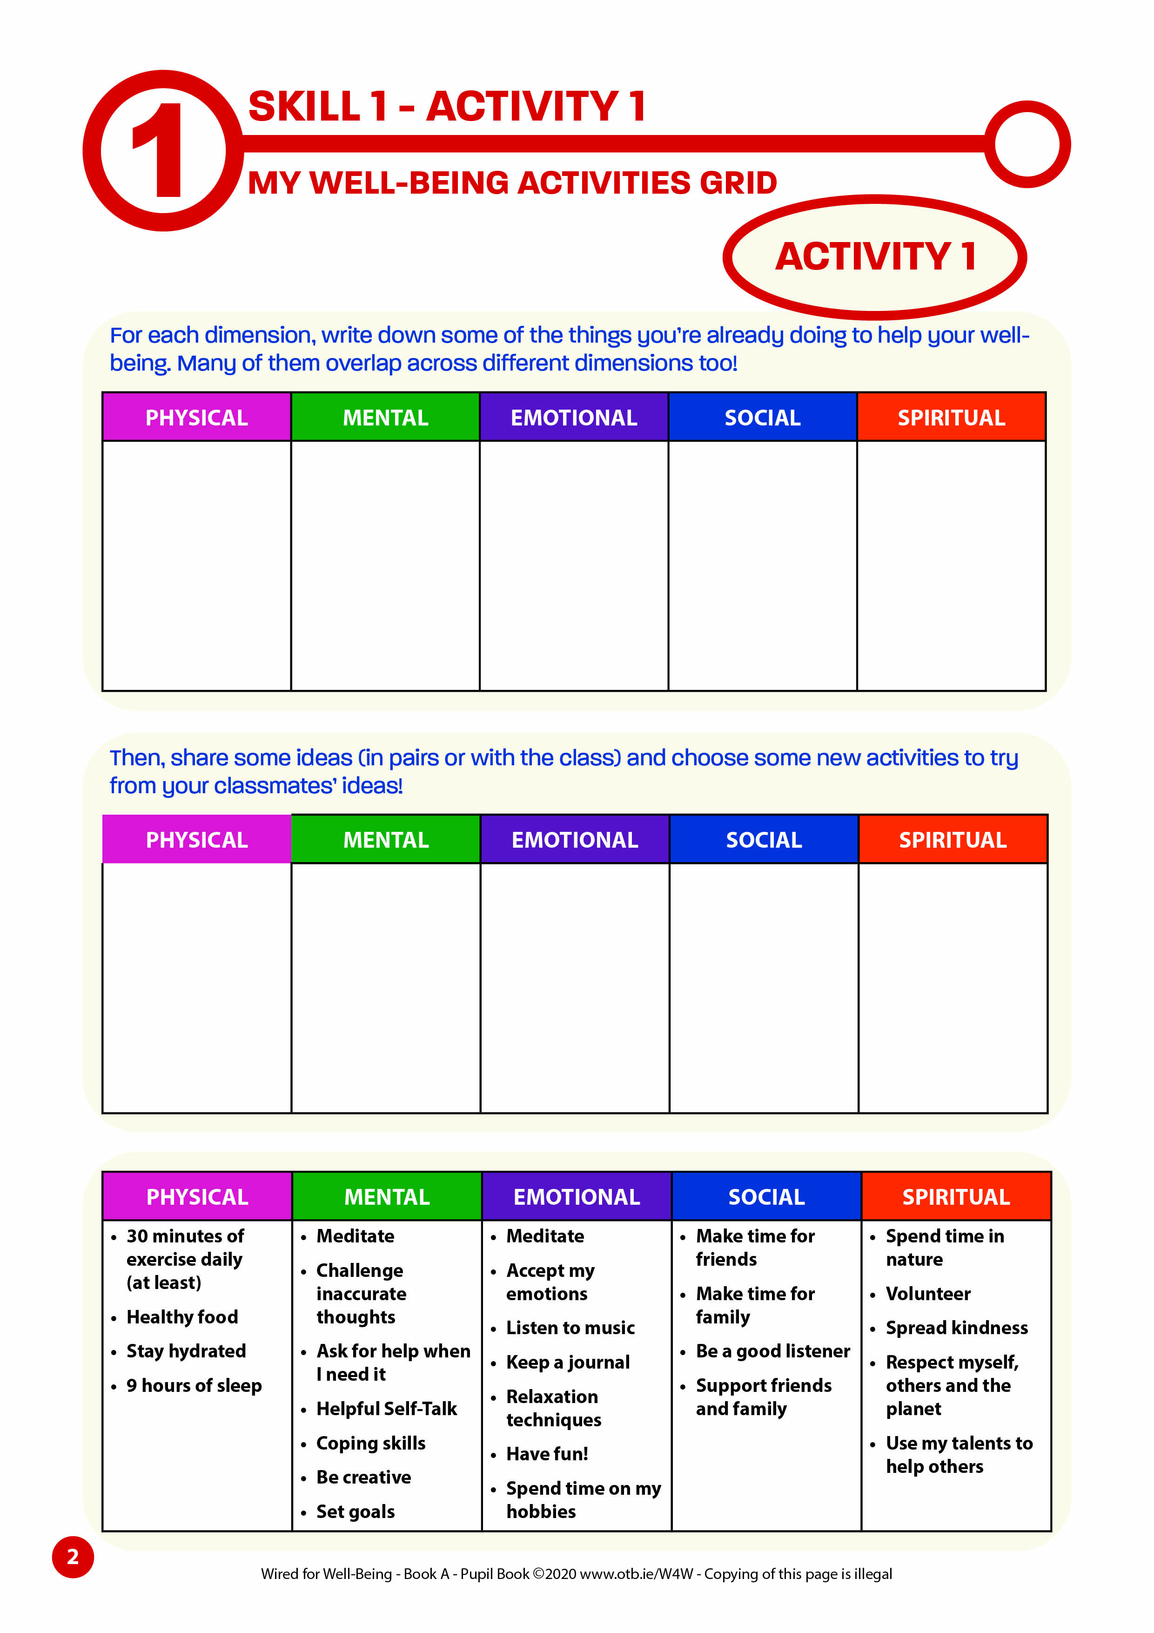
SKILL 1: UNDERSTAND YOUR WELL-BEING!
Pupil Book Activity 1 – Page 2 My Well-Being Activities Grid
Reflect on your own well-being now.
What do you already do to help your well-being in each of these areas?
Complete this activity in your Pupil Book. (Page 2)
There are some ideas at the bottom of that page!
Share in pairs and then with the class.
Slide 20

Slide 21
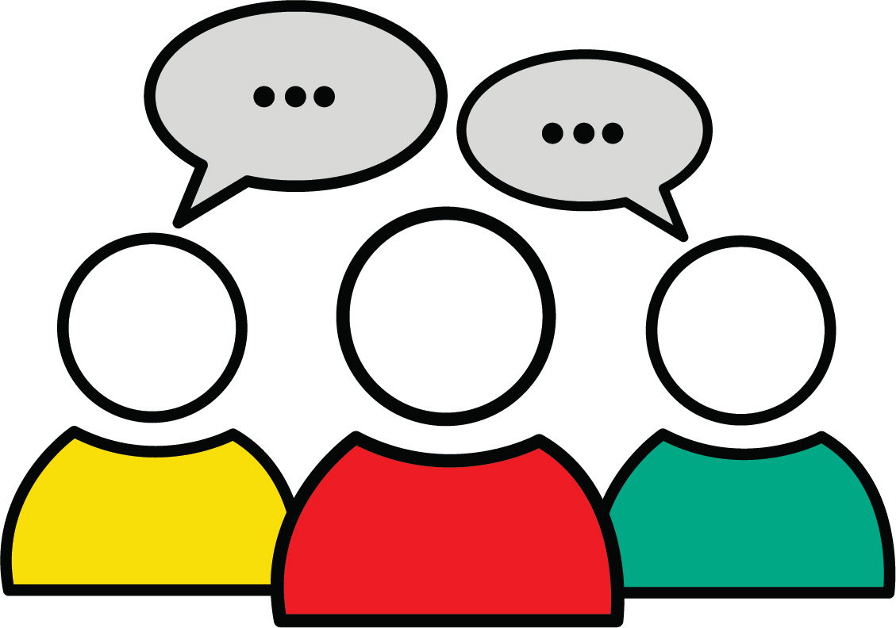
SKILL 1: UNDERSTAND YOUR WELL-BEING!
Feedback:
My Well-Being Activities Grid
Let’s share ideas on what you already do to improve your well-being in each area.
Take note of any helpful ideas from other people that you are not already using and that you might like to try!
Slide 21

Slide 22
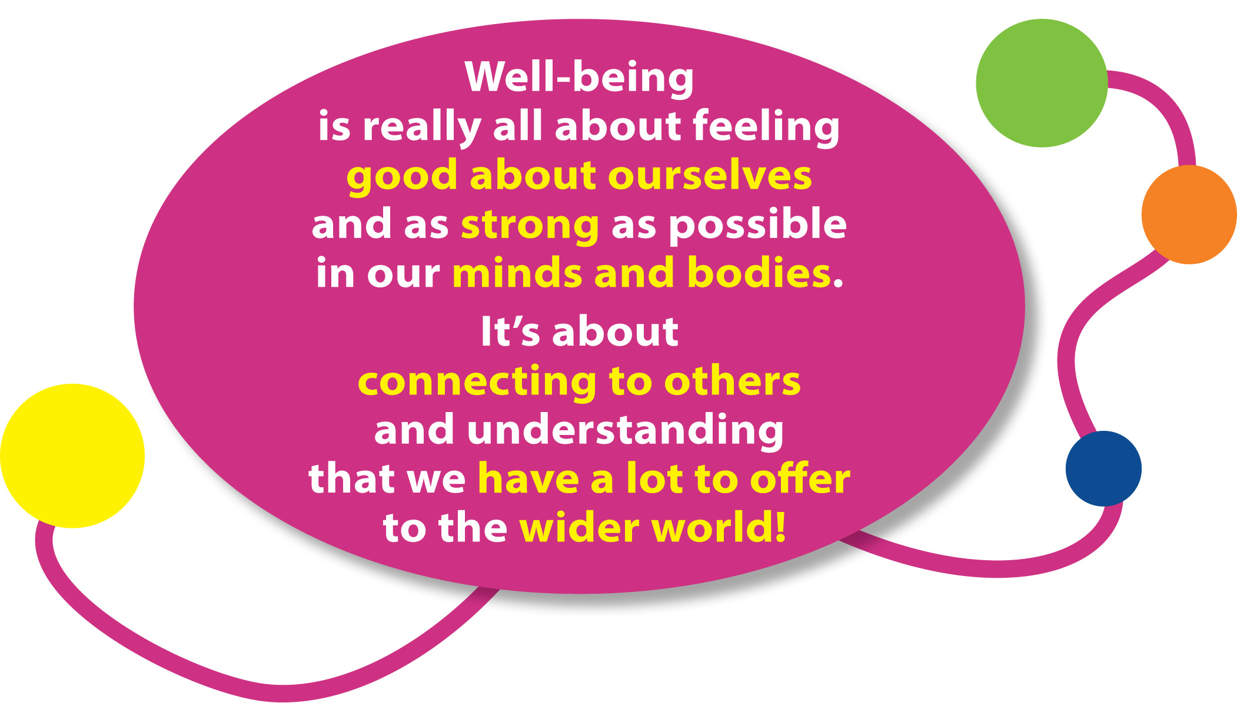
SKILL 1: UNDERSTAND YOUR WELL-BEING!
Here is a helpful way to understand what well-being is all about:
Slide 22

Slide 23
SKILL 1: UNDERSTAND YOUR WELL-BEING!
Take a look!
Have a look now at this video called ‘Snap Your Joy’ which sums up what well-being feels like!
www.otb.ie/W4W-snap-your-joy
Slide 23
Notes:
www.otb.ie/W4W-snap-your-joy
https://youtu.be/7_XSQfi8cos

Slide 24
SKILL 1: UNDERSTAND YOUR WELL-BEING!
Now it’s time to do some activities in your Wired For Well-Being Pupil Book.
Slide 24

Slide 25
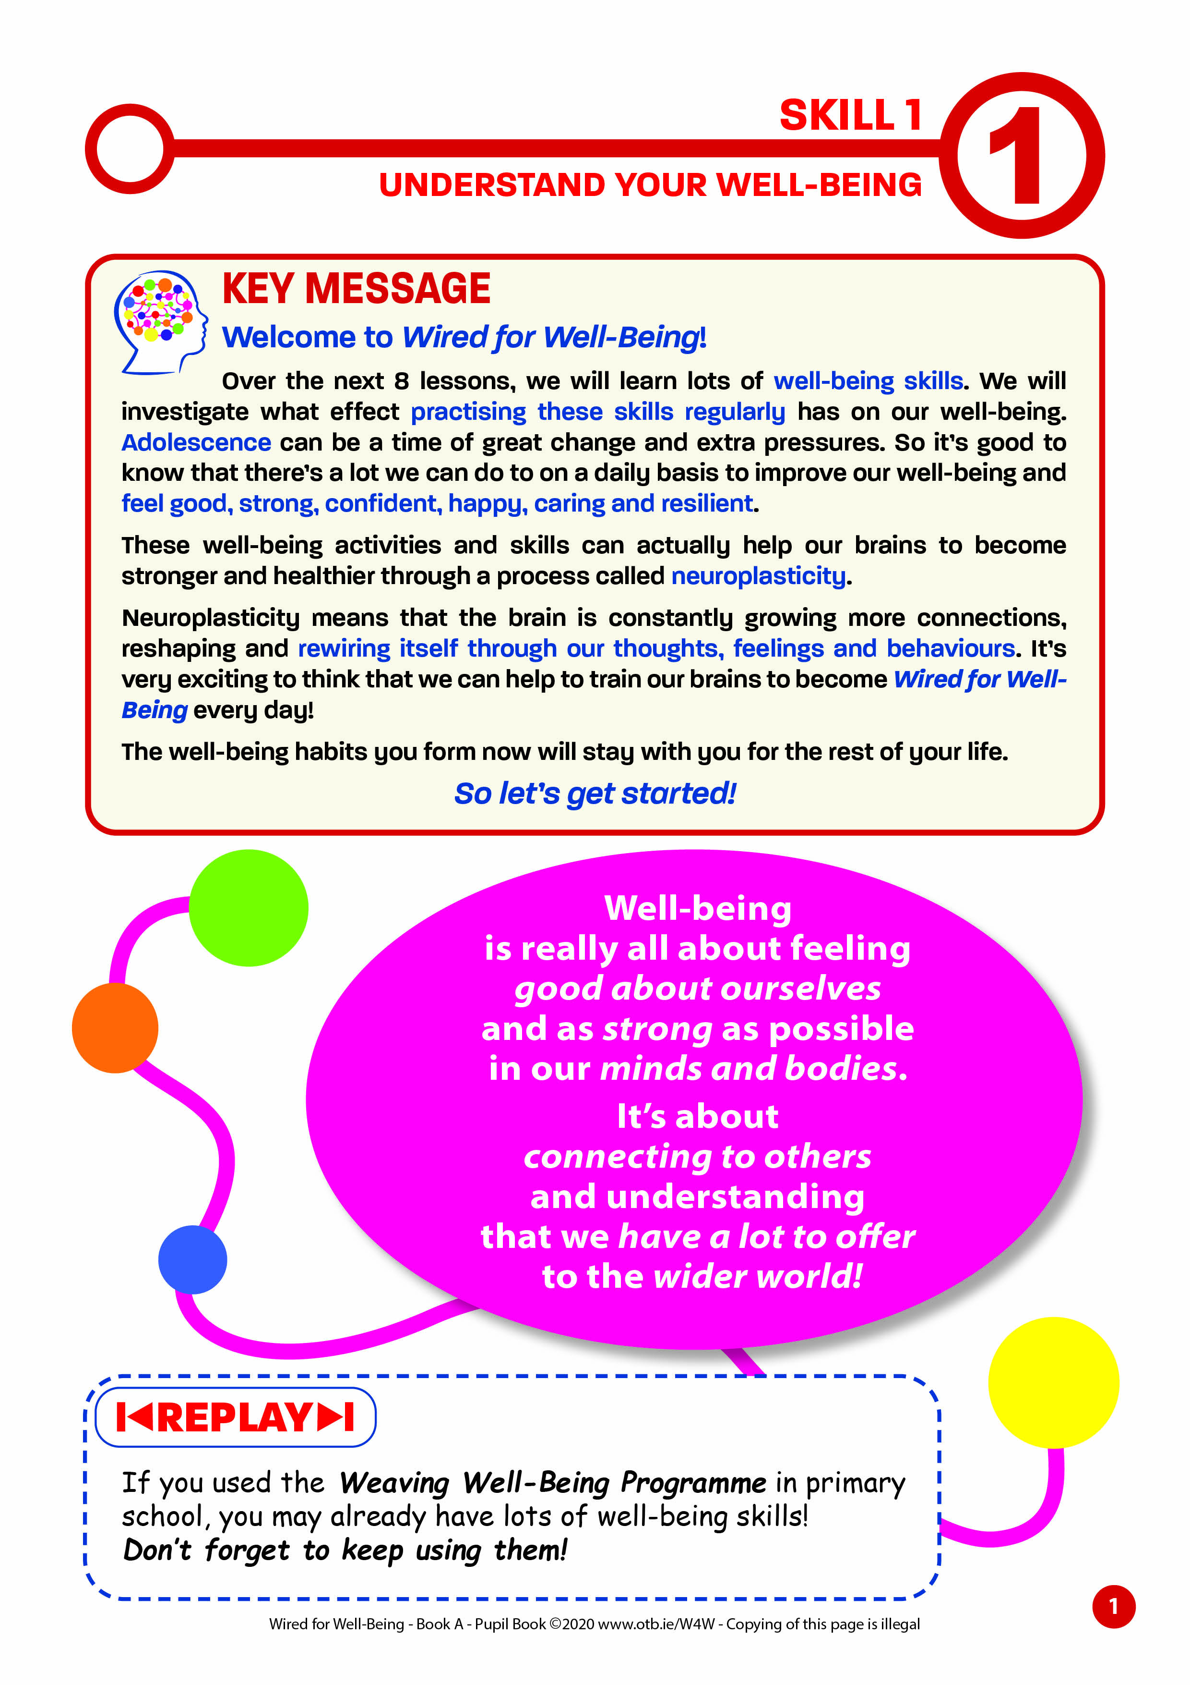
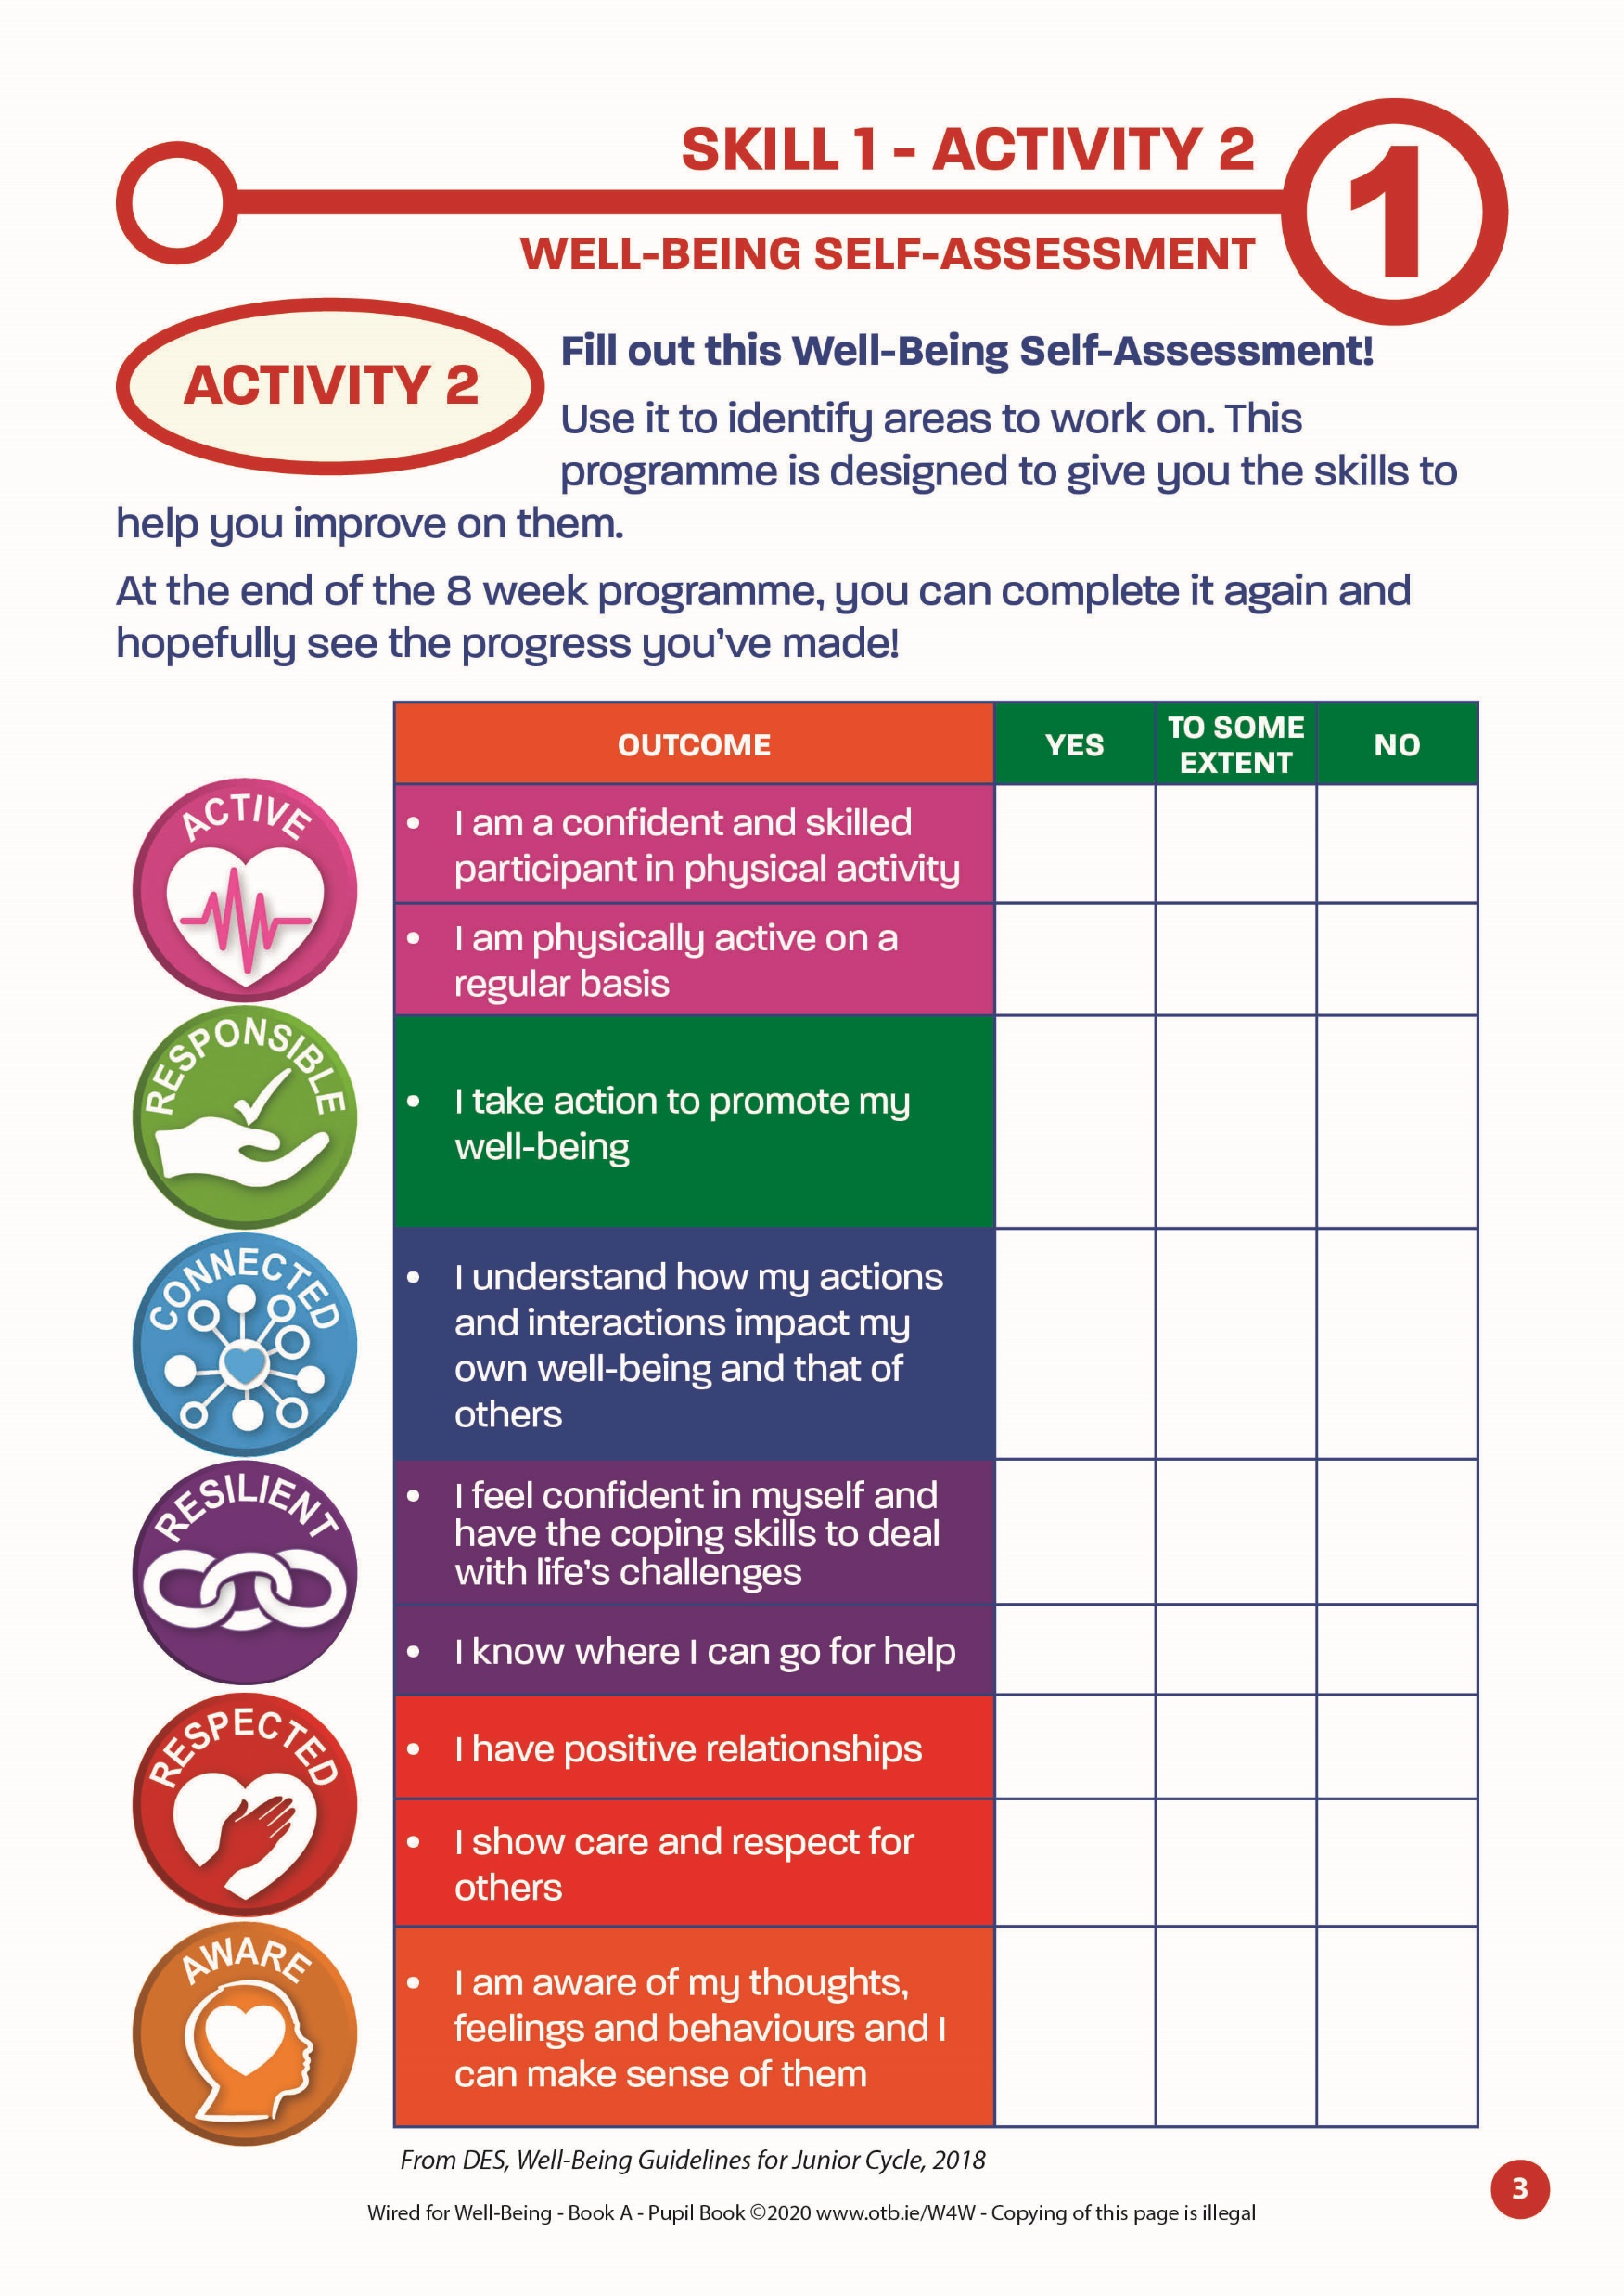
SKILL 1: UNDERSTAND YOUR WELL-BEING!
Closing Activities
1. Read the Key Message of this lesson – Pupil Book page 1
2. Complete Activity 2 – Well-Being Self-Assessment – there are 6 different indicators for you to use – Pupil Book page 3
3. Complete your Learning Self-Assessment – Pupil Book page 4
Slide 25

Slide 26
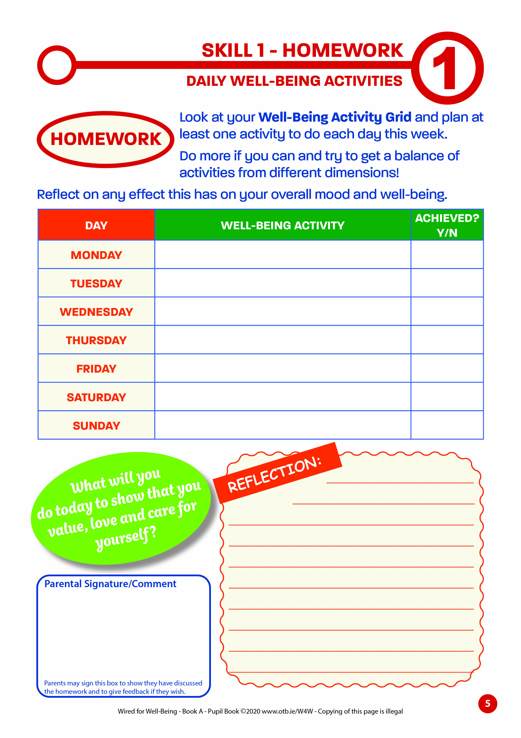
SKILL 1: UNDERSTAND YOUR WELL-BEING!
At home this week: Pupil Book page 5
Your well-being goal this week is to plan and do at least one activity daily from your Well-being Activity Grid – try to do more if you can!
Reflect on the effect this has on your well-being!
We may not always be able to control how others treat us, but we can always control how we treat ourselves.
Slide 26

Slide 27
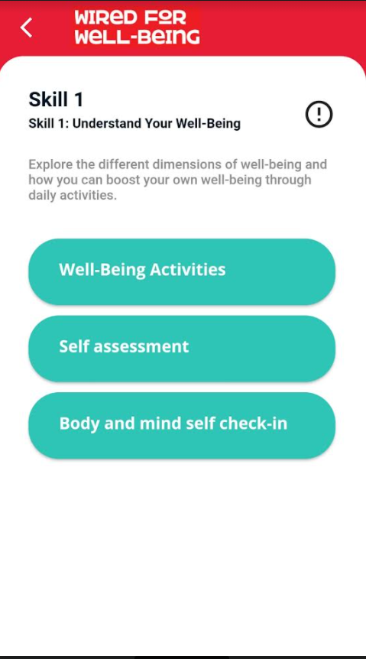
SKILL 1: UNDERSTAND YOUR WELL-BEING
If you are using the accompanying app
(W4W Level A App)…..
Slide 27

